Slide 1
Design and Development of Embedded based System for Monitoring Industrial and Environmental Parameters for Analyzing the Health of Human beings

Slide 2
Abstract
The main objective is to design a monitoring system for storage atmosphere. Controlled storage atmosphere means constant monitoring of storage environment and adjust accordingly to maintain the atmospheric parameter such as temperature, relative humidity etc. Several actuators are used for controlling the above parameters. The design and implementation of this process has been done using PIC 16F877A microcontroller, Zigbee & LABVIEW software. The project provides details about sensing, data acquisition, and controlling the storage atmosphere accordingly

Slide 3
Existing System
To provide information about surroundings, a system is required for monitoring and alerting mechanism along with effective visualization.
Different Sensors are interfaced with the microcontroller for the ecological checking air contamination and are displayed on LCD.
These qualities are forwarded to the close by versatile utilizing Bluetooth.But the system has some limitation due to less communication range and slow transfer of sensor data.
It has various sensors like temperature, humidity and rain sensor along with gas sensors .It uses modem based sensor data transfer and facilitates cloud storage.

Slide 4
Disadvantage of Existing System
The common effects of noise pollution on human beings are hearing problems, sleep disturbances and mental illnesses.
Our system design and implementation covers both hardware and software issues.
Evaporation of the electrolyte from the cells of lead–acid batteries is a well-known and serious problem.
It leads to performance degradation in terms of the power output and can damage the cells.
Different techniques including capacitive liquid level sensors, resistive liquid level sensors, and ultrasonic level detectors have been proposed already to overcome this problem.

Slide 5
PROPOSED SYSTEM :
We propose a web-based application to monitor, measure, process and analyze data from abiotic factors.
In this paper, a real-time monitoring system for multiple lead–acid batteries based on IoT, suitable for the industrial environment, is proposed and evaluated.
Our proposed monitoring system procures and stores the important parameters of the battery in real time.
It should be observed that in our proposed system the communication between the various parts of the system is done using WLAN technology, considering the mobility of the vehicles and the batteries in an industrial environment.

Slide 6
ADVANTAGE
An air-conditioner and a heater are used for controlling the temperature whereas a humidifier and a dehumidifier are used for humidity control.
The temperature sensor and relative humidity sensor are used to measure temperature and humidity in the air.
The most important factors affecting food items are moisture, temperatures, insects, rodents, storing type of storage bin, uses of pesticides and fumigants general conditions of location of storage etc.
Environmental pollution has a critical impact on human health.
The scientific community seeks the knowledge of all critical processes that regulate the functionality of the ecosystem, as well as their efficient management and protection.

Slide 7
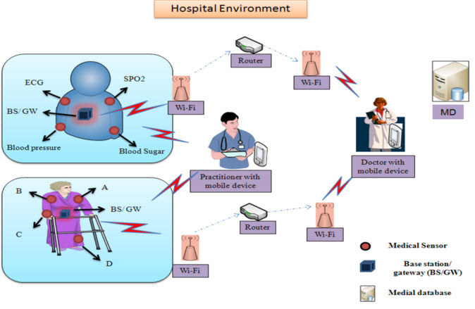
Block Diagram

Slide 8
SOFTWARE REQUIREMENTS:
Operating System : Windows 10
Platform : DOT NET TECHNOLOGY
Front End : ASP.Net 4.0
Back End : SQL SERVER 2014

Slide 9
HARDWARE REQUIREMENTS:
Keyboard
Mouse
Hard disk 500GB
Ram 4 Gb

Slide 10
CONCLUTION
The Wireless Embedded Instrumentation system has been resulted in a prototype of a small system for monitoring and controlling environmental parameter (e.g. temperature and humidity). Temperature and humidity are monitored and their values send wirelessly from respective Zigbee end devices to Zigbee coordinator which is attached to the main µC kit which further shows these values on LCD and operate relay for respective conditions. The temperature and humidity values send to the LabVIEW software successfully. The system has been tested successfully with different environments to see the system operation. The relative humidity in percentage and temperature in o C were monitored continuously. In future, more number of parameter can be measured in enhancement of the system which can be further analysed. The various gas level controls using various gas sensors can be further included in the system.

Slide 11
REFERENCE
[1] A Rahali, M. Guerbaoui, A. Ed-dahhak, Y. El Afou, A. Tannouche, A. Lachhab, B. Bouchikhi,” Development of a data acquisition and greenhouse control system based on GSM,” International Journal of Engineering, Science and Technology 2011.
[2] Nishantkumar D. Gajipara ,Prashant L. Ahire,” Design of SCADA for Real Time System with LabVIEW and Microcontroller,” International Journal of Innovative Research in Advanced Engineering (IJIRAE) August 2014.
[3] Hariprabha.V, Vasantharathna.S,” Monitoring and control of food storage depots using wireless sensor networks,” International Journal of Industrial Electronics and Electrical Engineering June2014.
[4] P.V. Mane-Deshmukh, B.P. Ladgaonkar, S. C. Pathan, S. S. Shaikh,” Microcontroller PIC 18f4550 Based Wireless Sensor Node to Monitor Industrial Environmental Parameters,” International Journal of Advanced Research in Computer Science and Software Engineering Volume 3, Issue 10, October 2013.
[5] M.Sudhagar, J.Gobinath ,” Implementation of WSN Based Transport Information System through ZIGBEE Protocol,” International Journal of Scientific & Engineering Research, Volume 5, Issue 5, May-2014.

Slide 12
[6] Tanmoy Maity, Partha Sarathi Das, Mithu Mukherjee,” A Wireless Surveillance and Safety System for Mine Workers based on Zigbee,” 1st Int’l Conf. on Recent Advances in Information Technology | RAIT-2012 |.
[7] Yubin Zhao,” Monitor and Control System Design of Grain Depot Temperature Based on Wireless Communication Technology,” First International Workshop on Education Technology and Computer Science, 2009.
[8] Afshan Mulla_, Jaypal Baviskary, Jeet Desaiz, Chandrashekhar Beralx and Anagha Jadhav,” GSM Based Interactive Voice Response System for Wireless Load Control and Monitoring,” International Conference on Communication, Information & Computing Technology (ICCICT), Jan. 16-17, 2015 , Mumbai , India.
[9] Ismail Sultan, Billy Wells, Stephen Wood,” Development of a Wireless Control and Monitoring System for Wave Energy Converters,” IEEE, 2012.
[10] http://www.microchip.com/wwwproducts/Devices.aspx?product=PIC16F877A

