Slide 1
Controller Area Network Assisted Grid Synchronization of a Microgrid With Renewable Energy Sources and Storage

Slide 2
Abstract
Microgrids are emerging as an important constituent of large-scale smart grids. They are equipped with the controls necessary for managing the operation in islanded or grid connected mode and serve the loads with clean, reliable, and uninterruptible power. Microgrid must be equipped with a robust grid synchronization (GS) algorithm so as to allow a smooth transfer from islanded mode to grid tied mode. This gets even more critical when the availability of the power grid is irregular or the power grid is weak. This paper proposes a simple yet highly reliable GS technique based on controller area network (CAN) communication.

Slide 3
The grid synchronizer block senses the three phase grid voltages, derives the phase angle (θ) using synchronously rotating reference frame-based phase lock loop, and transmits this information on the CAN network to all microsources (MS). The local controller associated with each MS receives the data with small but known and definite time latencies. This allows each MS to energize simultaneously in synchronization with the grid, facilitating easy GS of all the MS, minimizing the time required for GS of the complete microgrid. All the analytical, simulation, and hardware results related to this paper are presented.

Slide 4
Existing System
There exists so many forecasting tools for wind and solar power generation, still the power generation from these RESs is said to be unpredictable as weather conditions are uncertain in nature.
The advent of smart grid technologies in power sector has brought so many changes in existing techniques and algorithms that are used for grid micro grid synchronization.
The PLC is having its best advantage as it uses the existing power line as the medium and hence it is a preferable choice for cost effective communication.
There are many existing challenges, the majors are: charging/discharging balance, safety, reliability, size, lifecycle, cost, in addition to the overall control and management.

Slide 5
Disadvantage of Existing System
The intermittent nature of these creates problems in the distribution network.
Most of the problems like frequency variations, protection and optimal energy management will take care by main grid in parallel mode of operation.
Apart from energy demand crises, the globe is now facing a big problem with greenhouse gases releasing from power generation and transportation.
DSL are another level of quality communication as the data is transferred in digital form with no disturbance, whereas the PLC is facing problems with interference.

Slide 6
PROPOSED SYSTEM :
This paper presents a comprehensive review of decentralized, centralized, multiagent, and intelligent control strategies that have been proposed to control and manage distributed energy storage.
In particular, the strategy has proposed a high pass filter-based droop (HPFD) for battery converter, and a virtual capacitance droop (VCD) controller to control the supercapacitor (SC).
The role of the heterogeneous energy storage system here is to retain DC bus voltage under the control of the new proposed strategy.
The proposed controller has considered an SOC balance and charging constraints.

Slide 7
ADVANTAGE
The concept of integrating heterogeneous entities helps in improving grid efficiency, demand side management (flat load profile) and economic benefits.
These smart grid entities makes the micro grid more efficient in terms of all aspects: energy sharing among DGs, adaptive protection, V and f control and smart way of island detection.
ICT provides adequate real time data with negligible latencies in data transfer which makes the EMS more efficient in taking decisions for load/generator shedding or scheduling.
EMS through ESS control will be a better choice for efficient management of micro grid.

Slide 8
TITTLE | AUTHOR | DESCRIPTION
Defining control strategies for microgrids islanded operation | J. A. P. Lopes, C. L. Moreira and A. G. Madureira, | In such conditions, the microgrid must have the ability to operate stably and autonomously.
Overview of control and grid synchronization for distributed power generation systems | F. Blaabjerg, R. Teodorescu, M. Liserre and A. V. Timbus, | This paper gives an overview of the structures for the DPGS based on fuel cell, photovoltaic, and wind turbines.

Slide 9
TITTLE | AUTHOR | DESCRIPTION
A grid synchronization method for droop-controlled distributed energy resource converters | C. Lee, R. Jiang and P. Cheng, | In this paper, a grid synchronization method for the multi- converter oriented distributed generation system is proposed.
Power-synchronization control of grid-connected voltage-source converters | L. Zhang, L. Harnefors and H. Nee, | The method can be generally applied for all grid-connected VSCs but may be of most importance in high-voltage dc (HVDC) applications.

Slide 10
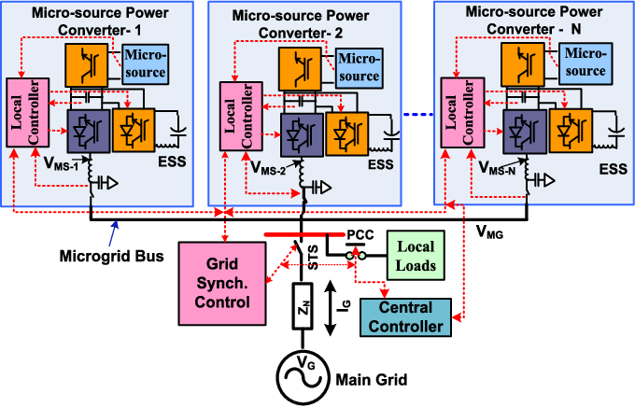
Block Diagram

Slide 11
SOFTWARE REQUIREMENTS:
Operating System : Windows 10
Platform : DOT NET TECHNOLOGY
Front End : ASP.Net 4.0
Back End : SQL SERVER 2014

Slide 12
HARDWARE REQUIREMENTS:
Keyboard
Mouse
Hard disk 500GB
Ram 4 Gb

Slide 13
CONCLUTION
Micro grid issues and challenges are discussed in this paper along with their existing solutions in the literature. Mainly DGs synchronization and V and f control are discussed, which are very deciding parameters of micro grid stability. Along with these stability issues there are other issues like protection of micro grid, reverse power flow, optimal placement of DGs etc., which are not covered in depth in this paper. The role of power electronic converters in controlling of grid parameters also discussed. The communication-based control strategies are also discussed for effective power sharing among the DGs in the micro grid. Anyhow the conventional droop control strategies are not discussed in this paper.

Slide 14
REFERENCE
1. J. A. P. Lopes, C. L. Moreira and A. G. Madureira, "Defining control strategies for microgrids islanded operation", IEEE Trans. Power Syst., vol. 21, no. 2, pp. 916-924, May 2006.
2."IEEE Standard for Interconnecting Distributed Resources With Electric Power Systems, IEEE Standard 1547", Jul. 2003.
3."Guide for Design, Operation, and Integration of Distributed Resource Island Systems With Electric Power Systems, IEEE Standard 1547.4", 2011.
4. F. Blaabjerg, R. Teodorescu, M. Liserre and A. V. Timbus, "Overview of control and grid synchronization for distributed power generation systems", IEEE Trans. Ind. Electron., vol. 53, no. 5, pp. 1398-1409, Oct. 2006.
5. C. Lee, R. Jiang and P. Cheng, "A grid synchronization method for droop-controlled distributed energy resource converters", Proc. IEEE Trans. Ind. Appl., vol. 49, no. 2, pp. 954-962, Mar./Apr. 2013.

Slide 15
6. L. Zhang, L. Harnefors and H. Nee, "Power-synchronization control of grid-connected voltage-source converters", IEEE Trans. Power Syst., vol. 25, no. 2, pp. 809-820, May 2010.
7.J. Svensson, "Synchronization methods for grid-connected voltage source converters", IEE Proc. Gener. Transm. Distrib., vol. 148, no. 3, pp. 229-235, May 2001.
8.M. Bobrowska-Rafal, K. Rafal, M. Jasinski and M. P. Kazmierkowski, "Grid synchronization and symmetrical components extraction with PLL algorithm for grid connected power electronic converters—A review", Bull. Polish Acad. Sci. Tech. Sci., vol. 59, no. 4, pp. 485-497, 2011.
9.C. Ramos, A. Martins and A. Carvalho, "Synchronizing renewable energy sources in distributed generation systems", Proc. Int. Conf. Renew. Energy Power Qual. (ICREPQ), pp. 1-5, 2005.
10.G. Xiaoqiang, W. Weiyang, S. Xiaofeng and S. Guocheng, "Phase locked loop for electronically-interfaced converters in distributed utility network", Proc. Int. Conf. Elect. Mach. Syst. (ICEMS), pp. 2346-2350, Oct. 2008.

