Slide 1
Android4Auto: A proposal for integration of Android in vehicle infotainment systems

Slide 2
Abstract
This paper presents a proposal for integration of Android into vehicle infotainment systems. The proposed system offers infotainment functionality, while enabling users to use the device as a regular Android device. The proposal includes a specification of a Java API that should be used to access in-vehicle related content from Android applications.

Slide 3
Existing System
The existing communication in infotainment system is supported by service provider relayed data transmission.
The existing system in mid range car, the display are analogy for speedometer, tachometer and other indicators, like car malfunction with some engine fault are indicated by a light blinking.
It is therefore desirable to enable interactive services to co-exist on a shared hardware platform that has access to other components that influence timing and safety critical control of the vehicle.
Our approach supports the co-existence of the Quest RTOS with Android, to manage timing-critical components of the vehicle.

Slide 4
Disadvantage of Existing System
The network model also includes line of sight problem while performing massive data streaming from neighboring vehicles.
However, with a dynamic topology and heavy traffic on cloud, this calculation is quite challenging and novel problem.
Line of sight problems are required to be considered as routing destination of different vehicles may be different and hence if the vehicle travels in their respective routes than proposed system attempts to hold the communication.
It can be seen that variable ranges of channel capacity do not have much significant impact on the throughput.

Slide 5
PROPOSED SYSTEM :
The prime purpose of the proposed system is to evolve up with a framework for generating error-free data over the services running in infotainment system considering the case study of vehicular network.
The proposed system also deals with optimization of the resources by using simplified network encoding system that has direct effect on saving channel capacity.
The core logic of the proposed system is to evolve up with a framework that facilitates faster transmission of heavier data files over a bigger stream in critical online services.
All these parameters in modeling will ensure that proposed system offers complete applicability on streaming services on any defined infotainment system.

Slide 6
ADVANTAGE
We used the second method to update the Micom firmware, but with a slightly modified version of the original firmware.
Our Micom firmware reverse engineering efforts suggest that an attacker can potentially update the Micom firmware using methods similar to those used in a previous study.
We identified multiple heap memory corruption vulnerabilities that could be potentially used for exploitation purposes.
We are exploring more real-time I/O and notification capabilities in Android for complete deployment of the interactive automotive system in a working high-performance electric vehicle.

Slide 7
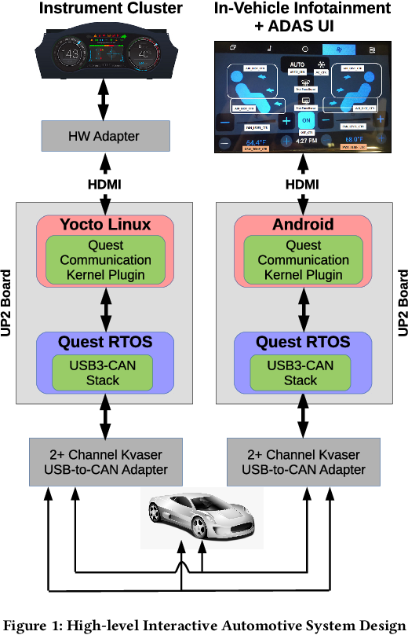
Block Diagram

Slide 8
SOFTWARE REQUIREMENTS:
Operating System : Windows 10
Platform : DOT NET TECHNOLOGY
Front End : ASP.Net 4.0
Back End : SQL SERVER 2014

Slide 9
HARDWARE REQUIREMENTS:
Keyboard
Mouse
Hard disk 500GB
Ram 4 Gb

Slide 10
CONCLUTION
This paper has discussed about a novel design of the infotainment system that is carried out on the top of a vehicular cloud system. The contributions of the proposed system are as follows: i) the study implements the complete algorithm over the graph which makes the network topology construction easier and simpler to maintain, which is required during dynamic topology of vehicle, ii) the applicability of the proposed system can be highly acclaimed as it is implemented over map system where visualization of results are validated, iii) the complete modeling is carried out considering the constraint of the existing infotainment system which shows better practicality of proposed system.

Slide 11
REFERENCE
1.GENIVI home page, June 2015, [online] Available: http://www.genivi.org/.
2.I. Son, K. Han, D. Park, M. Di and J. Cho, "A study on implementation of IVI applications for connected vehicle using HTML 5", 2014 International Conference on IT Convergence and Security (ICITCS), pp. 1-4, Oct. 2014.
3.T. Yamabe, S. Ikegami, A. Ishizaki, S. Kitagami and R. Kiyohara, "Car navigation user interface based on a smartphone", 2014 Seventh International Conference on Mobile Computing and Ubiquitous Networking (ICMU), pp. 85-86, Jan. 2014.

Slide 12
4.N. Gandhewar and R. Sheikh, "Google Android: An emerging software platform for mobile devices", International Journal on Computer Science and Engineering, pp. 12-17, 2010.
5.A. Tahat, A. Said, F. Jaouni and W. Qadamani, "Android-based universal vehicle diagnostic and tracking system", 2012 IEEE 16th International Symposium on Consumer Electronics (ISCE), pp. 813-819, June 2012.
6.A.V. Khanapuri, A. Shastri, G. D'souza and S. D'souza, "On road: A car assistant application", 2015 International Conference on Technologies for Sustainable Development (ICTSD), pp. 1-7, Feb. 2015.

