Slide 1
A pulse measurement and data management system based on Arduino platform and Android device

Slide 2
Abstract
A prototype of pulse measurement and data management system is built on Arduino platform and Android device. It is provided with functions of pulse measurement, data storage and share in local device and online cloud server. Among the system, first a smart pulse sensing module with a Bluetooth interface is designed to measure pulse rate and peak value. Pulse data with time stamp is then sent to Android device through Bluetooth. A data management application is developed for Android device, which can receive pulse data from sensing module and further upload to online cloud server.

Slide 3
Existing System
This can be an essential step to change the conventional healthcare systems which require patients’ existence inside hospitals or clinic centers to check their health parameters.
This method is used universally by using the curve between the ratio and saturation levels of the existing sensors.
The sensor uses Red and Infrared LEDs with phototransistor to convert the light received after modulating by human tissue to electrical output.
The DC part is due to tissues, Bone and non-pulsatile arterial blood while the AC part is due to pulsatile volume of arterial blood.

Slide 4
Disadvantage of Existing System
This problem stemmed from the fact that the output signal did not include all the ECG signal parameters such as P-Q-R-S-T and some of them disappear.
Therefore, obtaining instantaneous information about body temperature helps to avoid the mentioned problems.
This project is effective equipment for patients who are recovering from a heart attack or patients who suffer from chronic cardiovascular system issues.
The main issue with this sensor which is very sensitive to motion. So, it requires a rest position to read perfectly.

Slide 5
PROPOSED SYSTEM :
In order to achieve convenient and rapid detection of pulse signal, a real-time detection system of photoelectric pulse signal based on Bluetooth transmission is proposed in this paper.
In this paper, a pulse signal detection system based on wireless Bluetooth transmission is proposed, which can acquire pulse signal from wireless terminal carried on the body and avoid the cable restriction and poor scalability of wired system.
The achieved signal in this project cannot be trusted and used for diagnosing purposes.
In this paper, a NodeMCU module is chosen for satisfying this purpose.

Slide 6
ADVANTAGE
Pulse Oximeters are medical sensors used to determine percentage of oxygen saturation levels in blood non-invasively
This might cause an inefficient situation to take care of the patients, especially those who have critical and unstable health conditions.
The low cost embedded sensor system reported in this study can be used to monitor key health parameters of patients in hospitals or at home.
We are focused on developing a low cost, easy to use, portable and reliable health monitor system which can measure SpO2 levels, pulse rate and temperature.

Slide 7
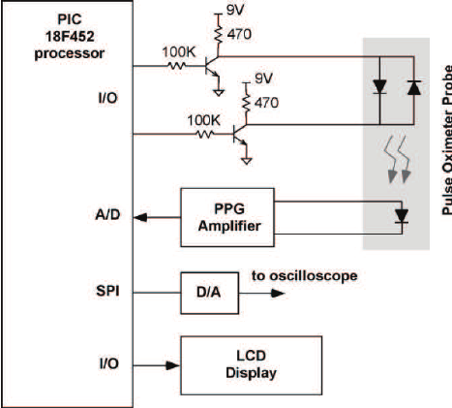
Block Diagram

Slide 8
SOFTWARE REQUIREMENTS:
Operating System : Windows 10
Platform : DOT NET TECHNOLOGY
Front End : ASP.Net 4.0
Back End : SQL SERVER 2014

Slide 9
HARDWARE REQUIREMENTS:
Keyboard
Mouse
Hard disk 500GB
Ram 4 Gb

Slide 10
CONCLUTION
The pulse signal detection system based on Bluetooth transmission is a new solution that used to meet the demand of high automation and convenient medicine. In this paper, we use Bluetooth technology to replace the intricate cables. And the system is low cost, high reliability, simple structure and free in transmission. We collect pulse signal through pulse sensor, and then send to microchip for real-time processing, calculate related data and display important information on PC management platform.

Slide 11
REFERENCE
1.I. Liviu, B. Cristian et al., "Smart phone: an embedded system for universal interactions", Proceedings of the 10th IEEE International Workshop on Future Trends of Distributed Computing Systems (FTDCS‘04), pp. 88-94, 2004.
2.M. Okada, K. Takiguchi and H. Ohwada, "A smart phone information appliance for improved usability", IEEE International Conference on Cognitive Informatics & Cognitive Computing, pp. 191-195, 2012.
3.Z. Tianyu, W. Lei and M. Jun, "The exploitation and discussion of new mobile healthcare system model based on smart phone", 10th IEEE International Conference on Networking Sensing and Control (ICNSC), pp. 497-502, 2013.
4.H. Aoki, H. Shikano et al., "Cloud architecture for tight interaction with the real world and deep sensor-data aggregation mechanism", International Conference on Software Telecommunications and Computer Networks (SoftCOM), pp. 280-284, 2010.
5.W. Huiyan, "A quantitative method for pulse strength classification based on decision tree", International Symposium on Information Science and Engineering, vol. 2, pp. 111-115, 2008.

Slide 12
6.S. Barrett, "Arduino Microcontroller Processing for Everyone: Part I" in , Morgan and Claypool eBooks, 2010.
7.C. Junwei and Y. Xingyao, "Experimental study on two methods of pulse wave measurement", Journal of China University of Metrology, vol. 2641, pp. 450-457, December 2015.
8.H. Chengying and Y. Zhaohui, Fundamentals of analog electronics, China:Higher Education Press, 2015.
9.X. Guo, "Design of a toy remotely controlled by mobile phone based on HC-06 module", Technological Development of Enterprise, vol. 34, no. 8, pp. 7-9, March 2015.
10.D. Gavalas and D. Economou, "Development platforms for mobile applications: status and trends", Software IEEE, vol. 28, no. 1, pp. 77-86, 2011.

