Slide 1
WiFACT -- Wireless Fingerprinting Automated Continuous Training

Slide 2
Abstract
The increasing importance in ubiquitous computing and context-dependent information has led in the last years to a growing interest in location-based applications and services. A considerable market demand concentrates on indoor localization tasks. In this setting, WiFi fingerprinting is currently one of the most popular and widespread techniques as it provides reasonable positioning accuracy while being able to exploit, at the same time, existing wireless infrastructures. WiFi-fingerprinting systems mainly operate though two distinct phases: one initial, named training, in which signals are collected and one subsequent, named usage, in which the recorded data are used to localize users.

Slide 3
While the usage phase is fast and effective, the training phase is time consuming. Moreover, to maintain a localization accuracy, the training needs to be repeated anytime the network structure changes. The latter may occur, for example, if an access point goes off-line or it is removed. In this paper, we propose a novel framework that allows for an automatic and continuous training in WiFi-fingerprinting systems, which is based on an opportune deployment of a WSN(Wireless Sensor Network). Precisely, the solution we propose allows for an efficient real-time updating of the database collecting the signals, without any human intervention.

Slide 4
Existing System
The fingerprint database has temporal correlation, considering the similarity that exists between RSSI values obtained by an AP at different times in a fixed position.
Due to the huge potential of such a network, many proposals have been made to improve the communication between the nodes, to select the best routing protocol possible, and to locate nodes inside the net.
In particular, the more the nodes are the more the precision of the algorithm grows.
This is obviously something to avoid: for this reason, we introduce a displacement factor, which represents how much one is ready to sacrifice the coverage in favor of a better user-based distribution of the signal.

Slide 5
Disadvantage of Existing System
The probabilistic methods achieve greater location accuracy since they solve uncertainty problems.
The localization problem becomes how to estimate the grid ID of the mobile user given the RSSI measurements collected from several APs at each RP.
To reduce the impact of environmental interference, AP clusters were constructed in, where hierarchical PCA was used to obtain cluster RSSI features by converting the raw data to a linearly independent dimensional matrix.
The impact of utilizing different training samples obtained at each RP on the mean localization error and percentage of improvements of the proposed HMM-DMD.

Slide 6
PROPOSED SYSTEM :
We proposed a logic range free algorithm able to uniformly distribute hubs around a given environment: this distribution is aimed to give the best coverage possible of the areas of interest.
Using the same approach, in they propose a range free algorithm based on RSSI comparisons, called Ring Overlapping.
An important indicator which is largely used in Wireless Sensor Networks for localization purposes is the RSSI (Received Signal Strength Indicator).
This indicator provides the power of the received signal in a certain point and it has a strong relevance since not only it gives important knowledge for the purpose of localization, but it is also recognizable by any device on the market.

Slide 7
ADVANTAGE
The performance and computing cost of the HMM are dependent on the feature dimension since a large quantity of RSSI measurements are required for the learning process.
The approach ignores APs that may contain useful information, thus affecting the system’s performance.
The extracted feature vector of the raw WiFi RSSI dataset is important to enhance the performance of the HMM and minimize the computational cost of the localization system.
The localization distance errors (accuracy) and the cumulative distribution function (CDF) are employed as a performance metric.

Slide 8
TITLE | AUTHOR | DESCRIPTION
Locating in fingerprint space: wireless indoor localization with little human intervention | Z. Yang, C. Wu and Y. Liu, | Indoor localization is of great importance for a range of pervasive applications, attracting many research efforts in the past decades.
An indoor localization mechanism using active rfid tag | G.-y. Jin, X.-y. Lu and M.-S. Park, | The location-aware technology and its application are prerequisite to realize the ubiquitous computing.

Slide 9
TITLE | AUTHOR | DESCRIPTION
Indoor localization without the pain | K. Chintalapudi, A. Padmanabha Iyer and V. N. Padmanabhan, | The mobile devices record Received Signal Strength (RSS) measurements corresponding to APs in their view at various (unknown) locations and report these to a localization server.
Wi-fi fingerprinting through active learning using smartphones | L. T. Nguyen and J. Zhang, | In this work, we propose an approach for reducing the amount of labeled data instances required for training a Wi-Fi fingerprint model.

Slide 10
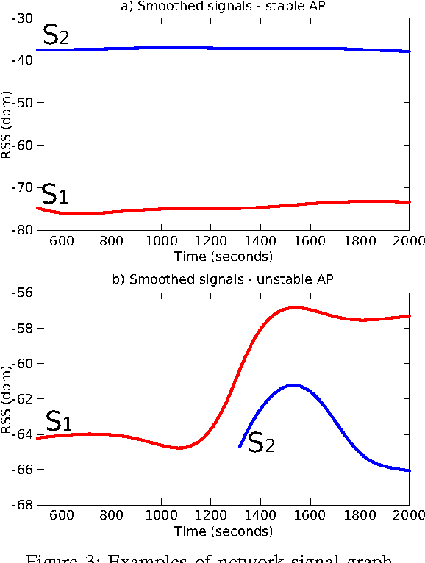
Block Diagram

Slide 11
SOFTWARE REQUIREMENTS:
Operating System : Windows 10
Platform : DOT NET TECHNOLOGY
Front End : ASP.Net 4.0
Back End : SQL SERVER 2014

Slide 12
HARDWARE REQUIREMENTS:
Keyboard
Mouse
Hard disk 500GB
Ram 4 Gb

Slide 13
CONCLUTION
This article presented a DMD approach for reducing the dimensionality of WiFi RSSI features to be employed in the HMM to achieve efficient indoor localization. The DMD decomposes raw WiFi signals into spatial–temporal modes, which were converted into HMM-ready feature vectors. This process reduces the effect of noise and varying visibility of the access points. To increase the localization performance, the HMM was used to train high-level reconstructions from the retrieved features and classify the sequence of observations. The accuracy and performance improvements of the proposed localization model were verified using simulations. The effects of varying the rank of DMD and using different numbers of training samples were investigated on localization errors. This assisted in selecting the best parameters for reducing the computational cost and obtaining enhanced accuracy.

Slide 14
REFERENCE
1. Z. Yang, C. Wu and Y. Liu, "Locating in fingerprint space: wireless indoor localization with little human intervention", 18th MobiCom, 2012.
2. G.-y. Jin, X.-y. Lu and M.-S. Park, "An indoor localization mechanism using active rfid tag", SUTC 2006, vol. 1, pp. 4, 2006.
3. K. Chintalapudi, A. Padmanabha Iyer and V. N. Padmanabhan, "Indoor localization without the pain", 16th MobiCom, pp. 173-184, 2010.
4. P. Krishnamurthy, "Wifi location fingerprinting", Advanced Location-Based Technologies and Services, pp. 55, 2013.
5."Wireless sensor networks: A survey on the state of the art and the 802.15. 4 and zigbee standards", P. Baronti, P. Pillai, V. W. Chook, S. Chessa, A. Gotta and Y. F. Hu, Computer communications, vol. 30, no. 7, pp. 1655-1695, 2007.

Slide 15
6. L. T. Nguyen and J. Zhang, "Wi-fi fingerprinting through active learning using smartphones" in UbiComp, ACM, pp. 969-976, 2013.
7.D. A. Tran and P. Truong, "Total variation regularization for training of indoor location fingerprints", 2nd MiSeNet, pp. 27-32, 2013.
8.A. Eleryan, M. Elsabagh and M. Youssef, "Synthetic generation of radio maps for device-free passive localization", GLOBECOM. IEEE, pp. 1-5, 2011.
9.O. Woodman and R. Harle, "Pedestrian localisation for indoor environments", 10th UbiComp, 2008.
10.T.-K. Dao, H.-L. Nguyen, T.-T. Pham, E. Castelli, V.-T. Nguyen and D.-V. Nguyen, "User localization in complex environments by multimodal combination of gps wifi rfid and pedometer technologies", The Scientific World Journal, vol. 2014, 2014.

