Slide 1
GPS based autonomous vehicle navigation and control system

Slide 2
Abstract
The main aim of the paper is the development of an overall routing system which accepts input from common users via a simple android application and as a result directs the nearest vacant Cab towards the passenger. In this project two algorithms for the implementation of our project have been developed. The first algorithm is an autonomous route calculation algorithm in which a PC is used to calculate coordinates at each road intersection between any two input coordinates. The PC takes input coordinates from user and transmits the output coordinates to the cab. The 2nd algorithm is a control algorithm that navigates our prototype robots. It does so by using Haversine heading and distance formulae. The code gets it desired set point in the form of input coordinates and compares it to the robots current heading to compute an error signal. Based on this signal the robot's heading is changed to maneuver it within the robot boundaries. This type of system has a variety of applications and can be used for other purposes such as guiding a completely autonomous robot to distressed areas.

Slide 3
Existing System
Many existing tools and theories in linear systems theory can be partially applied to TS fuzzy models and controllers.
However, if the linearization conditions are violated or nonlinearities in the steering mechanism or in the motion sensors exist, the tracking deteriorates.
A TS fuzzy model will approximate a nonlinear system by smoothly interpolating these affine local models.
A position estimation algorithm should use low-frequency sensor information for correcting low-frequency drift error in high frequency sensors and should use high frequency sensor information to decorrelate the errors in low-frequency sensors.

Slide 4
Disadvantage of Existing System
This paper proposes the application of fuzzy sensor data fusion to consider the heuristic knowledge involved in the estimation problem.
The search for the Lyapunov function can be stated as a convex optimization problem in terms of linear matrix inequalities (LMI) for which efficient solving methods and software exist.
One possible task of an autonomous vehicle is to navigate a pre-programmed route while avoiding any obstacles the vehicle may encounter.
It is felt strongly that either we should employ the GPS sensor with higher frequency of update rate or magnetic compass.

Slide 5
PROPOSED SYSTEM :
The TS fuzzy controller proposed in this paper analyses the path to track and adjust the lookahead with path characteristics, vehicle velocity and other driving conditions.
Both controllers show similar performance in straight and constant curvature segments, but the fuzzy controller proposed in this paper performs remarkably better in transitions between segments since it adapts smoothly to roads of changing curvature.
This controller obtains slightly better maximum lateral error than the proposed fuzzy navigation system,but at considerably lower speeds.
Researchers have developed several techniques for navigation under a variety of external environments.

Slide 6
ADVANTAGE
It is necessary to use additional high-frequency sensors to improve the performance and integrity of GPS navigation systems.
It has a high performance for short distances and can be computed very quickly, but the growth of position uncertainty is unbounded since it is an incremental method.
These parameters are related to the gain of the closed loop system and have a significant effect on the tracking performance.
The main advantage of the fuzzy controller is that it adapts much better to road segments with changes in curvature, and thus it is more flexible and can be used in a wider set of roads in real conditions.
In general, drivers reported that they used a closer reference point on the path and applied a tight control when the curvature was changing between straight and curved path segments.

Slide 7
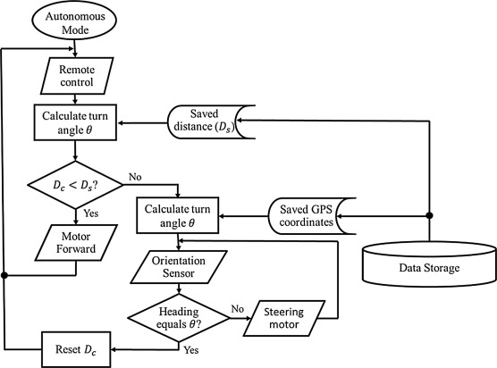
Block Diagram

Slide 8
SOFTWARE REQUIREMENTS:
Operating System : Windows 10
Platform : DOT NET TECHNOLOGY
Front End : ASP.Net 4.0
Back End : SQL SERVER 2014

Slide 9
HARDWARE REQUIREMENTS:
Keyboard
Mouse
Hard disk 500GB
Ram 4 Gb

Slide 10
CONCLUTION
This paper proposes a path following system designed and implemented for heavy unmanned vehicles. A TS fuzzy control system can be used to control heavy vehicles at different driving conditions. A good performance is achieved following paths with very different curvatures and velocities with this single controller. The controller is able to drive the truck at high speed (up to 100 km/h) on unpaved roads, and it can also control the vehicle on curved roads with a turning radius of 30-40 m. The conditions in which the driving tests have been done are very demanding, because in most of them legal speed limits have been exceeded. Moreover, most of the tests have been done on unpaved gravel roads. The main advantage of the presented controller is its capability of adaptation to road segments of different curvatures and the transitions between them. Furthermore, its structure allows the easy addition of new rules considering for example the slip angle or other factors to increase the envelope of working conditions of the controller. Future improvements can be done considering slip in the motion of the vehicle and applying on-line estimation of slip angle to correct the - mapping in the low-level control.

Slide 11
REFERENCE
1.Peter H. Dana, "Global Positioning System Overview", Internet, Sep. 2013, [online] Available: http://www.colorado.edu/geography/gcraft/notes/gps/gps_f.html.
2."Arduino Microcontrollers", arduinoBoardUno datasheet, Oct. 2013.
3.Aziz, Mochamad Vicky Ghani, Rifki Wijaya, Ary Setijadi Prihatmanto and Diotra Henriyan, "HASH MD5 function implementation at 8-bit microcontroller", 2013 Joint International Conference on Rural Information & Communication Technology and Electric-Vehicle Technology (rICT &ICeV-T), 2013.
4."Arduino GSM Shield Schematic", GSM shield documentation.
5."GSM", Internet, Oct. 2013, [online] Available: http://en.wikipedia.org/wiki/GSM.

Slide 12
6.Douglas W. Gage, "A Brief History of Unmanned Ground Vehicle (UGV) Development Efforts", Unmanned Systems Magazine, vol. 13, no. 3, pp. 1-8, Dec. 1995.
7."Arduino Microcontrollers", arduino Board Mega 2560 datasheet, Oct. 2013, [online] Available: http://arduino.cc/eniMain/arduinoBoardMega2560.
8."Products for wireless communications and GNSS", Internet, Nov. 2013, [online] Available: http://www.u-blox.com/en/embedded-gps-and-gsm-products.html.
9."SIM900D", Internet, Nov. 2013, [online] Available: http://wm.sim.com/producten.aspx?id=1021.
10."2-Axis Compass with Algorithms HMC6352", Internet, Jan. 2014, [online]

