Slide 1
Design of Prototype Model for Home Automation Using Wireless Sensor Networks

Slide 2
Abstract
Home automation technology is becoming as synonymous with sustainability as it is with convenience. Incorporating smart home technology into a new or existing structure makes it easier to reduce energy consumption by WSN. The main role of the sensor network that senses physical parameters estimating user behavior for future periods and adjusting prediction in real time. Wireless sensor networks have critical applications in the scientific, medical, commercial, and military domains The main aim of this project is to reduce the power consumption. It is possible to save energy when installing various products. Simple functions such as temperature sensors and detectors integrated into a relatively simple home automation system can save hours of wasted energy in both residential and commercial applications. Wireless home automation networks comprise wireless embedded sensors and actuators that enable monitoring and control applications for home user comfort and efficient management. Increased demands on implementation of wireless sensor networks in automation praxis result in relatively new wireless standard –ZigBee. This article surveys the main current and emerging solutions that are suitable for wireless home automation networks.

Slide 3
Existing System
In the proposed solution of existing homes or buildings, some installation costs may be induced.
The existing control system is still less efficient because the control distance is limited.
The purpose of home automation is to makes living in the house more enjoyable or productive by applying intelligence to make it happen.
Home automation can be seen as a collection of open source software, consumer hardware and a few line of code that makes them interact.
The fundamental of building an automation system for an office or home is to acquire an efficient and economical use of the electricity.

Slide 4
Disadvantage of Existing System
It simplifies the problem of setting up relay nodes in WSNs and increases the impact of wireless interference.
The main purposes of the proposed design are to extend the coverage of a smart home control network and mitigate the impact of wireless interference for home automation system on the WSN data gathering subsystem.
It will simulate the lights controlling as a solution in dealing with problems that occur in current situation of homeowner.
The lack of monitoring in the use of electronic devices has an impact on excessive use of electrical energy and increasing electricity bills.

Slide 5
PROPOSED SYSTEM :
Many ideas about smart lighting control for energy saving in smart homes have been proposed, a smart lighting control system with high reliability and control accuracy remains to be found.
It is the proposed architecture, WSNs with voice recognisation are responsible for collecting environmental parameters and transmitting them to WSN coordinators.
The proposed design in this work is quite different from that of conventional WSN-based smart homes in which the control commands for home appliances are transferred using WSNs.
In the proposed architecture, WSNs are responsible for collecting environmental parameters and transmitting them to WSN coordinators.

Slide 6
ADVANTAGE
In an effort to economize scarce fossil fuels on earth, sensor networks are a valuable tool to increase the energy efficiency of buildings without severely reducing our quality of life.
While recent advances in the field of material science led to an improved energy efficiency of the building, a lot of energy is consumed by different equipment such as HVAC (heating, ventilating, and air-conditioning), lightning, home and office appliances.
It can efficiently distribute various tasks related to home network to corresponding components and implement real ubiquitous home services via smart sensors in home areas.
Sensor Networks and proactive computing has the potential to improve our productivity and enhance safety, awareness and efficiency at the societal scale.

Slide 7
TITTLE | AUTHOR | DESCRIPTION
Commercial Applications of Wireless Sensor Networks Using ZigBee | Andrew Wheeler, (2007), | It also describes the ecosystem emerging around Zigbee, and the enabling trends in that ecosystem.
ZigBee Based Home Automation Wireless Sensor Network | MichalVarchola, Miloš Drutarovský, (2007) | A simple network based on ZigBee physical layer as well as ZigBee compliant network were made to confirm the basic ZigBee interoperability.

Slide 8
TITTLE | AUTHOR | DESCRIPTION
Wireless Sensors Networks | Sun, J. Z. Li, Y. Chen and H. S. Zhu, (2005), | A wireless network is any sort of computer network that uses wireless data connections to plug network nodes.
On Applications of Wireless Sensor Networks | Adam C and W. Jakub, (2009), | Wireless Sensor Networks (WSNs) are spatially scattered independent sensors to track physical objects or monitor environmental data and collectively transmit the data to master station.

Slide 9
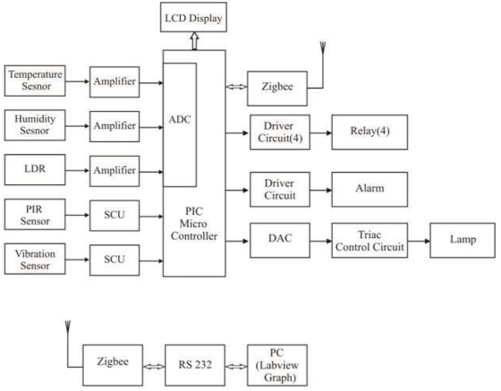
Block Diagram

Slide 10
SOFTWARE REQUIREMENTS:
Operating System : Windows 10
Platform : DOT NET TECHNOLOGY
Front End : ASP.Net 4.0
Back End : SQL SERVER 2014

Slide 11
HARDWARE REQUIREMENTS:
Keyboard
Mouse
Hard disk 500GB
Ram 4 Gb

Slide 12
CONCLUTION
Home Automation is undeniably a resource which can make a home environment automated. People can control their electrical devices via these Home Automation devices and set up the controlling actions in the computer. This project address a new intelligent home control system based on active sensor networks to makehome networks more intelligent and automatic.The proposed system has been implemented and related hardware and software are also developed. The new ubiquitous home scenarios based on the proposed system was suggested . To evaluate the effectiveness of our scheme, we performed simulations with the keil microvision simulator under various parameters. The parameters include the size of the house, the number of sensor nodes in the house, and applications. Sensors and communication devices used for the deployment in smart home are not required to have highspeed communication capacities; rather more consideration needs to be focused on a limited amount of delay in communication and a low energy consumption. which has been used as an interface between pic microcontroller and PC is for low-cost, low-rate and low-power consumption WSNs due to its flexibility to fulfill different requirements of various application patterns, by adequately tuning its parameters.

Slide 13
REFERENCE
[1] Andrew Wheeler, (2007), "Commercial Applications of Wireless Sensor Networks Using ZigBee," Communication Magazine, IEEE, vol. 45, pp. 70-77, April 2007.
[2] Kothari. C.R., (2004), ‘Research Methodology’, published by New Age International Publishers, New Delhi, p.219.
[3] MichalVarchola, Miloš Drutarovský, (2007) "ZigBee Based Home Automation Wireless Sensor Network,”Acta Electrotechnica et Informatica No. 4, Vol. 7, 2007.
[4] Brian Otis, Jan Rabaey, (2007), ‘Ultra-Low Power Wireless Technologies for Sensor Networks.: Springer.
[5] ZigBee Alliance, "ZigBee home automation puplic application profile,”revision 25,v.1.0,Oct.2007

Slide 14
[6] Sun, J. Z. Li, Y. Chen and H. S. Zhu, (2005), ‘Wireless Sensors Networks,’ Tsinghua University Press, Beijing.
[7]Willing A (2006), ‘Wireless Sensor Networks: Concept, Challenges and Approaches,, Elektrotechnik & Informations technik, Vol. 123, No.6, pp. 224-231.
[8] Adam C and W. Jakub, (2009), ‘On Applications of Wireless Sensor Networks,’ Internet -Technical Development and Applications, Springer, pp.91-99.
[9]Thomas S, D. F. Henri and V. Martin, (2005), ‘Sensor Scope:Experiences with a Wireless Building Monitoring Sensor Network,, Proceedings of the Workshop on Real-World Wireless Sensor Networks, Stockholm.
[10]Chang J. Y., J. Y. Kim and O. Kwon, (2009) “Demo Abstract: Control City –Integrating Wireless Sensor Networks and Building Management Systems,” Proceedings of the International Conference on Information Processing in Sensor Networks. San Francisco, pp.421-422.

