Slide 1
Visual Surveillance Using Absolute Difference Motion Detection System

Slide 2
Abstract
Surveillance is the monitoring of the behavior, activities, or other changing information, usually of people for the purpose of influencing, managing, directing, or protecting them. As security is becoming the primary concern of society and hence having a security system is becoming a big requirement. Video surveillance plays a vital role in security systems. This paper describes the ability to recognise objects and humans, to describe their actions and interactions from information acquired by sensors using absolute difference motion detection technique. Real-time implementation is achieved by using a Global System for Mobile Communication (GSM) modem for SMS (Short Message Service) notification. The ablity of tracking and recognition of the visual device was implemented using OpenCVTM for displaying an output. The detected objects motion is being captured and stored in HDD.

Slide 3
Existing System
A large literature exists concerning moving object detection in video streams and to construct reliable background from incoming video frames.
Because of the different placing of the cameras, its not possible to use space-time constraints among the exists and entrance area of the camera.
The length of this paper is restricted, we review here only recent researches on the major existing methods for gait recognition.
Surveillance using multiple different sensors seems to be a very interesting subject.
The main problem is how to make use of their respective merits and fuse information from such kinds of sensors.

Slide 4
Disadvantage of Existing System
Security is becoming the primary concern of real life due to increasing population and scarcity of jobs and growing problems especially in urban cities, the number of antisocial activities, etc.
Motion Detection & tracking is the basic problem that arises in various computer vision applications.
We have proposed two methods to overcome the problem of object tracking in varying illumination condition and background clutter.
In multiple camera object tracking, the problem of correspondence occurs and the job is to identify if the object is being tracked in some camera or the new object entered the camera FOVs.
Visual surveillance using multicamera brings problem such as camera calibration, automated camera switching and data fusion.

Slide 5
PROPOSED SYSTEM :
We have proposed two methods to overcome the problem of object tracking in varying illumination condition and background clutter.
A robust object tracking algorithm is proposed to overcome the problem of illumination variation.
It is proposed to detect and track a moving object using frame differencing.
In the proposed algorithm dilation and erosion is used iteratively till the foreground object is completely segmented from the background.
The primary purpose of this paper is to give a general review on the overall process of a visual surveillance system.

Slide 6
ADVANTAGE
In motion detection, a study on different recent background subtraction available in the literature have been studied and their performance tests on the different video test sequence.
It should be noted that robust motion detection is a critical task and its performance is affected by the presence of varying illumination, background motion, camouflage, shadow, and etc.
It is a key technology to fight against terrorism, crime, public safety and for efficient management of traffic.
The work involves designing of efficient visual surveillance system in complex environments.
Sometimes object tracking involves tracking of a single interested object and that is done using normalized correlation coefficient and updating the template.

Slide 7
TITLE | AUTHOR | DESCRIPTION
Real-time Alert System for Home Surveillance | Zazilah Binti May, | In the current market of surveillance technology, the products seem to offer minimal, nonflexible alert system and are costly.
Motion Detection based on Temporal Difference Method and Optical Flow Field | Wei Shuigen, Chen Zhen, Dong Hua, | The absolute differential image is filtered by low-pass filter and translation into binary image.

Slide 8
TITLE | AUTHOR | DESCRIPTION
An Improved Method Of Motion Detection Based On Temporal Differences | Wei Shuigen, Chen Zhen, LI Ming, ZHUO Liang, | An improved method of motion detection based on temporal difference is proposed in this paper.
Implementation of Motion detection and Tracking based on Mathematical Morphology | Sheetal Balsaraf, Uday Joshi, | The image of the area to be surveillance is captured and it is storedas a master frame (background model), as is done in background subtraction methods.

Slide 9
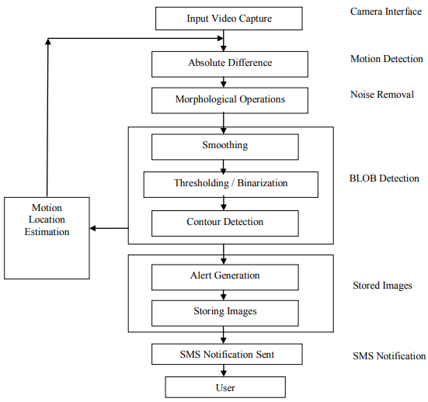
Block Diagram

Slide 10
SOFTWARE REQUIREMENTS:
Operating System : Windows 10
Platform : DOT NET TECHNOLOGY
Front End : ASP.Net 4.0
Back End : SQL SERVER 2014

Slide 11
HARDWARE REQUIREMENTS:
Keyboard
Mouse
Hard disk 500GB
Ram 4 Gb

Slide 12
CONCLUTION
The objective of visual surveillance system is to find out the motion made by any object in the surveillance area and generate the alert and allow user to get SMS notification once the motion is taking place in that area. From all the discussion we can be conclude that the real time alert system plays an important role in real time so as to observe the motion of an object in the motion restricted area and immediately the user is getting the SMS containing text as “Motion Detected”. Also the captured images are getting stored in the HDD so as the user come to know the responsible object for a single movement.

Slide 13
REFERENCE
[1] Zazilah Binti May, "Real-time Alert System for Home Surveillance", IEEE International Conference on Control System, Computing and Engineering,pp.501-505, 23-25 Nov – 2012, Malaysia.
[2] Wei Shuigen, Chen Zhen, Dong Hua, "Motion Detection based on Temporal Difference Method and Optical Flow Field", Second International Symposium on Electronic Commerce and Security, pp.85-88, May-2009, China.
[3] Wei Shuigen, Chen Zhen, LI Ming, ZHUO Liang, "An Improved Method Of Motion Detection Based On Temporal Differences", International IEEE Workshop on Intelligent Systems and Applications, pp.1-4, May-2009, China.
[4] Sheetal Balsaraf, Uday Joshi, "Implementation of Motion detection and Tracking based on Mathematical Morphology", International Journal of Computer Application, 80(15):22-28, October 2013.

Slide 14
[5] Masayuki Yokoyama, Tomaso Poggio, "A Contour-Based Moving Object Detection and Tracking, Proceedings of: Visual Surveillance and Performance Evaluation of Tracking and Surveillance", 2005.
[6] Li Fang, Zhang Meng, " Smart Motion Detection Surveillance System", International Conference on Education Technology and Computer, pp. 171-175, 2009.
[7] R. Arokia Priya, Poonam Gujrathi, "Survey Paper On Real Time Motion Detection Techniques", International Journal Of Electrical, Electronics and Data Communication, 1(8):75-79, October 2013, ISSN: 2320-2084.
[8] M. Valera and S.A. Velastin, "Intelligent distributed surveillance systems: a review" in „IEE Proc.-Vis. Image Signal Process‟, 152(2):192-204,IEE, April 2005, ISBN/ISSN 1350-245X(2005)

