Slide 1
A Wearable Device for Continuous Detection and Screening of Epilepsy during Daily Life

Slide 2
Abstract
Imbalance in the nervous system causes Epilepsy disease which may lead to death. The most common symptoms of epilepsy disease are sudden fluctuations in heart beat rate and involuntary muscular movements (seizures).The wireless electronic diagnosing system used here is meant for epilepsy patients only. Occurrence of seizures predicated by this system. With the aid of this system, the patient can lead a healthy life. Since the occurrence of seizures is unpredictable, it will be difficult to leave the patient alone. The electronic system used here is a wearable device which predicts the occurrence of epilepsy disease. The signals from human body is used to detect the occurrence of epilepsy disease.When the device detects the symptoms, it transmits a coded signal to produce control signals for switching an alarm device, doctor or relatives mobile phone using wireless communication with help of GSM modem and GPS is used to trace out the exact location of the patient.

Slide 3
Existing System
The visualization module allows for accurate ECG electrodes placement by displaying, upon user’s request, a snapshot representing the last seconds of the ECG signal.
Such as medication or electrical stimulation, exist that can counter a beginning seizure.
To qualitatively assess the comfort of the packaging and the selected sensor location, each healthy volunteer is asked to fill out an evaluation form after the completion of the data collection.
The data storage module enables the wireless download of the collected raw data, in case further offline analysis needs to be performed.

Slide 4
Disadvantage of Existing System
As epilepsy is the major problem, affecting a large number of people. Ensemble of pyramidal one-dimensional convolution neural network (P-1D-CNN) models was proposed.
CNN model required a huge volume of data, to overcome this problem CNN works on the concept of refinement and re-centralization and proposed to augmentation scheme.
We propose an effective method for distinguishing a set containing the seizure activity.
Electroencephalogram which is used for testing problems related to electrical activity of the brain is assumed to be a non-stationary signal.

Slide 5
PROPOSED SYSTEM :
The proposed system is intended to alert a caregiver (or relative, friend, etc.) in case of a potentially dangerous seizure.
Synchronization of the ECG system with external equipment such as a digital video system is also required for the purpose of this study.
Power efficiency purposes, the uplink is achieved by using protocol derived from low-power listening (LPL) techniques.
Another purpose of these dry-tests is to evaluate the robustness of the radio link.
An erroneous packet is an event packet that enters the QoS layer and is not successfully received by the control unit (despite being retransmitted several times).

Slide 6
ADVANTAGE
The performance for detection from a patient is verified using (EEG) electroencephalographic recordings. In order to reduce the power and to keep the circuit simple, it is compared with the amplifier.
Based on both signal and image processing can predict along with the comparison of performance of different extraction method and classifiers, we can detect the epilepsy.
The device will increase the efficiency and reduce the burden of neurologist in detecting epilepsy.
The worker performance can be monitored based on the GPS location and relative job at the job site.
It keeps track of the performance of the athlete and helps to achieve goals.

Slide 7
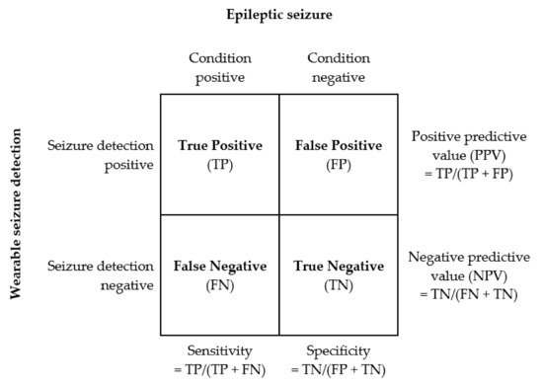
Block Diagram

Slide 8
SOFTWARE REQUIREMENTS:
Operating System : Windows 10
Platform : DOT NET TECHNOLOGY
Front End : ASP.Net 4.0
Back End : SQL SERVER 2014

Slide 9
HARDWARE REQUIREMENTS:
Keyboard
Mouse
Hard disk 500GB
Ram 4 Gb

Slide 10
CONCLUTION
Nowadays, modern technologies are in leading edge developing many automation's. Using the convolution neural network (CCN) and short time Fourier transform (STFT), EEG signals can be developed. EEG signal has main approach of the research of the epileptic seizure due to the connection between the EEG and epileptic seizure. The predication and diagnosis of epilepsy seizure depends on the signal processing or the image processing, here without using multi model tool there is a possibility of fault identification which leads to either fault treatment or delay treatment which may also lead to death. Especially a wearable device is developed which is cost effective this device helps million victims of epilepsy. By using this device, the patient can move freely like normal person. Prevention is better than cure. Prediction of occurance of epilepsy is necessary for preventing loss of life.

Slide 11
REFERENCE
[1] “A Low Power System With EEG Data Reduction for Long-Term Epileptic Seizures Monitoring” by Syed Anas Imtiaz, Saam Iranmanesh ,Esther Rodriguez-Villegas.Paper Published by IEEE in 2019 .
[2] “Highly efficient and accurate seizure prediction on constrained IOT devices” by Farad Sammie, Lars Bauer, Jorge Helen. Paper Published by IEEE in 2018.
[3] “An Automated System for Epilepsy Detection using EEG Brain Signals based on Deep Learning Approach” by Ihsan Ullah 1, Muhammad Hussein, Edam-ul-Haq Qazi and Hatim Aboalsamh. Paper Published by IEEE in 2018.
[4] “A Multi-view Deep Learning Framework for EEG Seizure Detection” by Ye Yuan, Guangxu Xun, Kebin Jia, Aidong Zhang. Paper Published by IEEE in 2018.
[5] “Diagnosis of epilepsy — A systematic review” by R. Vetrikani , T Christy Bobby.Paper Published by IEEE paper in 2017 .

Slide 12
[6] “Epileptic seizure auto-detection using deep learning method” by Yuzhen Cao, Yixiang Guo, Hui Yu, Xuyao Yu. Paper Published by IEEE in 2017.
[7] “Analysis and Prediction of Epilepsy Based on Visibility Graph” by Chongqing Hao, Zhe Zhao. Paper Published by IEEE in 2017.
[8] “A new method for predicting epilepsy seizure” by AbdellAtif Abuimara . Paper Published by IEEE in 2013.
[9] “Epileptic electroencephalogram classification” by Nilima Mohite , Rajveer Shastri , Arnab Das . Paper Published by IEEE in 2014.
[10] “ Automated seizure detection from multichannel EEG signals using Support Vector Machine and Artificial Neural Networks” by S A Asha, C Sudalaimani, P Dev anand, T Elizabeth Thomas ,S Sudhamony .Paper Published by IEEE in 2013.

