Slide 1
Food calories diet info system

Slide 2
Abstract
To provide an overview of the published scientific information on the safety and efficacy of very low-calorie diets (VLCDs) and to provide rational recommendations for their use. Data Sources and Extraction. Original reports obtained through a MEDLINE search for 1966 through 1992 on VLCDs or reducing diets plus obesity, supplemented by a manual search of bibliographies and the opinions of experts in the field of nutrition and weight loss therapy for obesity. Only studies of humans were cited. Data Synthesis. Current VLCDs are usually provided in the context of comprehensive treatment programs, during which usual food intake is completely replaced by specific foods or liquid formulas containing 3350 kJ/d (800 kcal/d) or less.

Slide 3
Weight loss on VLCDs averages 1.5 to 2.5 kg/wk; total loss after 12 to 16 weeks averages 20 kg. These results are superior to standard low-calorie diets of 5020 kJ/d (1200 kcal/d), which lead to weight losses of 0.4 to 0.5 kg/wk and an average total loss of only 6 to 8 kg. There is little evidence that intakes of less than 3350 kJ/d (800 kcal/d) result in better weight losses than 3350 kJ. Intake of at least 1 g/kg of ideal body weight per day of protein of high biologic value appears to be important in helping to preserve lean body mass. Serious complications of modern VLCDs are unusual, cholelithiasis being most common.

Slide 4
Existing System
The physician with a patient in the condition of insulin resistance, metabolic inflexibility and inflammation, must be able to choose between several options of diet therapy.
The best diet for losing weight and maintaining good health is the Mediterranean diet.
However, in the strategy of weight loss there are several dietary approaches available, divided between low calories diet (LCD, 800 kcal day-1) and very low-calorie diets (VLCDs, < 800 kcal day-1).
Moreover, the choice of the physician should be based on the effectiveness of the loss of fat mass and the patient safety during dietary intervention.

Slide 5
Disadvantage of Existing System
Treatment of obesity is also problematic. In theory, control of obesity should be quite simple. But for most obese patients, weight loss is extremely difficult, and maintenance of that weight loss even more so.
The frequency with which attempts to treat obesity have met with failure has led to a multitude of dietary, behavioral, pharmacologie, mechanical, and even surgical approaches to control weight.
These diets should be used with caution with patients who have a diagnosis of a psychotic disorder, or in whom follow-up may be problematic.
While there is evidence that dieting is not as closely linked to binge eating as to bulimia nervosa, patients who have difficulties with binge or episodic overeating may experience difficulties in adherence to LCD or VLCD programs.

Slide 6
PROPOSED SYSTEM :
A cross-talk between skeletal muscle and adipose tissue has been proposed and linked with the control of body weight, both fat stores and muscle mass.
Sarcopenia has profound physiologic and clinical consequences, including but not limited to impaired protein turnover, mobility loss, osteoporosis, increased fracture risk, dyslipidemia, insulin resistance, overall frailty, and increased mortality.
The effects of diet on metabolic pathways related diabetes, cardiovascular diseases, and other chronic non-communicable diseases (CNCD) is currently under investigation.
The technique combined a total body scanner, an X-ray source, an internal wheel to calibrate the bone mineral compartment, and an external lucite/aluminum phantom to calibrate soft mass.

Slide 7
ADVANTAGE
These complications are transient and rarely require modification of diet. Physical performance is generally unimpaired.
Mood and affect usually improve in patients participating in VLCD programs that incorporates behavioral treatment, but a few patients will develop depression, anxiety, or irritability during weight loss.
The controversy over VLCDs relates to their safety and their long-term efficacy.
The most commonly used VLCDs have been liquid formulations, often provided as a powder to be mixed with water.
Most studies of VLCDs have used them as part of a more general weight control program that includes exercise, behavior modification, and nutritional education to help promote long-term weight control.

Slide 8
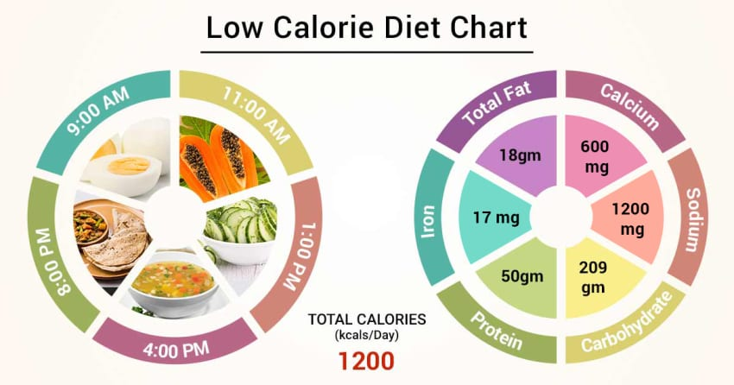
Block Diagram

Slide 9
SOFTWARE REQUIREMENTS:
Operating System : Windows 10
Platform : DOT NET TECHNOLOGY
Front End : ASP.Net 4.0
Back End : SQL SERVER 2014

Slide 10
HARDWARE REQUIREMENTS:
Keyboard
Mouse
Hard disk 500GB
Ram 4 Gb

Slide 11
CONCLUTION
For the vast majority of overweight Americans, who are only mildly obese, a balanced LCD combined with a pro¬ gram of exercise and behavior modification remains the treatment of choice. For those who are more severely obese, a VLCD can be effective in producing significant short-term weight loss and rapid improvement in weight-related medical conditions. Current formulations, which usually contain protein of high biologic value and adequate calories, are generally safe when properly used in selected patients with appropriate medical supervision. Most adverse reactions are minor and well tolerated. The most serious complication associated with current VLCDs is symptomatic cholelithiasis. Very low-calorie diets should generally be used only in patients with a BMI greater than 30. Use of VLCDs in patients with a BMI of 27 to 30 should be reserved for those who have medical complications resulting from their obesity (such as hypertension or diabetes) and who have been unsuccessful with conventional LCDs. The VLCD formulation should contain a minimum of 1 g/kg of IBW per day of high biologic value protein. No advantage has been demonstrated by the use of formulations with an energy level below 3350 kJ/d (800 kcal/d or approximately 12 kcal/kg of IBW per day), and there are few published data on the safety of exclusive use of VLCDs for longer than 16 weeks. All patients undergoing VLCDs should have a thorough initial evaluation by a physician. Severely obese patients frequently have underlying medical problems that will require careful monitoring during VLCD treatment. The frequency and intensity of continued surveillance during the VLCDs should be dictated by clinical judgment.

