Slide 1
Bakery Management System

Slide 2
Abstract
Information Communication Technology (ICI) has played a major role in the day to day running of companies, organizations and institutions and general life. Through the use of information technology these companies are able to perform daily activities efficiently and accurately. The bakery sector too has benefited from this advancement in information Technology. The BMIS project outlines the formulation of a computerized management information System of any bakery particularly hot loaf bakery. The project highlights the following; Problems faced by the current system in carrying out a management information systems, use of php and it’s related technologies of apache server and JavaScript in validation as an efficient tools for designing and developing a bakery management information systems that helps to solve the problems faced by the current system, Ways of making sure that the data or inputs of the current system can be verified and validated. It involves the development of a centralized database system using MySQL.

Slide 3
It also involves the process of making access to whatever information as fast as possible. This involves real time reports. It also shows how the whole system can be made secure to avoid an unauthorized access to its various resources. Here role based authentication provided by The Apache server is put into use, therefore the project looks at the various ways and technologies that can be used to accomplish the goal of the whole project. That is to provide a computerized management Information system that facilitates or enhances effectiveness and efficiency of all bakery system.

Slide 4
Existing System
An information system is useful to keep managers informed of how well the department or organization is performing and to let them know where problems exist.
The customer will continue with the existing system and thereby defeat the purpose of the developed system.
It is therefore a waste of resources to build information systems without sufficiently satisfying the target user.
These bakeries mainly evaluated raw materials by a random check. Bakeries applying BRC always used the same design of production plan and fixed their product order.
They used margins for quiet days and took failures and unexpected orders into account in the planning.

Slide 5
Disadvantage of Existing System
The political factors have a serious impact on country and business. Factors effecting the business usually include stability of government, tax laws and tariff and so on.
This kind of unstable environment mostly has a huge impact on the food business.
The system has a customer’s database that solves the problem of registering daily customers (agents), daily finished products, stock takings and sales in terms of returns, deliveries, product sales and rates.
The other big problem accounted was the central server that has been on and off hence it has not been possible in time schedule.

Slide 6
PROPOSED SYSTEM :
They did not improve procedures or evaluate procedures for the purpose of improving them.
They instructed their employees by supervision and/or demonstration but used no information. Mixed bakeries evaluated product quality by supervision.
Although several studies also indicate that quality management is related to contextual factors, the specific characteristics ofthe agri-food industry contribute to a higher complexity of contextual factors.
We assume that this relation will also hold for the differences within the groups, although we were not able to investigate this due to lack of data.

Slide 7
ADVANTAGE
These requirements include; user needs, performance expectations, and other specifications.
This will provide a competitive advantage because customer satisfaction leads to increased customer loyalty, reduced customer acquisition costs, reduced price elasticity of demand, and increased profit margins.
The advantage of this method of data collection is that there is high response rate since the production manager and sales manager were able and willing to fill and give the required data like bakery background, production trend and sales requirements.
The term information system refers to the information technology that is used by people to accomplish a specific organization or individual objective.

Slide 8
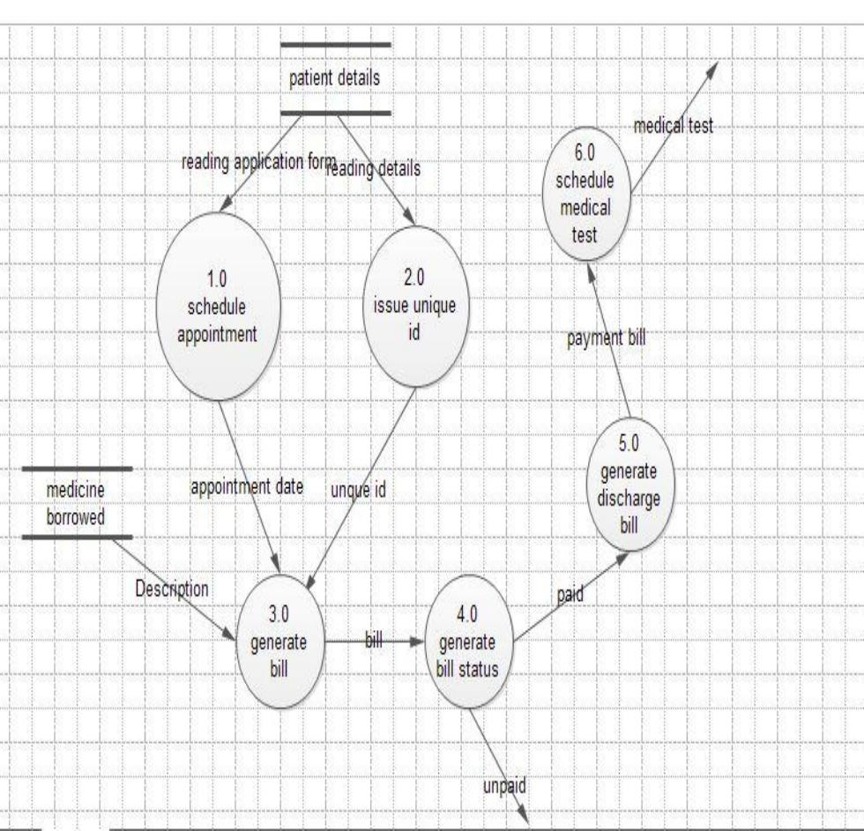
Block Diagram

Slide 9
SOFTWARE REQUIREMENTS:
Operating System : Windows 10
Platform : DOT NET TECHNOLOGY
Front End : ASP.Net 4.0
Back End : SQL SERVER 2014

Slide 10
HARDWARE REQUIREMENTS:
Keyboard
Mouse
Hard disk 500GB
Ram 4 Gb

Slide 11
CONCLUTION
The BMIS has achieved all the mentioned Objectives of the system; the system is able to generate reports and searches when needed. The system is able to post, update and delete data from the database. The system also can search for a particular record from the database. Thus, the system has been a success to both the system developer/designer and there is hope that the system will make the work of the Bakery very easy, since it’s a computerized system.

