Slide 1
Encryption image binding with secret key

Slide 2
Abstract
Symmetric key cryptography is a common cryptographic technique using the same key at both the transmitter and receiver side. The main advantage of symmetric key encryption is its less computational cost compared to its counterpart-public key encryption. In this work a new symmetric key encryption scheme is proposed. Rather than using normal binary secret keys, our technique uses images as secret keys. Message letters are converted into their corresponding 8-bit binary codes. These 8-bit codes are scanned for image pixel values which are represented by the same 8-bit codes. When a match is found between the message 8-bit code and pixel values codes that location of the pixel is saved in a separate file. Instead of saving pixel locations as (x, y) coordinates, their locations are saved as one value column wise. After having all matches, pixels locations are transmitted as cipher text. The receiver side will scan the same image for those locations and will pick values at those locations which represent message codes. The main advantage of this scheme is its high security as its key size is very large.

Slide 3
Existing System
The signature identifies the image’s copyright information such as profile information, or an identification number and it is integrated within digital files as noise, or random information that already exists in the file, thereby making the detection and removal of the watermark difficult.
If average throughput of encryption and decryption is considered, the proposed technique is much better than the existing symmetric key techniques.
Execution time (Encryption + Decryption) of the proposed technique is compared with different existing symmetric encryption techniques.
However, earlier findings of the research work discover that there exist certain key values that resulted in weak encryption.

Slide 4
Disadvantage of Existing System
There are several issues that need to be concerned. Firstly, compression technique employs pattern library for encoding.
The main objective of SIP was to overcome the weak key problem as well as to enhance the security strength of the algorithm.
One of the drawbacks of DES is that the key length was too short. To overcome this problem DES was enhanced and 3DES was proposed.
The main challenge of the research is to overcome the weak key problem, to extend the algorithm to support variable size images and to introduce electronic codebook (ECB) and cipher block chaining (CBC) mode of operations.

Slide 5
PROPOSED SYSTEM :
As cryptographic keys are very long and has to be protected from unauthorized access, a new technique generating secret keys directly from image properties was proposed.
All images whose pixel values can represent all characters can be used as secret key.
Character probability is checked for any image that is to be used as secret key.
If the characters of the secret message are present in image in the form of pixel values, find the location of every character.
There can be multiple locations for one character, take any random location. After finding all the locations of characters, write these locations in a separate file.

Slide 6
ADVANTAGE
In Symmetric key encryption or secret key encryption, only one key is used for both encryption and decryption.
In study of different symmetric key algorithms is performed. Files of variable sizes and contents were encrypted and performance was measured.
Images are routinely used in diverse areas such as medical, military, science, engineering, art, entertainment, advertising, education as well as training.
Digital watermarking or also known as digital fingerprinting is another technique that is used for digital image protection.
This technique inserts pattern of bits known as signature into a digital image, audio or video file.

Slide 7
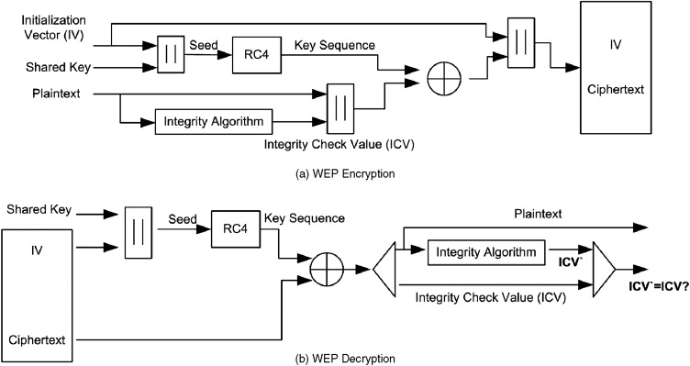
Block Diagram

Slide 8
SOFTWARE REQUIREMENTS:
Operating System : Windows 10
Platform : DOT NET TECHNOLOGY
Front End : ASP.Net 4.0
Back End : SQL SERVER 2014

Slide 9
HARDWARE REQUIREMENTS:
Keyboard
Mouse
Hard disk 500GB
Ram 4 Gb

Slide 10
CONCLUTION
In this paper, a new symmetric key encryption technique is implemented using image as secret key. The pixel locations of characters of message text are transmitted as cipher text instead of transmitting actual message text. On receiving side, receiver extracts actual text by using the locations of secret key image pixels. Security and computational analysis is presented which showed that the proposed technique has low computational cost and high security because of the huge key size. The computational cost of the proposed technique is calculated for different message file sizes and compared with the computational costs of the state of the art encryption techniques available in literature. Computational analysis shows that the proposed technique is well ahead of the existing techniques.

Slide 11
REFERENCE
[1]. J.J. Amador and R.W. Green, "Symmetric-key block cipher for image and text cryptography," International Journal of Imaging Systems and Technology, vol. 15, pp. 178-188, 2005.
[2]. A. Ramesh and A. Suruliandi, "Performance analysis of encryption algorithms for Information Security," International Conference on Circuits, Power and Computing Technologies, 2013, pp. 840-844
[3]. M. Umaparvathi and D.K. Varughese, "Evaluation of symmetric encryption algorithms for MANETs," IEEE International Conference on Computational Intelligence and Computing Research, 2010, pp. 1-3
[4]. D. Trinca, "Sequential and parallel cascaded convolutional encryption with local propagation: Toward future directions in symmetric cryptography," Third International Conference on Information Technology: New Generations, 2006, pp. 464-469
[5]. O. Verma, R. Agarwal, D. Dafouti, and S. Tyagi, "Peformance analysis of data encryption algorithms," 3rd International Conference on Electronics Computer Technology 2011, pp. 399- 403

Slide 12
[6]. S.R. Masadeh, S. Aljawarneh, N. Turab, and A. M. Abuerrub, "A comparison of data encryption algorithms with the proposed algorithm: Wireless security," Sixth International Conference on Networked Computing and Advanced Information Management, 2010, pp. 341-345
[7]. D.S.A. Elminaam, H. M. Abdual-Kader, and M.M. Hadhoud, "Evaluating The Performance of Symmetric Encryption Algorithms," International Journal of Network Security, vol. 10, pp 216-222, 2010
[8]. S.A. Hirani, "Energy Consumption of Encryption Schemes in Wireless Devices” PhD Thesis, University of Pittsburgh, 2003.
[9]. A. Nadeem and M. Y. Javed, "A performance comparison of data encryption algorithms," First international conference on Information and communication technologies, 2005, pp. 84-89.
[10]. P. Krishnamurthy and N. Ruangchaijatupon, "Encryption and Power Consumption in Wireless LANs-N," Third IEEE Workshop on Wireless LANs-Newton, Massachusetts, 2001.

