Slide 1
College fees management

Slide 2
Abstract
These methods of paying fees have not been efficient enough especially during periods of tests and examinations when most of the students are paying fees to meet the requirements for entering examination rooms. The process of paying fees is characterized by long queues, too much waiting by students and congestion at banks where payments are made. This has always resulted in students missing to sit for their tests and/or examinations while they are queuing to make payments. It was upon such background that the researchers embarked on the project to develop of an alternative system that enables online fees payment by students and their sponsors.

Slide 3
With the use of questionnaires, interviews, observation and document reviews, data was collected from project stakeholders and analysed. Data flow diagrams and Entity relationship diagrams were used to accomplish system analysis and design. The system was implemented using Apache web server, Mysql database server, Hypertext Preprocessor, Hypertext markup language, Cascading style sheets and JavaScript. System testing and validation was also done by allowing users of the system interact with it using test data. Findings showed that most of the students were unsatisfied with the current modes of paying fees to the university and agree that an online fees payment system can improve the process of fees payment. The result of the project was an online fees payment system for Makerere University (MUK-OFPS) and researchers recommend the university to implement the system that provides relief of the long endured problems of the current modes of payment at the university.

Slide 4
Existing System
An ERD was used to show the relationships between the entities involved in the system together with their attributes and indicate the number of occurrences an entity can exist for a single occurrence of the related entity.
The researchers‟ attempts to access and connect to the university existing information systems were futile as managers and administrators of those systems claimed it would compromise their security.
The developed product is a prototype and not a fully functional system that is integrated with other existing university systems.
To review the existing system used in paying university fees so that its strength and weaknesses are identified.

Slide 5
Disadvantage of Existing System
The problem is addressed by developing a system that enables students and their sponsors to securely pay university fees online from wherever they are using credit and debit cards.
The card issuing bank issues credit cards to customers and maintains their accounts and the merchant opens an account with a bank to receive payments.
A credit card is a small plastic card issued to users as a method of payment for online or off-line purchases.
Many banks issue a combined ATM/debit card that looks like a credit card and can be used in places where credit cards are accepted.

Slide 6
PROPOSED SYSTEM :
This project proposed the development of an alternative platform that enables students and their sponsors securely pay university fees online from wherever they are using credit and debit cards.
We used interviews to establish grounds for accessing the acceptability and feasibility of our proposed solution and to understand the business environment with its associated needs.
The system helps to reduce the number of students that currently miss sitting for their tests and examinations while waiting to reach bank counters to make payments.
Sponsors of students, especially those abroad, will also save money and time since it will no longer necessitate them to first transfer money to students before it is paid to the university.

Slide 7
ADVANTAGE
This method of paying fees has not been efficient enough especially during periods of tests and examinations when most of the students are paying fees to meet the requirements for entering examination rooms.
Both debit and credit cards are associated with advantages of convenience, speed, flexibility, simplicity, ease of use, accessibility and availability.
Monitoring database performance and managing other parameters.
Monitoring LIMS/database performance and offering technical support on the corporate database functionalities.
Participating in the design and execution of the corporate LIMS/database capacity planning.

Slide 8
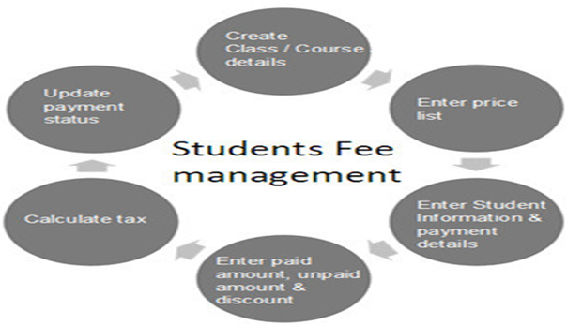
Block Diagram

Slide 9
SOFTWARE REQUIREMENTS:
Operating System : Windows 10
Platform : DOT NET TECHNOLOGY
Front End : ASP.Net 4.0
Back End : SQL SERVER 2014

Slide 10
HARDWARE REQUIREMENTS:
Keyboard
Mouse
Hard disk 500GB
Ram 4 Gb

Slide 11
CONCLUTION
The project sought to develop an online fees payment system that provides relief of the long endured problems of the current modes of paying fees in Makerere University. Problems that students and their sponsors faced regarding paying fees to the university were identified and a solution was designed. Researchers developed a web based system that enables students and their sponsors to pay university fees from wherever they are using credit and debit cards. This system was welcomed by all its users who believed it would solve most of the problems and improve conditions regarding paying fees in Makerere University. The project achieved all its objectives and as a result, MUK-OFPS was designed, developed, tested and validated with real users. Hence, it was proved that this online system was fit to be implemented.

Slide 12
REFERENCE
A Beginner‟s Guide to Payment Systems For E-Commerce. (nd). Retrieved February 22, 2013, from http://blog.pixelcrayons.com/ecommerce/a-beginners-guide-to-payment-systemsfor-e-commerce/
Abrazhevich, D. (2004). Electronic payment systems: A user-centered perspective and interaction design.
Eindhoven: Technische Universiteit Eindhoven. Bank of Uganda (BoU), (2012). Fees payment systems in Uganda. Retrieved March 19, 2013 from http://www.bou.or.ug/bou/payment_systems/Current_Payment_Systems.html
Chanm, D. (2010). Untraceable electronic cash. In proceedings on Advances in cryptology. Spring-verlag, New York.
Chou, Y., Lee, C. and Chung, J. (2004). Understanding M-commerce payment systems through the analytic hierarchy process. Journal of Business Research 57, 1423–1430.

Slide 13
Mohammad, A. and Emmanuel, U. (2003). Online credit card processing models: critical issues to consider by small merchants. Human systems management 22(3), 133-142.
Neuman W. L. (2003). Social Research Methods: Qualitative and Quantitative Approaches. Research (pp. 297-320). USA: Sage Publications, Inc.
Plymouth, K. & Martin, J. (2009). Bill payment trends: major shifts in consumer behavior require comprehensive planning. A first data white paper.
Shon, T. and Swatman, P.M. (1998). Identifying effectiveness criteria for Internet payment systems, Internet Research: Electronic Networking Applications and Policy 8(3), 202- 218.
Singh, M.P. (2004). Information Systems. Practical Handbook of Internet Computing. University of Toronto

