Slide 1
Modern Ready Made Customer Billing system

Slide 2
Abstract
In modern days, people are getting too busy in their works but still they need to spend time in shopping malls. In Shopping malls, customers face a difficulty to follow a queue for the process of billing, which takes a long time under huge crowd. Customer thought that, to avoid the standing time in the billing section at shopping malls. To overcome the above problems, we emerged the Bascart system. To increase the pace of a billing process, RFID tags in products, then the product is read by the barcode scanner which describes the cost of that product and is displays on the LCD screen attached in our shopping list. As customer buy their exact product its price is add on the previous list. The cost of the product is displayed on the LCD screen by using microcontroller through Zigbee Communication from host PC. Zigbee supports bidirectional communication between microcontroller and host PC. We have proposed the Weighing Sensor for the purpose of checking the weight of the items and it is directly stored in the server database. Customer get direct bill at the billing section which is already stored at host PC which automatically reduces the queue. Then GSM Module in our system is used to detect the Geoposition of the customer’s mobile for the process of intimating the shopping details of the customer through messages which is already updated in database.

Slide 3
Existing System
They consist of a microchip and an antenna which transmit a locate items using radio signals the Radio-Frequency Identification tags were used.
An RFID tag consists of a microchip, memory and antenna.
They also enable individual items to be given a unique identification number, rather than just a product code.
In this Pioneering Billing Cart System, each product will contain the passive Radio Frequency ID tag which is bearing a unique Electronic Product Code (EPC).
It is the best choose for electronic enthusiast to do some tiny home scale.

Slide 4
Disadvantage of Existing System
To overcome the above problems, we emerged the Bascart system. To increase the pace of a billing process, RFID tags in products, then the product is read by the barcode scanner which describes the cost of that product and is displays on the LCD screen attached in our shopping list.
We introduced baccarat using different techniques till date to solve the problems.
Many security and privacy issues have emerged and lightweight cryptographic methods are in high demand to fit in with IoT applications.
This is the first time that LF RFID is employed in enhancing shopping experiences and security issues are discussed in the context of a smart shopping system.

Slide 5
PROPOSED SYSTEM :
In order to save customers precious time in the billing section, we propose a Smart Trolley System (STM).
The system implementation will use Wireless Access Network and Radio Frequency Identification (RFID) technologies.
The Smart Trolley is connected to the router of the store.
Customer needs to login to store’s website where he will be able to see the list of items purchased.
The Smart Trolley is equipped with an RFID scanner along with the other hardware components all the items in the store will have RFID tag fitted to them.
All the data such as cost total quantity etc.

Slide 6
ADVANTAGE
It becomes easy for the store to do inventory management as all items can be automatically read and easily logged.
As an IoT application, the power consumption must be low.
Computational overhead at the smart cart side for higher efficiency.
Many security and privacy issues have emerged and lightweight cryptographic methods are in high demand to fit in with IoT applications.

Slide 7
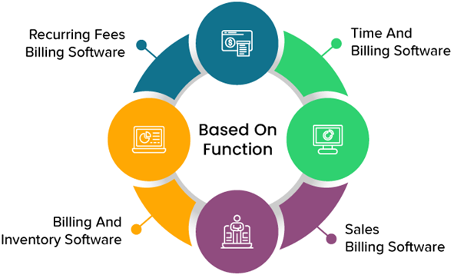
Block Diagram

Slide 8
SOFTWARE REQUIREMENTS:
Operating System : Windows 10
Platform : DOT NET TECHNOLOGY
Front End : ASP.Net 4.0
Back End : SQL SERVER 2014

Slide 9
HARDWARE REQUIREMENTS:
Keyboard
Mouse
Hard disk 500GB
Ram 4 Gb

Slide 10
CONCLUTION
In this project, we propose a secure smart shopping system utilizing RFID technology. This is the first time that LF RFID is employed in enhancing shopping experiences and security issues are discussed in the context of a smart shopping system. We detail the design of a complete system and build a prototype to test its functions. We also design a secure communication protocol and present security analysis and performance evaluations. We believe that future stores will be covered with RFID technology and our idea is a pioneering one in the development of a smart shopping system. Our future work will focus on improving the current system, for example, by reducing the computational overhead at the smart cart side for higher efficiency, and how to improve the communication efficiency while preserving security properties.

Slide 11
REFERENCE
[1] J. Suryaprasad, Praveen Kumar B O, Roopa D & Arjun A K "A Novel Low-Cost Intelligent Shopping Cart", 2014 IEEE.
[2] Udita Gangwal, Sanchita Roy,Jyotsna Bapat, Smart Shopping Cart For Automated Billing Purpose Using Wireless Sensor Networks, ICCMIT7026.
[3] J.S.Awati, S.B.Awati, Smart TrolleyIn Mega Mall, IJETAE-0312-82. Amine Karmouche, Yassine Salih-Alj, "Aisle-level Scanning for Pervasive RFID-based Shopping Applications", 2013 IEEE.
[4] Satish Kamble, Sachin Meshram, Rahul Thokal & Roshan Gakre, "Developing a Multitasking Shopping Trolley based on RFID Technology", January 2014 International Journal of Soft Computing and Engineering (IJSCE).
[5] Mr. P. Chandrasekar, Ms. T. Sangeetha, "Smart Shopping Cart with Automatic Central Billing System through RFID and ZigBee", 2014 IEEE.

Slide 12
[6] Gangwal U, Roy S, Bapat J. Smart Shopping cart For Automated Billing using Wireless sensor N/W. The Seventh International Conference on Sensor Technologies and Applications. 2013. p. 168–72.
[7] Maini E, Sheltar J. Wireless Intelligent Billing Trolley for malls. International Journal of Scientific Engineering and Technology. 2014 Sep; 3(9):1175–78.
[8] Kumar R, Krishna KG, Ramesha K. Intelligent Shopping Cart. International Journal of Engineering Science and Innovative Technology (IJESIT). 2013 Jul; 2(4):1–9.
[9]Accessed from : www.schneider_electric.com.hk/.../Sympholux_Shopping_ Mall_Solu..
[10] J. Thangakumar, S. Sainath, K. Surender, V. Vikram Arvind, “Automated Shopping Trolley for Super Market Billing System”International Journal of Computer Applications (0975 – 8887) International Conference on Communication, Computing and Information Technology (ICCCMIT-2014)

