Slide 1
Leave approvel management system

Slide 2
Abstract
E-Leave Management System and Payroll (E-LMSP) project is a web application and mobile application which can be used for all the organization or company that will ease the employees leave management. This is due to the problem in using manual system which can cause damage, missing and can be costly as well. In addition, it also will cause delay in leave request when the respective officer not in the office. To solve leave delayed problem, this system provided with the automated function ease leave management process such as information of employees, approval of leave, types of leave, leave balances, payment, notification of email, report generation are element of this system.

Slide 3
The system is design in such a simple and friendly user interface to ease the users to use. Every employee is provided with unique username, password and accessible either by an employee or admin for log into a system. Moreover, the functions of administrator for this system are to register the new employee, delete and update information of user in a database. Administrator is known as higher authorities that use to manage the leave whether want to approve or reject the leave of employees. This system also provides the function that help the administrator to auto calculate the salary for each employee based on leave request by employees. This system is developed by using Waterfall method to ensure it is deployed in the prescribed time. As a conclusion, this system is very useful for any companies or organization where there are have large number of employee and easier to track and manage employees leave.

Slide 4
Existing System
In the existing it is individual to apply leave. It increases the paper work and record maintenance which is a tedious work.
This software is supported to eliminate and in some cases, cut back the hardships faced by these existing systems.
This technique is intended for the actual want of the corporation to hold out operations in a very swish and effective manner.
In this existing system, NFC technology is used by which each employee will be able to access this application online and can request leave as per their needs.
The proposed application offers multiple company accounts each of which has its company users.

Slide 5
Disadvantage of Existing System
The leave management system has been developed to override the issues prevailing within the active manual system.
It does not ensures security of every record .
It increases the redundancy of data and gives various facilities .
It leads to loss of data .
The staff has to write a letter to its superior for leave which makes it a tedious work for the staff

Slide 6
PROPOSED SYSTEM :
In our system we are going to work on software only.
The main objective of the proposed system is to automate the existing system.
It decreases the paper work and easier record maintenance by having a database for leaves.
It reduces the time and manual paper work for applying a leave.
The leave management system reduces the work and risk of the Head of the department/Principal.

Slide 7
ADVANTAGE
It is very faster.
Provide user friendly.
Less Time Consuming

Slide 8
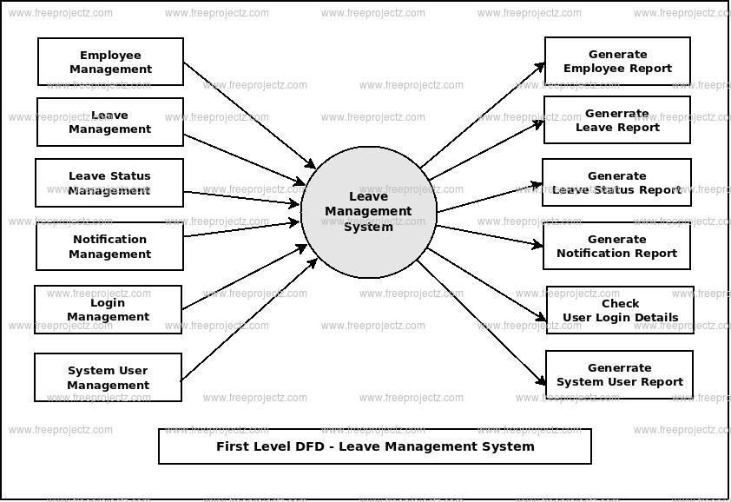
Block Diagram

Slide 9
SOFTWARE REQUIREMENTS:
Operating System : Windows 10
Platform : DOT NET TECHNOLOGY
Front End : ASP.Net 4.0
Back End : SQL SERVER 2014

Slide 10
HARDWARE REQUIREMENTS:
Keyboard
Mouse
Hard disk 500GB
Ram 4 Gb

Slide 11
CONCLUTION
Leave Management System is useful for college to maintain the leave records of the staff/faculties and it also maintain leave applications of the staff. Our systems aim is to decrease paperwork and easier record maintenance by having a particular website for leave maintenance. Our approach deals with the record of leaves taken by faculties within the institute where higher authorities like HOD's and Director will approve/reject the leave applications requested by the employees. Our system also approaches to reduce the formalities and time delay facing by faculty members for the approval of leaves. Further up-gradation of the Leave Management System for various types of institutes with multiple hierarchies can help in reducing paperwork and help achieve error-free calculation of leaves.

Slide 12
REFERENCE
[1] S Selvi, Manas Rath, N K Sinha, S P Singh, N N J Hemrom, A Bhattacharya, A K Biswal , "HR e-Leave Tour Management System at RDCIS, SAIL International Conference on Information Technology, [June 2014]
[2] Sai Ba Oo*, Nang Hlaing Myat Oo, Suparat Chainan, arpha Thongniam, Waralak Chongdarakul , School of Information and Technology, Mae Fah Luang University, "Cloud-based web application with NFC for employee attendance management system, [June 2018]
[3] Pandore Yogesh Bandopant ,"E-Notifier: Transport Information Services in Colleges and Exploring Mobile Notification Journal of Advanced Research in Computer and Communication Engineering Vol.5, Issue 4",[April 2016]
[4] https://ieeexplore.ieee.org/document/8281931

