Slide 1
Advertisement video editing project

Slide 2
Abstract
Today marketers seek the ways and information facilities to create loyal customers, because it reduces the marketing and operations costs and increases the benefits. In every organization, whether manufacturing or service, customers are the most important factor of ensuring the survival of organization. If the organization succeeds in attracting customers and creating their loyalty, the field of its growth and long-term survival can be provided. It is possible to achieve this through studying and planning by management, and this will lead at the end to the comprehensive recognition of customer needs. Since focusing on factors of customers’ satisfaction has a significant effect in banking, so, identifying the categories and priorities of these factors is important. All hypotheses of this study are approved by both Student’s ttest and Friedman test. The results of study indicated that the factors of reliability, accountability and credit factors, respectively, have more importance in order of priority. In credit factors: variety of banking services (providing any kind of services which customers need); in accountability factors: speed in providing banking services; in reliability factors: proper behavior of staff is considered of the most priority.

Slide 3
Existing System
The HDTV technology exists and some television stations have begun transmitting to users on limited channels now uses digital rather than analog signal transmission, utilizing the MPEG-2 and MPEG-4 file format and compression standard.
It exists as an additional clip in the Project window.
When you want to cross fade existing clips in the Timeline window, you have to extend the duration of one or more audio clips.
With the Adobe Title Designer you can create text and graphics that you can import and superimpose over existing video or run alone as an independent clip.
Open a new or existing project for which you want to create a new title clip.

Slide 4
Disadvantage of Existing System
When you diagnose problems related to interlaced fields, view the clips on an interlaced television display, because diagnosing field problems on a progressive-scan monitor is unreliable.
The second was that the TV studios would have had enormous problems with flicker on their cameras when making programs.
NTSC (often scurrilously referred to as Never Twice the Same colour) works perfectly in a video or closed circuit environment but can create problems of varying hue when used in a broadcast environment.
This hue change problem is caused by shifts in the colour sub-carrier phase of the signal.

Slide 5
PROPOSED SYSTEM :
Most videos are prepared to serve a purpose, such as telling a story or providing information. Editing is a crucial step in ensuring that the video flows in a way which achieves the goal.
A rolling trim's purpose is to adjust the meeting point of two neighbouring clips, but keeping the In point of the first clip or the Out point of the second clip fixed.
If you are producing a video for a website or for a certain purpose, you may already know what format is required.
With the increasing use of broadband communications and fast personal computers, the future of video distribution will involve the use of the Internet, and a technology known as streaming video, a technology ideal for sales presentations and tutorials.

Slide 6
ADVANTAGE
An efficient editor with a good aesthetics sense can bring out the best output.
It is often used to mean analog editing, because in digital editing it is both unnecessary and difficult. It is also known as assembly editing.
Non-linear editing has to be digital (computers don't do analog) and it is often used just to mean digital video.
It is called non-linear editing because you are not constrained to start at the beginning and finish at the end, as you generally do with linear editing.
In this way, the editing work done on the less expensive workstation is used to create the final cut on the more expensive, higher-quality workstation.

Slide 7
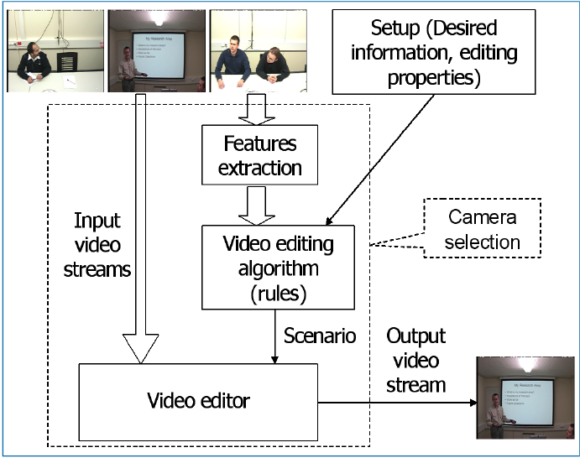
Block Diagram

Slide 8
SOFTWARE REQUIREMENTS:
Operating System : Windows 10
Platform : DOT NET TECHNOLOGY
Front End : ASP.Net 4.0
Back End : SQL SERVER 2014

Slide 9
HARDWARE REQUIREMENTS:
Keyboard
Mouse
Hard disk 500GB
Ram 4 Gb

Slide 10
CONCLUTION
The student evaluation of teaching effectiveness data presented in this study suggests that students had a positive learning experience. Students get a sense of accomplishment when, in a single class period in computer lab, they start with nothing at the beginning of class, follow a tutorial during class, and by the end class have created a video or learned a new video editing skill. Video editing and motion graphics skills and concepts are an extension of graphic design skills and concepts. Ideally, students would have basic or fundamental graphic design skills before they start to animate graphics and create videos. But, with the help of Lynda.com tutorials and a focused weekly schedule like the schedule presented in Table 1, students can tackle video editing and motion graphics in a semester-long marketing course. It is true that there is more advanced video editing software such as Adobe Premiere Pro and Apple’s Final Cut. But, this software contains more features and is more complex. Would students find it helpful to learn this more complex software? It would be interesting to see research on whether or not marketing students found it helpful to learn Adobe Premiere Pro or Final Cut. As Adobe introduces new versions of Photoshop, Lynda.com will continue to add new tutorials to its website. As marketing professionals continue to use sites like Videohive, Audiojungle, and Graphicriver will continue to add new template files and stock footage for sale. Hopefully marketing students and marketing educators continue to use these resources to create positive learning experiences.

Slide 11
REFERENCE
1. Buzzard, C., Crittenden, V. L., Crittenden, W. F., & McCarty, P. (2011). The Use of Digital Technologies in the Classroom: A Teaching and Learning Perspective. Journal of Marketing Education, 33(2), 131-139.
2. Chen, Y., Gupta, A., & Hoshower, L. (2004). Marketing students’ perceptions of teaching evaluations: An application of expectancy theory. Marketing Education Review, 14, 23-36.
3. Clayson, D. E. (2009). Student evaluations of teaching: Are they related to what students learn?: A meta-analysis and review of the literature. Journal of Marketing Education, 31, 16-30
4. Clarke III, I., & Flaherty, T. (2007). Fostering Information Literacy in the Marketing Curriculum by Engaging Students with Print Marketing Resources. Marketing Education Review, 17(1), 79-85.
5. Clow, K. E. (1999). Interactive distance learning: Impact on student course evaluations. Journal of Marketing Education, 21, 97-105.

Slide 12
6. Crittenden, V. L., & Crittenden, W. F. (2015). Digital and Social Media Marketing in Business Education: Implications for Student Engagement. Journal of Marketing Education, 37(3).
7. Green, T. (2015). Flipped Classrooms: An Agenda for Innovative Marketing Education in the Digital Era. Marketing Education Review, 25(3), 179-191.
8. Hannaford, W., Erffmeyer, R., & Tomkovick, C. (2002). Championing Technology in Marketing Education: Assessing the Value of a Discipline-Specific Technology Course. Marketing Education Review, 12(3), 47-57.
9. Malhotra, N. K. (2002). Integrating technology in marketing education: Perspective for the new millennium. Marketing Education Review, 12(3), 1-5.
10. McArthur, E., Kubacki, K., Pang, B. & Alcaraz, C. (2017). The Employers’ View of ‘Work-Ready’ Graduates: A Study of Advertisements for Marketing Jobs in Australia. Journal of Marketing Education, 39(2), 82-93.

