Slide 1
Property sale management system

Slide 2
Abstract
The information and intelligent requirement of modern residence is improving with the development of computer and property management. It is becoming the key problem for property companies how to implement the intelligent property information management. In this paper, we present a framework of property management information system based-on E-business, which can integrate the information of intelligent residences, property information and user information. We apply GIS technology into the spatial property information management, then different of property data can be displayed and evaluated by using E-map. The network hardware integration of property system is based-on LonWorks technique which can make multi-networks to use the same route. The property services model is based-on e-business and thus property user can inquire and pay property fees by the internet. It is a versatile and flexible framework for functions and processes required by subscribers for different property business needs, with reusable application modules throughout the system.

Slide 3
Existing System
The best method of spatially representing property interests that exist on different floors of the same building; a feature common to commercial property.
For new properties, computers are standard equipment; for existing hotels, computers are being integrated into everyday operations to assist in providing hospitality to guests.
The guest data are received through a personal phone call, through another computer in the referral system, or via the Internet.
All of the possibilities or room types and locations, room rates, and special requests can be matched with the existing room inventories.

Slide 4
Disadvantage of Existing System
It is becoming the key problem how to realize the intelligent property information management.
GIS are now able to address some of the problems inherent in property information value maps by producing them efficiently and as part of a wider suite of data analysis techniques.
Problems in the past related to lack of information resources, the production of expensive paper maps and the complex calculations involved.
The research highlighted the issues that must be addressed when recording and analyzing property value factors, for example, the best method of spatially representing property interests that exist on different floors of the same building; a feature common to commercial property.

Slide 5
PROPOSED SYSTEM :
The effectiveness of a PMS depends on selecting software that allows management to increase guest satisfaction and to access financial and informational data for control purposes.
The property management system is organized around the functions needed to assist in delivering service to the guest.
The PMS has become so much an essential part of lodging operations that to operate a hotel without one would be very difficult.
The guest registration procedure can also be completed by the self-check-in process, a procedure that requires the guest to insert a credit card having a magnetic stripe containing personal and financial data into a self-check-in terminal and answer a few simple questions concerning the guest stay.

Slide 6
ADVANTAGE
It has the advantage of web management and data storage.
The Web management can optimize the performance of web communication and automatically monitor the node work condition.
We use the high performance CommRex in the implementation of E-business service.
A high priority in CommRex’s design was the distribution of data resources for business operation, system performance, and user management.
The personal computer and the Internet technology have been widely used in company management and manufactory.

Slide 7
TITTLE | AUTHOR | DESCRIPTION
Computers in property management companies | Han,S,S,and Lim L,Y,(2001). | The main purpose of this study is to investigate the current usage of computers in Singapore’s property management companies.
Web-based services for real estate: model and implementation | Lin ,Z.X, Anderson, G. D, and Anderson T.J. (2004). | E-commerce success stories have taught companies that every successful e-business must have a feasible business plan that complies with a model.

Slide 8
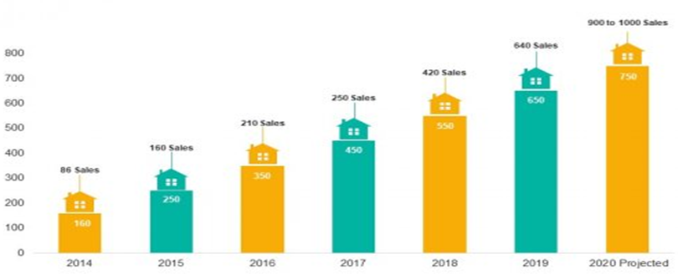
Block Diagram

Slide 9
SOFTWARE REQUIREMENTS:
Operating System : Windows 10
Platform : DOT NET TECHNOLOGY
Front End : ASP.Net 4.0
Back End : SQL SERVER 2014

Slide 10
HARDWARE REQUIREMENTS:
Keyboard
Mouse
Hard disk 500GB
Ram 4 Gb

Slide 11
CONCLUTION
The framework design of IPMIS system is based on LonWorks technology which has many advantages in home automation and intelligent building property management. It can easily implement the integration of different networks applications such as home intelligent control net, Internet services and sky TV net based on the single physical LonWorks cable. Thus it can simplify the web construction of the intelligent housing and save construction fee. The web-based property services aims to E-business and are implemented by using the advanced CommRex E-commerce software. CommRex’s performance in terms of four characteristics—scalability, portability, operation ability, and availability—is satisfactory, owing to its distribution data allocation scheme. CommRex is scalable, according to a property subscriber’s customization needs. Both property membership and property database services provide optional functional modules for customization, which include a data model extension, optional advanced functions, and other business services. IMW can more easily implement these modules because of the core data model and the use of metadata management. CommRex’s design is also portable to different network operating systems and platforms.

Slide 12
REFERENCE
Cheng, D, Z, Fang, W, and Chen H (2006). The research of intelligent building future development, Intelligent Building, 2006, 6.
Dixon, T. (2002), IT applications in property, Mapping Awareness and GIS in Europe, 16(2), 49-51.
Feng, P, and Chen, Z, C(2002). LonWorks Technology Application in intelligence Residential Community. Technology Report.
Fraser, W. (1991), Principles of Property Investment and Pricing, Macmillan, London.
Greenberg P.A(2000).Consumers Edge Toward Web-Based Real Estate, E-Commerce Times, 10 April 2000; http://www.ecommercetimes.com/perl/story/2932.

Slide 13
Han,S,S,and Lim L,Y,(2001). Computers in property management companies. Journal of Property Management , 19(5),433-440.
Howes, C. (1980), Value Maps: Aspects of Land and Property Values, Geo Books, Norwich.
Karris N. and Pike P(2001). Entering the E-Commerce Age. Mortgage Banking, July, 2001, 40-46
Lin, G, X, and Xuan H,Y. (2004). Design of Information System Based-on MS.NET and Application in Property Management. The Journal of Computer Application Research, in Chinese, 21(4). 207-208
Lin ,Z.X, Anderson, G. D, and Anderson T.J. (2004). Web-based services for real estate: model and implementation. IT Pro . 2004, 52-57. (http://www.computer.org/publications/dlib).

