Slide 1
I-faktor Testimonial Bureau

Slide 2
Abstract
The project deals with the I-Factor followed for an IT firm and also with the profit and process management followed for a firm. The Software companies will be in need of the hardware resources from the different client and the problem faced by the company is they will be unable to get the complete requirements of the hardware as due to finance to solve this, the company focus on the banking sector. The company directly will be having the direct investment on the banking sector and with the help of bank the company will be getting the hardware resources from the client. As part of the manual it is very difficult to manage the process of the bank to provide the facilities to all the company having account with them.

Slide 3
Based on the criteria followed in the banking sector, they will be providing the opportunities to the firm to get the hardware requirements to them. As by making to a web-based process the firm will be getting the complete record from the bank and also the criteria for getting the help from the bank. The back order process for the requirements also will be handled by the banking sector and the information will be providing to the client. The default mailing procedure will be followed in which the mail will be applied within the intranet of the web –application. The application also maintains the client details of the company and also the banking sector details up to date. The on-line processing of ordering the resource requirements to the bank and the file transfer within the web server will be followed based on the authentication provided to the user.

Slide 4
Existing System
The existing system is being done manually. Each process is entered by manual means.
The process involved in creating a particular report consumes such time, since searching through the manual record involves more manual activity which is a time consuming process.
The process can be prone to resulting in errors and in duplication of data.
Apart from tedious process, there is a chance for missing data and reports.

Slide 5
Disadvantage of Existing System
We do not believe the problem is with the FBI’s policy, which we found to be clear and unambiguous.
The FBI did not implement any review of campaign donations to assess potential conflicts or appearance issues that could arise from the donations.
We recommend that Department ethics officials include the review of campaign donations for possible conflict issues when Department employees or their spouses run for public office.
We will issue a separate report relating to those issues when our investigative work is complete at a future date.

Slide 6
PROPOSED SYSTEM :
This project helps to maintain the details of the clients, banks and transaction details in full fledged security. Unauthorized persons cannot access the data.
The transactions are kept online, so that there is fast completion of the transaction process available.
The current system is developed by web based application.
No need for manual work.
The retrieval time is quick and fast.
File Transfer is very easy.

Slide 7
ADVANTAGE
We identified numerous instances in which Comey used a personal email account to conduct unclassified FBI business.
We found that, given the absence of exigent circumstances and the frequency with which the use of personal email occurred, Comey’s use of a personal email account for unclassified FBI business to be inconsistent with Department policy.
Numerous Department and FBI witnesses told us that the debate over how to obtain evidence was mostly about efficiency—the prosecutors believed they could obtain evidence faster through consent and the FBI believed that criminal process was more efficient.
Moreover, the damage caused by their actions extends far beyond the scope of the Midyear investigation and goes to the heart of the FBI’s reputation for neutral fact finding and political independence.

Slide 8
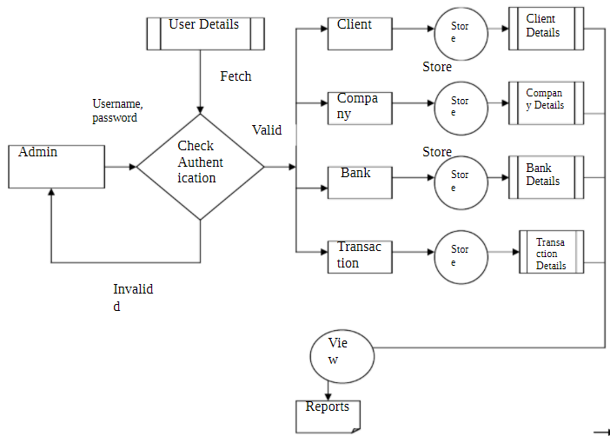
Block Diagram

Slide 9
SOFTWARE REQUIREMENTS:
Operating System : Windows 10
Platform : DOT NET TECHNOLOGY
Front End : ASP.Net 4.0
Back End : SQL SERVER 2014

Slide 10
HARDWARE REQUIREMENTS:
Keyboard
Mouse
Hard disk 500GB
Ram 4 Gb

Slide 11
CONCLUTION
The FBI appreciates the role of the OIG, its dedication to its task, and the thoroughness of its investigation in bringing to light ways in which the FBI can improve the performance of its mission. The Bureau also appreciates the finding that there was no evidence that bias or improper considerations affected its investigative actions or decisions. Further, while the OIG Report focused on only a handful of individuals, as described above, the FBI is reviewing the recommendations of the OIG and will be taking action that applies far more broadly to FBI leadership, career Special Agents and Intelligence Analysts, and all the various personnel that make the FBI the premiere law enforcement and national security agency in the world. The FBI is extraordinarily cognizant of the need to maintain impartiality and objectivity, and to make certain that the American people trust it to always do so.

