Slide 1
Advanced professional services automation

Slide 2
Abstract
The paper deals with the newest ìkiller applicationî ñ professional service automation (PSA). The solution concept is explained, and the existing and potential users are identified as well as the benefits realized by users. Next the situation on the market is analyzed, main existing solutions are categorized and strength and weaknesses of the major categories are identified. Finally Autotask solution is used as an example to demonstrate the PSA solution functionality

Slide 3
Existing System
To support the development, production, and use of an IT innovation, existing arrangements must be invoked and new arrangements often need to be made.
This new focus suggests that the diffusion of an IT innovation hinges not just on existing institutional arrangements, but also on how institutional entrepreneurs can invoke or create more favorable arrangements.
The market for a new technology itself constitutes a needed institutional arrangement, as early on, its existence and nature may not even be recognized.
New IT often involves new actors and activities for which existing institutional arrangements cannot easily be invoked or needed arrangements do not yet exist.

Slide 4
Disadvantage of Existing System
The problem is that, because actors’ involvements change over time, certain so-called institutional entrepreneurs may not always be such, while those not so identified may on occasion be key players.
PSA is argued to be a solution to problems unique to service-oriented organizations that previous, product-centric software did not address.
However, even if a focused leading vendor had emerged in the PSA community, as SAP and Siebel did in the ERP and CRM communities respectively, we argue that PSA would still founder due to its problematic legitimation, to which we turn next.
When a label is absent or in question, dissemination of the vision is made problematic and cognitive legitimation is undermined.

Slide 5
PROPOSED SYSTEM :
In the PSA community, we became observers for the most part, except that a vendor approached us hoping to demonstrate its products in our school’s executive education program, we were invited to post our research on a conference web site, and, further, an analyst proposed a joint research program with us on the business benefits of PSA.
Besides changing the proposed benefits, some strategies include selling through the VAR channels, so customers are buying from someone they trust, or alliances with the already accepted vendors.
The purpose of the CRM solution is to support all of the customer-centric processes within enterprise, mid-enterprise, and mid-market organizations including marketing, sales, and customer support.

Slide 6
ADVANTAGE
A new breed of software that can track the complex and evolving information related to an IT staff, including schedules, skills, career goals, and knowledge base.
They can also capture performance metrics and let workers map their own career development
Recent scandals have created the need for organizations to more accurately track and report financials. With PSA, executives can now assess the performance of their enterprises in real time.
In order to create the market for PSA among service-oriented firms, institutional entrepreneurs invoked the institutional logic that existed in manufacturing-oriented firms, that operational efficiency can be improved through automation.

Slide 7
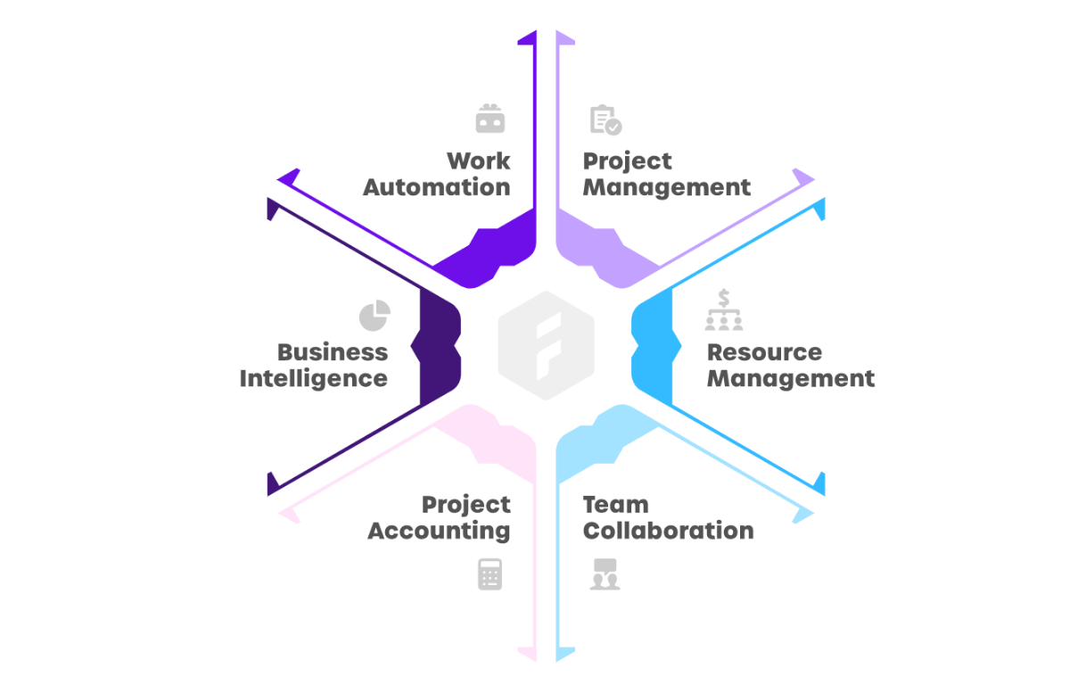
Block Diagram

Slide 8
SOFTWARE REQUIREMENTS:
Operating System : Windows 10
Platform : DOT NET TECHNOLOGY
Front End : ASP.Net 4.0
Back End : SQL SERVER 2014

Slide 9
HARDWARE REQUIREMENTS:
Keyboard
Mouse
Hard disk 500GB
Ram 4 Gb

Slide 10
CONCLUTION
PSA is still an emerging market and still has a long way to go to reach the potential adoption rate. It is currently facing the chasm; however, there are already signs of crossing it. When the early majority is reached, we will see a tremendous growth. There is currently no clear market leader, but as the market develops, there will be intensive consolidation and few vendors will dominate the market. Vendors of solutions like Autotask, who realize first, that the value proposition must be changed and are able to offer and communicate it to the market, have the best chance to be one of those leaders. Customers have the most to gain from this development. There is no doubt, that to master the customer relationship management and become a truly customercentric organization, the PSA solution will soon become a requirement for every service oriented company.

Slide 11
REFERENCE
i) Taking Your Service Business to the Next Level, The Kyros Group, March 2002
ii) Autotask Business Plan, March 2002
iii) Professional Service Automation: End-User Research Study, Aberdeen Group, November 2001
iv) Professional Service Automation: Integrated Solutions Optimize Services Supply Chain Performance and Increase Profitability, Aberdeen Group, January 2001
v) PSA Consulting Organizations Are Optimistic About the Future but Face Operational Hurdles in Europe, IDC Press Release, 31 May 2001

Slide 12
vi) Moore, Geoffrey A., ì High-Tech Marketing Illusion, Crossing the Chasmî, New York: Harper Collins Publishers, 1995
vii) Professional Services Automation ñ Return on Investment Study Results, IDC White Paper, 2000
viii) Tiazkun, S., PSA for the Little Guy, Professional Services Automation Applications Bulletin, IDC, March 2002
ix) Vendor Profile: Autotask Group, Aberdeen Group, March 2002
x) Autotask Sales Presentation, March 2002

