Slide 1
Student library system and attendance system

Slide 2
Abstract
RFID is a radio frequency based technology which is used to transmit data wirelessly. The combination of RFID and IP provides accuracy to the system. Our proposed system manages all the student activities like attendance and library management system. Although there are many other biometric techniques but modality of face is the unique characteristic of a person which can be used to mark the attendance accurately. For library system, the barcode of the book as well as user’s RFID card will be scanned while issuing and borrowing of the book.

Slide 3
Existing System
The existing attendance system present in many of the universities is traditional manual and it is taken on papers while lecturer is conducting the lecture.
In case of library management system barcode and token card system is used. Students are using different types cards for issuing books from library.

Slide 4
Disadvantage of Existing System
There are numerous disadvantages of using the traditional college management system .
Besides, there are chances of getting proxies and since attendance is marked on paper sheet there is a high chance of losing the data also to store the data in database, a lot of manual work needs to be done.
In case of traditional library management system, usually library system uses barcode system and the students have to maintain different reader's and borrower's card.
There is no proper system present which strictly follows the deadline of returning of book.
Librarian has a lot of manual work for maintaining the book and it needs more human labor.

Slide 5
PROPOSED SYSTEM :
Smart ID system is mainly based on passive RFID card for students. Students can use their unique cards for attendance management and library management also.
RC522 readers, raspberry pi 3b and RFID are main components of system.
In case of attendance management system students need to scan their ids first while entering into the classroom, at the same time for student authentication image will be captured through camera. Students’ unique id along with their respective photos are stored in database.
Camera is placed on raspberry pi and to mark attendance that captured image will be compared with existing image in database.

Slide 6
ADVANTAGE
Usage of High Frequency (HF) active RFID tags against passive Low frequency (LF) RFID tags for better performance and flexibility of users.
There arises a need for a more efficient and effective method of solving this problem.
Performance evaluation of combination of thumbprint, facial recognition and RFID technology to students’ attendance monitoring problem.
The ability of RFID systems to deliver precise and accurate data about tagged items will improve efficiency and bring other benefits to business community and consumers alike in the not distant future.
The antenna is used in series resonant circuit, formed by capacitor, inductor and resistor.

Slide 7
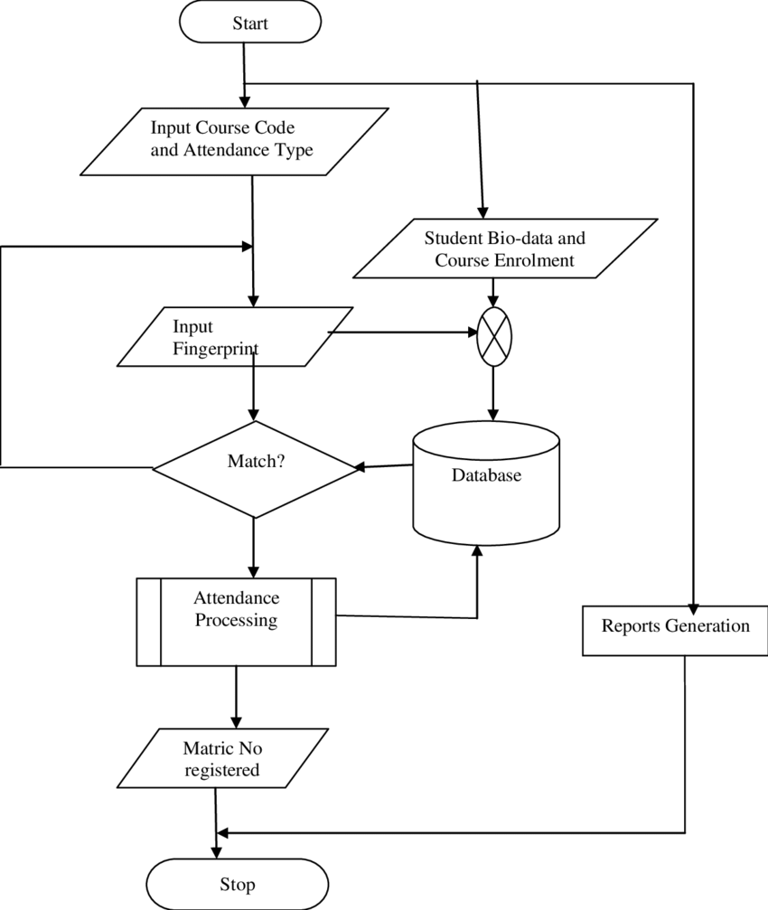
Block Diagram

Slide 8
SOFTWARE REQUIREMENTS:
Operating System : Windows 10
Platform : DOT NET TECHNOLOGY
Front End : ASP.Net 4.0
Back End : SQL SERVER 2014

Slide 9
HARDWARE REQUIREMENTS:
Keyboard
Mouse
Hard disk 500GB
Ram 4 Gb

Slide 10
CONCLUTION
We conclude Smart Id as a system for attendance and library management. This system reduces the possibilities of proxies and save time. Similarly, for library, it will manage the issuing and borrowing the books. This will reduce the manual intervention and errors and provide fast issuing, reissuing and searching of books.

Slide 11
REFERENCE
[1] Darshankumar Dalwadi* m Insiya Guriwala,Shiwangi Chaudhary, Miloni Kapadia & Megha Savalia .“Implementation of Attendance Sysem based on RFID and GSM with respect to power saving concept” .Accepted 01 April 2016.
[2] Sree Gowri Addepalli, Sree Lakshmi Addepalli."Library Management System Using RFID Technology" .Sree Lakshmi Addepalli et al, / (IJCSIT) International Journal of Computer Science and Information Technologies, Vol. 5 (6) , 2014
[3] P Prudhvi Kiran,Ravi Kumar G."Image Processing Based Student Attendance System using Raspberry PI" nternational Journal Of Engineering And Computer Science ISSN:2319-7242 Volume 6 Issue 4 April 2017, Page No. 21145-21148 Index Copernicus value (2015): 58.10 DOI: 10.18535/ijecs/v6i4.60.
[4] https://github.com/
[5] https://en.wikipedia.org/wiki/Haar-like_feature
[6] Creating a Cascade of Haar-Like Classifiers: Step by Step Mahdi Rezaei Department of Computer Science, the University of Auckland

