Slide 1
Customer relation process scheme

Slide 2
Abstract
Customer relationship management (CRM) has the potential for achieving success and growth for organizations in the nowadays environment of extensive competition and rapid technological development. CRM enables organizations to know their customers better and to build sustainable relationships with them. However, CRM is considered as buzzword and it is not understood well. The main components of CRM are people, technology, and processes. This paper provides an extensive review of the literature regarding the CRM processes. This review aims to increase the understanding of the different perspectives and the various types and levels of CRM processes. This paper reveals that there are four major perspectives of CRM processes which are customer facing level processes, customer oriented processes, cross functional CRM processes, and CRM macro-level processes.

Slide 3
This paper recommends that for ensuring the successful adoption and implementation of any CRM initiative, organization should understand the different levels of CRM process and the integrated activities among the CRM processes at each level. In addition, for organizations to be successful adopters and implementers of CRM programs/systems, they should understand the need for business process reengineering and effective anticipation and management of the change that may accompany any CRM initiative. This paper suggests a pre-implementation plan for CRM programs/systems. Such a plan aims to initiate and communicate a customer-oriented culture within the organization. This step emphasizes on increasing the understanding of CRM concept and communicating and spreading the knowledge of the promising benefits of CRM programs/systems to all parties in the organization. All that will contribute in increasing the success rate of CRM programs/systems implementation.

Slide 4
Existing System
The organization's customer strategy entails the identification of the existing and potential customer base and recognition of the most appropriate form of customer segmentation.
The existing academic literature and practical applications of CRM do not provide a clear indication of what specifically constitutes the implementation of CRM processes.
It should be noted that though all three subsections of the hypothesis are in the same direction, the possibility exists that the magnitude of the effect across the three stages varies.
To strengthen the insight and veracity of our analysis, we also collected objective performance measures for the existing set of firms.

Slide 5
Disadvantage of Existing System
Customer process encompasses the customer activities performed to satisfy a need or to solve a problem.
The process of relationship evolution can be subject to termination at any point through customer causes (ceasing of category consumption), competitive causes, or internally unintended (attrition through service problems) or internally intended (customer firing) causes.
The determinate nature of the PLS approach avoids parameter identification problems that can occur under covariance-based analysis.
When dependent and independent variable data are collected from a single informant, common-method bias can be a problem.

Slide 6
PROPOSED SYSTEM :
In addition, this paper intends to propose an enhancement of the CRM process model by suggesting a pre-implementation plan for CRM programs/systems.
The purpose of this step is to be as a pre-implementation plan for CRM programs/systems in which, a better understanding of the concept of CRM and the sense and awareness of the CRM program/system are created within the organization.
Therefore, we followed the guidelines for constructing indexes based on formative indicators, as proposed by Diamantopoulos and Winklhofer (2001).
In this context, CRM technology is the information technology that is deployed for the specific purpose of better initiating, maintaining, and/or terminating customer relationships.

Slide 7
ADVANTAGE
The performance assessment process in which the assuring of achieving an organization's strategic aims in terms of CRM to a satisfactory standard is covered and the basis for future improvement is established.
Its components are shareholder results and performance monitoring.
The understanding of the expected benefits of the CRM program and the enabling of the organization to measure the influence and implication on the organizational performance of the CRM program are other two important dimensions of the benefits of understanding CRM processes.
The information management process in which customer data and information is gathered from customer contact points and used to create proper marketing responses.

Slide 8
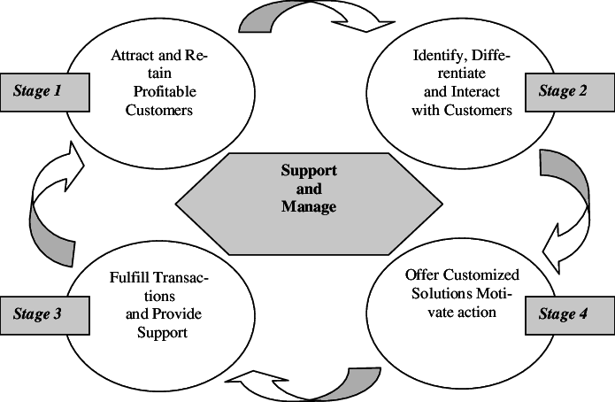
Block Diagram

Slide 9
SOFTWARE REQUIREMENTS:
Operating System : Windows 10
Platform : DOT NET TECHNOLOGY
Front End : ASP.Net 4.0
Back End : SQL SERVER 2014

Slide 10
HARDWARE REQUIREMENTS:
Keyboard
Mouse
Hard disk 500GB
Ram 4 Gb

Slide 11
CONCLUTION
It becomes a matter of fact that the implementation of CRM initiatives and programs have faced with failure over different industries and businesses. In addition, the understanding of CRM and its different aspects like definition, scope, processes, and technology is still limited and shallow. The previous discussion of the fundamental theory of the CRM processes is very important to strengthen the understanding of CRM, before planning for the adoption and implementation of CRM initiative. The understanding of the main components of any CRM initiative is very essential for its success. People, technology, and process are the three main components of CRM. This paper provides an extensive review of the literature for the CRM processes. In essence, there are three CRM types or forms that extend in organizations which are strategic CRM, operational CRM, and analytical CRM. From the critical analysis of the literature there are four main perspectives of CRM processes which are customer facing level processes, customer oriented processes, cross functional CRM processes, and CRM macro-level processes. They are different, integrated, and play complementary roles for achieving the goals of any CRM initiative. The understanding of the CRM processes as one of the main elements of any CRM program is important for understanding the amount of change and for identifying the required integration with other business processes for ensuring the successful CRM implementation.

Slide 12
REFERENCE
[1] L. Ryals and S. Knox, "Cross-Functional Issues in the Implementation of Relationship Marketing Through Customer Relationship Management," European Management Journal, vol. 19, p. 534-542, 2001.
[2] A. Croteau and P. Li, "Critical success factors of CRM technological initiatives," Canadian Journal of Administrative Sciences, vol. 20, pp. 21-34, 2003.
[3] R. K. Srivastava, T. A. Shervani, and L. Fahey, "Marketing, Business Processes, and Shareholder Value: An Organizationally Embedded View of Marketing Activities and the Discipline of Marketing," Journal of Marketing, vol. 63, pp. 168-179, 1999.
[4] M. Hsieh, "A case of managing customer relationship management systems: Empirical insights and lessons learned," International Journal of Information Management, vol. 29, pp. 416-419, 2009.
[5] K. Rababah, H. Mohd, and H. Ibrahim, "A Unified Definition of CRM towards the Successful Adoption and Implementation," in the 3rd Lifelong Learning International Conference(3LInC'10), Kuala Lumpur-Malaysia, 2010.

Slide 13
[6] Z. Lun, L.Jinlin, and W. Yingying, "Customer relationship management system framework design of Beijing Rural Commercial Bank," in IEEE International Conference on Service Operations and Logistics, and Informatics (SOLI 2008), 2008, pp. 97-101.
[7] A. R. Zablah, D. N. Bellenger, and W. J. Johnston, "Customer Relationship Management Implementation Gaps," Journal of Personal Selling & Sales Management, vol. 24, pp. 279-295, Fal 2004.
[8] D. J. Finnegan and W. L. Currie, "A multi-layered approach to CRM implementation: An integration perspective," European Management Journal, vol. 28, pp. 153-167, 2010.
[9] R. Kotorov, "Customer relationship management: strategic lessons and future directions," Business Process Management Journal, vol. 9, pp. 566 - 571, 2003.
[10] G. Zhang, Y. Chen, and C. Fu, "A study on the relation between enterprise competitive advantage and CRM based on data mining," in International Technology and Innovation Conference (ITIC 2006), 2006, pp. 1710-1714.

