Slide 1
E-Sales on turkey purchase

Slide 2
Abstract
Today, the number of technological devices such as computers, cell phones, tablets etc. has increased and their usage has become widespread. As a result of frequent use of these technologies depending on situation, these devices have developed even further and became a part of our lives. Development of Internet infrastructure and increase of its usage have led people to interact more with the Internet and it has become an indispensable aspect of our lives. The fact that the Internet offers new opportunities for businesses and consumers formed a basis for development of e-commerce. The purpose of this paper is to determine impacts of electronic commerce and Internet technology in Turkey on both companies and customers through literature reviews.

Slide 3
Existing System
As it is forecast these mega-trends will have crucial implications for corporate activities and customer behaviours, a good many companies have already analysed them in order to shape their strategies and investments and preserve their commercial existence in the future.
The programme also intends to increase domestic savings, to re-channel existing resources towards productive areas, and to improve the production capacity and technological accumulation of the economy.
Economic power shifting from developed to developing countries creates an urgent need for retailers to revisit their existing positions within the market.

Slide 4
Disadvantage of Existing System
It is believed that all these facts will increase the spare time of people and, therefore, electronic commerce will have impacts on both economic and social lives of the society.
However this problem, the decrease in employment caused by redundancies in the long term, can be compensated with the new employment opportunities created by information technologies (database specialist, biotechnology expert, web designer, solution architect, Internet strategy specialist, programming etc.).
The concerns of people who refrain from performing all of these procedures and even those who carry out their transactions in electronic environments are tried to be eliminated with laws and regulations issued by governmental bodies.

Slide 5
PROPOSED SYSTEM :
The purpose of this report is to present extensive data to potential investors, regulators, and other stakeholders, while analysing the current state and future projections of traditional and organised retail in Turkey in light of emerging trends.
However, shopping centers with different concepts and serving different purposes will be more advantageous in the future. Istanbul has turned into a regional hub for peripheral countries, further attracting foreign investors.
The internet is not a domain which solely serves shopping purposes.
The number of individuals who travel for shopping purposes has increased, as pointed out in the Global Shopping Report of the United Nations Tourism Organisation (UNWTO).

Slide 6
ADVANTAGE
As an instrument that astounded everyone since the day it entered to our lives, television has been considered as one of the most efficient instruments due to its audiovisual property.
Electronic commerce will reduce the time spent on performing tasks, and the time required to monitor the daily routine works, and thus the costs will decrease and consequently the efficiency will go up.
It is possible for them to manage customer demands quickly and efficiently.
Phone is the most important means used in e-commerce. The reason for this is the presence of smart phones that are commonly used by almost everybody.

Slide 7
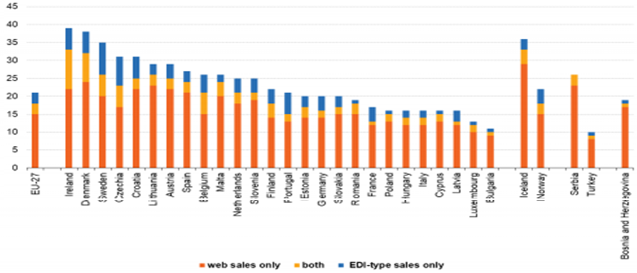
Block Diagram

Slide 8
SOFTWARE REQUIREMENTS:
Operating System : Windows 10
Platform : DOT NET TECHNOLOGY
Front End : ASP.Net 4.0
Back End : SQL SERVER 2014

Slide 9
HARDWARE REQUIREMENTS:
Keyboard
Mouse
Hard disk 500GB
Ram 4 Gb

Slide 10
CONCLUTION
When compared to the previous years, the number of individuals using Internet for ordering or purchasing goods or services via the Internet for personal use increased. And this indicates that Turkish society showed progress in terms of electronic trade. In comparison with traditional marketing or commerce rates, the volume of electronic trade is increasing. The increase in the Internet subscriptions, people’s dependency on the Internet and other means of e-commerce, proliferation of cell phones, availability of smart phones in particular, campaigns of service provider phone operators especially regarding the Internet connection, cause e-commerce to have a profound place in the lives of Turkish people, just as it is worldwide. The availability of cell phones and Internet packages especially among young people and high school and university students in particular, makes this group dependent on the Internet. Since the universities now use automated systems, students carry out many of the procedures, their grading in particular, through e-commerce. Citizens began to carry out their procedures in an electronic environment through systems such as e-business, e-government, etc.

Slide 11
REFERENCE
1. Başhan, F. (2011). İnternetİn Çeşİtlİ Yönlerİyle Türk Toplumunca Benİmsenmesİ: Karaman Örneğİ. İşletme Ana Bilim Dalı İşletme Bilim Dalı Yüksek Lisans Tezi. Karaman.
2. Budak, B. (2010). E-ticaret Internet ortamında ticaret. Istanbul: etap yayınevi, 19
3. Defining and Measuring E-Commerce: a Status Report,DSTI/ICCP/IIS(99)4/FINAL,OLIS : 07-Oct-1999,Dist.: 08-Oct-1999.
4. Ford, W., & Baum, M. S. (2000). Secure electronic commerce: building the infrastructure for digital signatures and encryption. Prentice Hall PTR.
5. Jahns, G. (2006). Bilgi İşlemenin Tarihçesi. Çevirmenler: Pınar Demİrcİoğlu ve İsmail Böğrekcİ,Jahns, Gerhard..

Slide 12
6. Kalakota, R., & Whinston, A. B. (1996). Frontiers of electronic commerce. MA: Addison-Wesley.
7. Kalayci, C. (2008). Elektronİk Tİcaret ve Kobİ’lere Etkİlerİ, Uluslararası İktisadi ve İdari İncelemeler Dergisi, 1(1).
8. Kirçova, İ. (2000). İnternette Pazarlama. Beta Basım Yayım, 6.
9. Mesafelİ Sözleşmeler Yönetmelİğİ. (27 November 2014). Official Gazette, 28(29188).
10. Munack, A. & Joseph, St. Michigan The History of Information Processing. Handbook of Agricultural Engineering Volume VI Information Technology. USA: ASABE.

