Slide 1
Transport maintenance system

Slide 2
Abstract
A model of vehicle maintenance system, realized trough simulation modeling is presented in this article. The model covers all routine activities related to movement, maintenance and regulations. Activities are done by a certain number of specialists. The result of the model is obtaining information about the workload of the specialists, queuing time of vehicles and other statistical information

Slide 3
Existing System
These opportunities generally include: refactoring a process on the purpose of reducing complexity or duration, simplifying an existing feature to improve the engagement of the customer, consolidating, reducing infrastructure costs, etc.
Due to time limitation, the study will focus on current existing vehicle technologies and mainly investigate cases where the transport provider outsources the vehicle maintenance to the truck OEM.
It is not possible for organization to create opportunities in its environment and the environment does not need the organization in order to exist.
The industrial network approach assumes that the existence of business relationships has a significant importance.

Slide 4
Disadvantage of Existing System
In order to reduce the direct maintenance cost, the ability of the management team to deal with the maintenance management implementation problem should be high.
However, if they decide not to sign a contract then they have to pay the repairs done in the workshop each time a problem occurs and which is costly for them.
The truck OEM then needs to give a replacement truck, as solving the problem in the workshop might take some days because they might lack some parts when the problem occurred.
The company never says no to the customer demands, therefore some problems can occur sometimes about the planning process.

Slide 5
PROPOSED SYSTEM :
In order to manage maintenance, many different steps, sequences of activities or the best practices have been proposed by different authors in the history.
The purpose of this master thesis is analyzing and increasing the value of maintenance from different perspectives through reduction in cost of poor maintenance and investigating future expectations of actors.
Some of the features can be unutilized while the some features are exploited when using the resources for a particular purpose.
The purpose and research questions of this master thesis focuses on cost, value, poor maintenance and future expectations regarding maintenance operations.

Slide 6
ADVANTAGE
It has been stated that strategy has five different core aspects which are the purpose, organization, competitive performance of the firms, strategic leadership and direction.
This has led researchers to develop new research topics which are designing the ideal model to manage maintenance operations and also achieving efficiency and effectiveness of maintenance management .
With the other words, efficiency can also be interpreted as being able to provide the same or better maintenance for the same cost.
The way that interdependencies are handled is very important since they affect the efficiency and effectiveness directly.
The truck OEM offers service contracts in order to increase efficiency and effectiveness of maintenance operations for their customers.

Slide 7
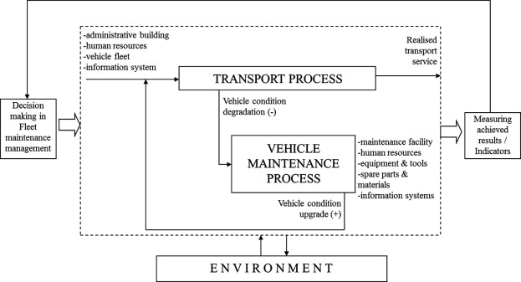
Block Diagram

Slide 8
SOFTWARE REQUIREMENTS:
Operating System : Windows 10
Platform : DOT NET TECHNOLOGY
Front End : ASP.Net 4.0
Back End : SQL SERVER 2014

Slide 9
HARDWARE REQUIREMENTS:
Keyboard
Mouse
Hard disk 500GB
Ram 4 Gb

Slide 10
CONCLUTION
The histogram for the distribution of the queue length shows that its maximum length at certain times can reach 20 vehicles and their waiting time can be up to 6 hours. The comparative analysis of the analytic research data about the system and the data from the simulation model are presented in tables 2 and 3, and the relative statistical error of TMS indexes is 11%, which shoes good coordination between the two modeling methods.The simulation model gives the opportunity for carrying out experiments with varying input data about the system as well as opportunity for researching its behavior over the time, which facilitates the system optimization activities.

