Slide 1
Online Item Purchase and Payment Gateway using Paypal

Slide 2
Abstract
As online transactions continue to increase and become a significant part of the global economy, the ability to accept payments online becomes more important for businesses. This paper evaluates the literature and provides current information for IS researchers and instructors focusing on electronic commerce. In this paper, we explore the components of e-credit providers (conventional, person-to-person, and third-party) and explain how each system processes a single transaction. We then analyze several market leaders in each segment and summarize the strengths and weaknesses of each company. We provide guidelines for selecting an e-credit provider and highlight the options that apply best to online businesses. Finally, we outline potential areas of future research and provide a simple tutorial on creating a business account with PayPal website Payments Standard as an example of an online payment provider.

Slide 3
Existing System
Most widely used and trusted electronic payment system both online and offline. Leverages existing credit accounts.
Despite the growth and importance of online payment in the current global economy, little academic literature exists in this area that integrates the disparate research streams about online payment systems and describes their implementation.
Because of existing electronic infrastructure surrounding e-credit, these types of processes have been the easiest for businesses to adapt for viable commercial use online. E-credit payments are the focus of this paper.
The generated code into its existing site allows a business to collect funds from its website.

Slide 4
Disadvantage of Existing System
In particular the problem of maintaining security while providing anonymity in e-cash solutions could be addressed so that e-cash solutions can approach the liquidity of traditional cash payments.
Such as music or art, micropayments are seen as a way for content creators to obtain revenue and avoid the free riding problem.
These components interact with the customer, merchant, merchant bank, and credit card issuer during a typical transaction.
The concept of online micropayment systems to facilitate the payment for content online has been theorized and debated, but only limited commercial success has been realized.

Slide 5
PROPOSED SYSTEM :
The growth in spending on the Internet, together with the underlying need for secure transactions, increases the importance of online payment systems.
Online payment systems can be broadly defined as the means and processes involved in conducting transactions online; however, this description can be expanded to include the online monetary connections between sellers, buyers, financial institutions, and intermediaries.
Online payment systems have been around for several years, yet are now becoming ubiquitous with the increased common use of the Internet.
The online payment options available on the Internet mirror those provided by physical retailers.

Slide 6
ADVANTAGE
Some of the benefits provided by online payment systems include improved cash flow efficiency, guaranteed transactions, reduced costs, increased protection of sensitive information, and increased protection of the payment provider.
Online payment providers assist businesses in keeping costs of receiving payments low while enhancing and improving the company’s ability to collect funds.
Finding an efficient and cost-effective way to collect money is of great importance for any company.
Many services offer the ability for customers to make a one-time payment or to pay by subscription.

Slide 7
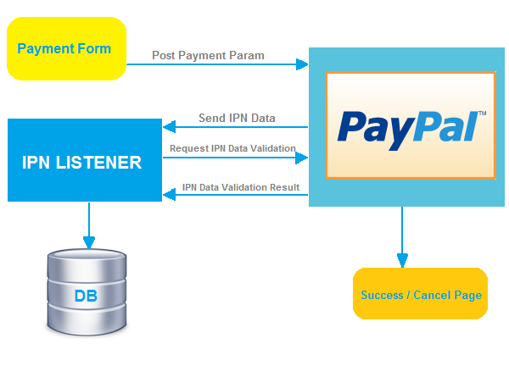
Block Diagram

Slide 8
SOFTWARE REQUIREMENTS:
Operating System : Windows 10
Platform : DOT NET TECHNOLOGY
Front End : ASP.Net 4.0
Back End : SQL SERVER 2014

Slide 9
HARDWARE REQUIREMENTS:
Keyboard
Mouse
Hard disk 500GB
Ram 4 Gb

Slide 10
CONCLUTION
As businesses increasingly adopt online payment technologies, researchers, faculty, and students need to understand the resulting benefits and problems. The systems currently available should decrease costs, provide risk management, and help provide competitive advantage to users. Electronic payment technologies offer both opportunities and challenges. The largest challenge to the use of online payments is security and fraud prevention. This challenge is expected to become greater as e-commerce becomes more prevalent. The potential of e-cash, micropayments, wireless commerce, and new architectures for online payment offer fertile ground for future research.

Slide 11
REFERENCE
Afuah, A. and Tucci, C. (2002). Internet Business Models and Strategies: Text and Cases. Boston: McGraw-Hill Higher Education.
Au, Y. A. and Kauffman, R. J. (2001), "Should We Wait? Network Externalities, Compatibility, and Electronic Billing Adoption," Journal of Management Information Systems 18:(2), pp. 47-63.
Ball, K. (2001), "The Use of Human Resource Information Systems: A Survey," Personnel Review 30(5/6), pp. 677-693.
Bills, S. (2002), "PayPal is First Client of Wells Processing Service," American Banker 167(222), pp. 7.
Chau, P. Y. K. and Poon, S. (2003), "Octopus: An E-cash Payment System Success Story," Communications of the ACM 46(9), pp. 129-133.

Slide 12
Dhamija, R., Heller, R., and Hoffman, L. J. (1999), "Teaching e-Commerce to a Multidisciplinary Class," Communications of the ACM 42(:9), pp. 50-55.
Herzberg, A. (2003), "Payments and Banking with Mobile Personal Devices," Communications of the ACM 46(5), pp. 53-58.
Hou, X. and Tan, C. H. (2005a), "A New Electronic Cash Model," Paper presented at the International Conference on Information Technology: Coding and Computing, Las Vegas, NV, April 4-6, pp. 374-379.
Kreyer, N., Pousttchi, K., and Turowski, K. (2003), "Mobile Payment Procedures: Scope and Characteristics," e-Service Journal 2(3), pp. 7-22.
Panurach, P. (1996), "Money in Electronic Commerce: Digital Cash, Electronic Fund Transfer, and Ecash," Communications of the ACM 39(6), pp. 45-50.

