Slide 1
Employee System Maintenance and Leave Approval System

Slide 2
Abstract
This project is aimed at developing an online leave management system that is of importance to either an organization. The Leave Management System (LMS) is an Intranet based application that can be accessed throughout the organization or a specified group/Dept. This system can be used to automate the workflow of leave applications and their approvals. The periodic crediting of leave is also automated. There are features like email notifications, automatic approval of leave, report generators etc in this system. Leave Management application will reduce paper work and maintains record in more efficient way.

Slide 3
Existing System
In the existing paper work related to leave management, leaves are maintained using the attendance register for staff.
The staff needs to submit their leaves manually to their respective authorities.
This increases the paperwork & maintaining the records becomes tedious.
Maintaining notices in the records also increases the paperwork.
In the existing paper work related to leave management, leaves are maintained using the attendance register for staff.

Slide 4
Disadvantage of Existing System
It does not ensures security of every record .
It increases the redundancy of data and gives various facilities .
It leads to loss of data .
The staff has to write a letter to its superior for leave which makes it a tedious work for the staff.

Slide 5
PROPOSED SYSTEM :
To automate the existing leave management in educational institutes.
To decrease the paperwork and enable the process with efficient, reliable record maintenance by using centralized database, thereby reducing chances of data loss .
To provide for an automated leave management system that intelligently adapts to HR policy of the organization and allows employees and their line managers to manage leaves and replacements for better scheduling of work load & processes.
The main objective of the proposed system is to decrease the paperwork and help in easier record maintenance by having a particular centralized Database System, where Leaves and Notices are maintained.

Slide 6
ADVANTAGE
This system can be used to automate the workflow of leave applications and their approvals.
The periodic crediting of leave is also automated.
There are features like email notifications, automatic approval of leave, report generators etc in this system.
Leave Management application will reduce paper work and maintains record in more efficient way.
It is used to develop console and graphical user interface application along with Windows Forms or WPF application , web sites , web application and web services in both native code together with managed code for all platforms.

Slide 7
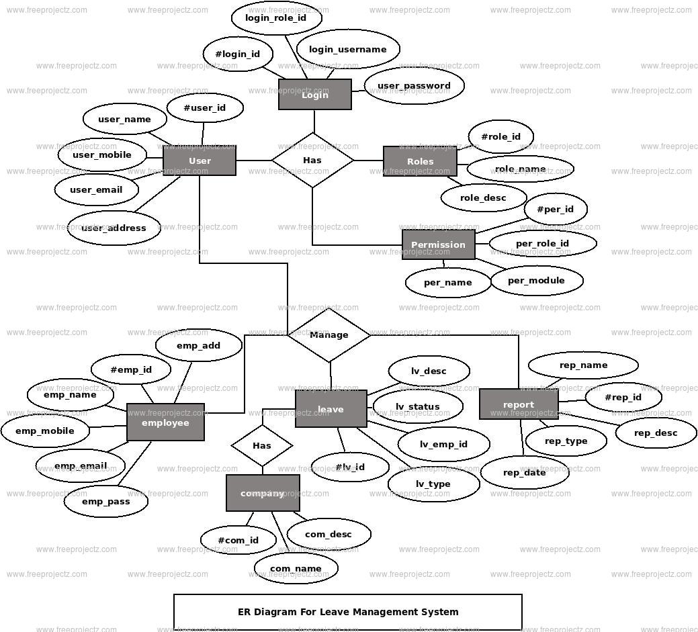
Block Diagram

Slide 8
SOFTWARE REQUIREMENTS:
Operating System : Windows 10
Platform : DOT NET TECHNOLOGY
Front End : ASP.Net 4.0
Back End : SQL SERVER 2014

Slide 9
HARDWARE REQUIREMENTS:
Keyboard
Mouse
Hard disk 500GB
Ram 4 Gb

Slide 10
CONCLUTION
It is aimed at automating the existing manual system for applying the leave by the employee and process the leave through HOD and Principal. It helps in maintaining the records of the employees which will help human resource team to manage leave approval, leave cancellation and report generation. It is useful in organisations with large number of employees. It’s a faster approach as it takes less time when compared to a manual process.There is a proper management of database as the one handled by manual system is not always accurate and even there is a misplacement of databases which could cause a severe problem in near future.It is very reliable and it leads to an efficient report generation.

Slide 11
REFERENCE
[1]. www.wikipedia.com
[2]. http://csharp.net-informations.com
[3]. http://msdn.microsoft.com
[4]. http://net-informations.com
[5]. Notes on c# BY Herbert Scildht
[6]. The Complete Guide to C# Programming by Er.V.K.Jain
[7]. C# Programming by E. Balgurusamy

