Slide 1
Cibil system

Slide 2
Abstract
A cibil system to keep tracks of peoples credit scores and dues. The system is similar to the real cibil system with an enhancement(Here the defaulter can view his status and can apply for improvement by good behavior). Our software system consists of admin login ,Cibil associates login and individual login. Here cibil associates are banks or companies who want to report faulty members. They may send faulty member data and this is passed on to the cibil admin. The cibil admin can view the data and approve it to be added after inspection. The system also consists of member login for which a member first needs to register. He can then check if he is listed in the black list and for what. The member may then apply for the removal along with the receipt of fine paid or other documents of proved good behavior.

Slide 3
Existing System
The banks have to send the transaction data of every user to CIBIL from time to time (with certain frequency). Currently, the frequency of data collection by CIBIL is around 1 month.
Banks and financial institutes partner with CIBIL and send this data to one central portal.
As the banks have data related to the financial transactions, credit card usage and loans, the data collected is purely based on how the person has managed his transactions with the financial institutions and credit usage.
In the present system a user can be reminded with the calculated CIBIL score based on the repayment of the loans that the user availed.

Slide 4
Disadvantage of Existing System
No human interaction.
Requires internet connection.

Slide 5
PROPOSED SYSTEM :
The proposed law CIBIL associates include member banks and credit institutions or companies who want to report their faulty members.
They may send faulty member data and this is passed on to the CIBIL admin.
The system also consists of member login for which a member first needs to register. Thus the CIBIL system is a fully functional and user friendly project.
In this work, two different types of Credit Scoring system have been proposed where one belongs to the scoring of the credit of an individual, which can be used by the individual to pursue loans or credit invoices.

Slide 6
ADVANTAGE
Individuals can view their credit ratings without going to the company for enquiry.
Individuals can even apply for improvement online.
Saves user time and money.
Automates the process of credit score calculation.
Saves organization resources and efforts.

Slide 7
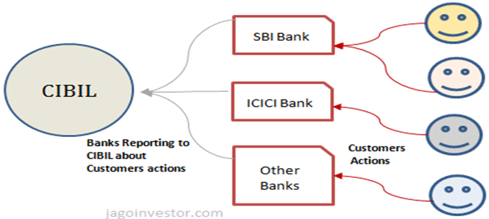
Block Diagram

Slide 8
SOFTWARE REQUIREMENTS:
Operating System : Windows 10
Platform : DOT NET TECHNOLOGY
Front End : ASP.Net 4.0
Back End : SQL SERVER 2014

Slide 9
HARDWARE REQUIREMENTS:
Keyboard
Mouse
Hard disk 500GB
Ram 4 Gb

Slide 10
CONCLUTION
The web application collects various information about the user. Here the web application is mainly made for providing awareness over the CIBIL score and properly providing the various mechanisms to pay the due within the time. This application uses the block chain technology which gives the security to stay strong in your finance. This system is mainly accessed on the Permanent Account number (PAN card).the web Application would send the notification to the registered email id and the register mobile number, which is basically generated as the question type module. The questions are sending the clients on or before ten days of the due date. Based on the user answer it is further processed. If the client answer is “NO”, the web application works further on the personal detail of the Area of Interest, and display the various part time jobs that would able to earn money and repay the due amount within the time. However by paying the due amount within the time would able to maintain a constant CIBIL score. If the client answered the question as “YES”, then the client will be motivated and encouraged to pay the amount within the time.

