Slide 1
Florist online purchasing

Slide 2
Abstract
With the rapid development of Internet, e-commerce had been widely using by more and more people, so had shopping online . The J2EE architecture was adopted in this paper. An florist’s shop online system was designed and implemented based on the analysis of the actual needs of users. Through running test for a period of time, the system could be operated steadily, and its function was complete. The system could achieve flower sales on line that was highly efficient and convenient, and the design purpose was achieved also.

Slide 3
Existing System
The system administrator was exist in the initialization of system. They were added into the database manually in the database design.
A two-step process was utilized: first, millennial consumers were invited to participate in focus group discussions where open-ended questions were used to elicit their existing perceptions toward floral products.
The focus group responses were analyzed and paired with existing literature and information from other industries to create questions that were included in a nationwide online survey.
Floral firms should explore the existing companies that use mobile phone GPS to track customers and offer tailored content (e.g. GPShopper, etc.).

Slide 4
Disadvantage of Existing System
As the important link in the flower sales system, the florist’s couldn't meet the needs of the vast number of consumers yet after the traditional sales mode just like flowers retail, flower art design etc.
To development of an online flower shop sales system had become the urgent need to resolve problems.
However, it was a complicated project to develop the florist’s shop online system, the further improvement of system must be done combined the problems appeared in the course of the actual use.
It was consisted of a set of class and interface composition byJava language writing.

Slide 5
PROPOSED SYSTEM :
The purpose of the FMRF is to collect funds from industry sources to be used in the support of funding consumer research benefiting the entire floriculture industry.
Many millennials indicated that they were not aware of or failed to consider the benefits associated with floral products.
Firms can remind customers about the benefits associated with floral products. Specifically, flowers brighten up/refresh their homes and mindsets, improve air quality, and reduce stress.
All the benefits associated with flowers make the products more meaningful since they serve a dual purpose (i.e. décor and benefits).
This improves their value to the customer and may increase the customer’s likelihood of purchase.

Slide 6
ADVANTAGE
An florist’s shop online system was designed and implemented based on the analysis of the actual needs of users.
The system could achieve flower sales on line that was highly efficient and convenient, and the design purpose was achieved also.
Flower product management to add, delete and show of classification about flower product .And it can be used recommend flower product to users based on flower product sales and each manufacturer prestige.
User management to management member information and administrator information in web site.
This can be a challenge for businesses since they need to weigh the pros of increased customer satisfaction with the cons of decreased efficiency.

Slide 7
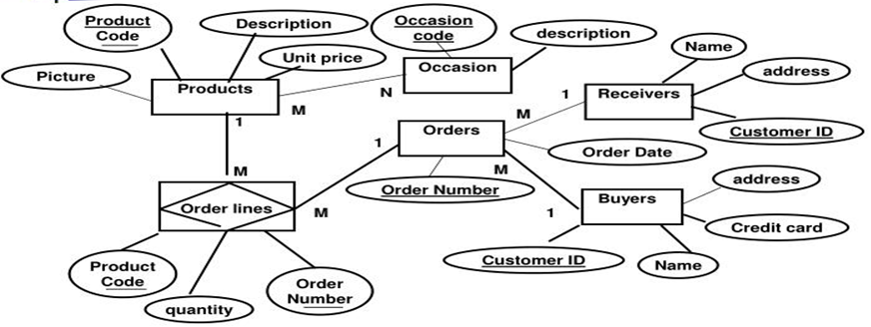
Block Diagram

Slide 8
SOFTWARE REQUIREMENTS:
Operating System : Windows 10
Platform : DOT NET TECHNOLOGY
Front End : ASP.Net 4.0
Back End : SQL SERVER 2014

Slide 9
HARDWARE REQUIREMENTS:
Keyboard
Mouse
Hard disk 500GB
Ram 4 Gb

Slide 10
CONCLUTION
The florist’s shop online system was an important application of e-commerce sales model. It could realize online trading of flowers. In the rapid development of the Internet today, the florist’s shop online system would have a great market potential because the flowers had certain refreshing time. Based on elaborating the necessity of development of the florist’s shop online system, the J2EE technology to develop the system was introduced at first in this paper. then the user demand of the system was analysed deeply. A scientific and reasonable database was designed according to the customer demand. Finally, the design of the whole system and the key code of implementation part in the system realization was given. After a period of time in the system test and trial operation, it had been shown that the system had accomplished the desired basic goal. And it had a certain inspiration and reference significance to other similar online shopping system. However, it was a complicated project to develop the florist’s shop online system, the further improvement of system must be done combined the problems appeared in the course of the actual use.

Slide 11
REFERENCE
[1] Huangxianying. The design of servlet in the J2EE platform. Computer application research 2002.01:140-141
[2] Duming,Lichaochun. the design and implementation of Struts+EJB in J2EE platform [J], Computer application research,2005(3):223-225,228
[3] Feisike product research and development center.JSP application development steps.Beijing:Publishing house of electronics industry,2002
[4] http://baike.baidu.com/view/3542.htm
[5] http://baike.baidu.com/view/25611.htm
[6] http://baike.baidu.com/view/4242783.htm

