Slide 1
Software development life cycle

Slide 2
Abstract
This history column article provides a tour of the main software development life cycle (SDLC) models. (A lifecycle covers all the stages of software from its inception with requirements definition through to fielding and maintenance.) System development lifecycle models have drawn heavily on software and so the two terms can be used interchangeably in terms of SDLC, especially since software development in this respect encompasses software systems development. Because the merits of selecting and using an SDLC vary according to the environment in which software is developed as well as its application, I discuss three broad categories for consideration when analyzing the relative merits of SDLC models. I consider the waterfall model before the other models because it has had a profound effect on software development, and has additionally influenced many SDLC models prevalent today. Thereafter, I consider some of the mainstream models and finish with a discussion of what the future could hold for SDLC models.

Slide 3
Existing System
The objective of this review is to examine the classification of the existing SDLC(Software Development Life Cycle) early phases and define the set of software process quality metrics.
Although there is an abundance of SDLC models in existence, we shall consider the most important ones or those that have gained popularity.
Created research questions to define are the classification of the software development life cycle phases, the existing models/approaches for software quality in early phases, activities that are performed during these phases and metrics accordingly.
By analyzing the existing software process early phases, methodologies and metrics to assess and evaluate the quality of the software we have answered all four research questions.

Slide 4
Disadvantage of Existing System
The top-down approach needs to be tempered with a lookahead step in order to account for software reusability or the identification of risks and issues at an early stage.
Applying Agile to large projects can be problematic because it emphasizes real-time communication, preferably on a personal, face-to-face basis.
Incremental implementation enables changes to be monitored, and issues to be isolated and resolved to mitigate risks.
Issues with schedule feasibility might lead to the project’s timeline being extended, or the scope of the program or apps features to be scaled back. Quality assurance (Testing software and reporting any issues to the developers.) testers perform the testing and report any issues to the developers.

Slide 5
PROPOSED SYSTEM :
The design stage incorporates verification (to assess whether it is fit for purpose), the development stage has unit and integration testing, and the validation stage contains system testing as its part and parcel.
It’s purpose is to mitigate factors such as the time and effort of extracting trace links.
It is important that all documentation be well written, thorough, consistent, and understandable.
Project managers distribute documentation guidelines to all project members to ensure that the documentation each produces will be complete and consistent.

Slide 6
ADVANTAGE
The risks are then categorized as performance (or userinterface) related risks or development risks.
If development risks predominate, then the next step follows the incremental waterfall approach.
On the other hand, if performance risks predominate, then the next step is to follow the spiral through to the next evolutionary development.
This ensures that the prototype produced in the second quadrant has minimal risks associated with it.
A repository containing lessons learned will enable key parameters to be distilled from the model and a statistical analysis to be performed on their use and efficacy in various categories of projects.

Slide 7
TITTLE | AUTHOR | DESCRIPTION
Production of large computer programs | Benington, H.D. (1956) | The author describes the techniques used to produce the programs for the Semi-Automatic Ground Environment (SAGE) system.
Managing the development of large software systems | Royce, Winston W. (1970) | Many additional development steps are required, none contribute as directly to the final product as analysis and coding, and all drive up the development costs.

Slide 8
TITTLE | AUTHOR | DESCRIPTION
The relationship of system engineering to the project cycle | Forsberg, Kevin and Mooz, Harold (1991) | A new way of portraying the technical aspect of the project cycle clarifies the role and responsibility of system engineering to a project.
A spiral model of software development and enhancement | Boehm, Barry W. (1986) | An outline is given of the process steps involved in the spiral model, an evolving risk-driven approach that provides a framework for guiding the software process, and its application to a software project is shown.

Slide 9
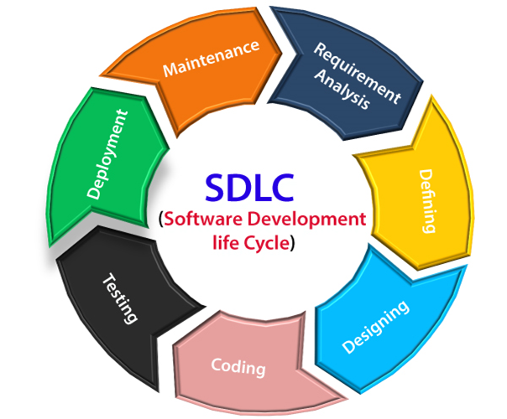
Block Diagram

Slide 10
SOFTWARE REQUIREMENTS:
Operating System : Windows 10
Platform : DOT NET TECHNOLOGY
Front End : ASP.Net 4.0
Back End : SQL SERVER 2014

Slide 11
HARDWARE REQUIREMENTS:
Keyboard
Mouse
Hard disk 500GB
Ram 4 Gb

Slide 12
CONCLUTION
This history column invariably ends with a consideration of the future; history’s importance is in creating a framework for the future. Although in the past software development has influenced systems design in an inordinate way, there should be a fusion of knowledge sharing between the two in both directions in future. Moreover, SDLC models for both disciplines can draw from domains outside their technological boundaries. A large amount of work has been done in other spheres such as behavior analysis, time management, and business management (the Japanese Kanban or Just-In-Time model, for example) that could be borrowed by future SDLC models. To some extent, this is already happening with some models. For example, the Behavior Driven Development technique (facilitates collaboration between various participants) that is part of the Agile model has drawn from behavior analysis. This sharing of ideas from disparate sources to incorporate them in an SDLC model should gather momentum in future.

Slide 13
REFERENCE
[1] Benington, H.D. (1956): Production of large computer programs. In Proceedings, ONR Symposium on Advanced Programming Methods for Digital Computers, June 1956, pp 15-27.
[2] Royce, Winston W. (1970): Managing the development of large software systems. In Proceedings, IEEE Wescon, August 1970, pp 1-9.
[3] Birrell, N. D. and Ould, M.A. (1988): A practical handbook to software development; Cambridge University Press. ISBN 978-0521347921. pp 3-12.
[4] Forsberg, Kevin and Mooz, Harold (1991): The relationship of system engineering to the project cycle. At NCOSE, Chattanooga, Tennessee, October 21- 23, 1991.
[5] Doran, George T. (1981): There's a S.M.A.R.T. way to write management’s goals and objectives. In Management Review, vol. 70.11.

Slide 14
[6] Mooz, H and Forsberg, K. (2001): A visual explanation of the development methods and strategies including the waterfall, spiral, vee, vee+, and vee++ models, pp 4-6.
[7] Boehm, Barry W. (1986): A spiral model of software development and enhancement. In ACM SigSoft Software Engineering Notes, Vol. II, No. 4, 1986, pp 22-42.
[8] Iivari, Juhani (1987): A hierarchical spiral model for the software process: notes on Boehm’s spiral model. In ACM SIGSOFT Software Engineering Notes, vol. 12, no. 1, January 1, 1987. Pp 35-37.
[9] TOGAF 9:The Open Group; http://www.opengroup.org/togaf/.
[10] Jacobson I., Booch G. & Rumbaugh J. (1999): The unified software development process; Addison-Wesley, Reading, Massachusetts.

