Slide 1
School library system

Slide 2
Abstract
Igniting a passion for reading and research is core business for school libraries, inevitably placing the library at the centre of the twenty-first century reading and learning experience. Teacher librarians, librarians and library teams in Australian and New Zealand schools are responding to the learning needs within the school community with a focus on curriculum integration empowered by digital environments. School libraries are challenged to build learning opportunities and lifelong learning through integrated and innovative approaches to information literacy, critical thinking and creativity. The importance of school libraries in connecting students with local and global concerns as part of the curriculum is expected in both countries, placing significant emphasis on digital media, information management and responsive school library collections. Despite differing staffing approaches in Australia and New Zealand, the overall professional expertise is clear and expectations are highlighted through relevant professional standards. School library and information services in Australia and New Zealand continue to have a bright future.

Slide 3
Existing System
The school library exists to provide a range of learning opportunities for both large and small groups as well as individuals with a focus on intellectual content, information literacy and the learner.
The school in the past was entirely dependent upon the textbook. At present, however method of teaching in school has changed.
It provides vital information and ideas that are fundamental for the functioning successfully in our increasingly information and knowledge based society.
School library is capable ofundertaking this important responsibility. It serves to arouse curiosity for learning and supplements the instructional programme for a creative life.

Slide 4
Disadvantage of Existing System
The issues relating to collection development are very similar to those in Australia.
The issues that schools face fall into three main categories: the ebook genre and purpose, the infrastructure required to make ebooks accessible, and the technology required to read the texts.
It has been observed that when the teachers and the school librarians work together, students achieve higher levels of literacy, reading, learning, problem solving and information and communication technology skills.
Although the number of school libraries in primary, secondary and the higher education is growing, yet there are many problems to overcome.

Slide 5
PROPOSED SYSTEM :
A library is a storehouse of information and a key to the knowledge, but the era of information technology revolution has relegated the librarians especially in schools to the background.
The audiovisual media specially the Internet has lured the budding readers away from the printed works like the Pied Piper.
There is a great need for the upliftment of school libraries in India. If the reading habits of the students have to be changed, the conditions of the school libraries have to be improved.
This purpose, the central as well as the state government, the school authorities, the school librarian and the teachers will all have to work together.

Slide 6
ADVANTAGE
It provides details about teacher librarian practice to those involved with performance appraisal.
Provide access to information resources through efficient, effective and professionally managed systems.
Operating relevant and efficient library systems to make resources available.
SCIS has used AACR and AACR2 as its standard for descriptive cataloguing since its inception before the introduction of RDA.
One of the distinguishing features of information literacy teaching in schools is the range of models that have been developed, though only a limited number are designed to be used by students themselves.

Slide 7
TITTLE | AUTHOR | DESCRIPTION
New Literacies: Towards a Renewed Role of School Libraries | Asselin, Marlene. 2004. | The notion of "new literacies" is appearing increasingly in the news in literacy research, journals and books; and in preservice and inservice teacher education.
Supporting Informed Learners in the 21st Century | Bruce, Christine S., Hilary E. Hughes and Mary M. Somerville. 2011. | Drawing on existing research into peopleâ€™s experience of information literacy, it identifies critical experiences of informed learners in each of these three settings.

Slide 8
TITTLE | AUTHOR | DESCRIPTION
Engaging Secondary Students in Lifelong Learning | Bryce, J. and G. Withers. 2003. | The schools selected were not necessarily exemplars although all had an interest in focusing on lifelong learning.
Building a Future ready Personal Learning Network | Cox, Ernie. 2010. | School librarians might add or subtract from this list, but at least one of these factors must impact the daily existence of every member of the school library profession.

Slide 9
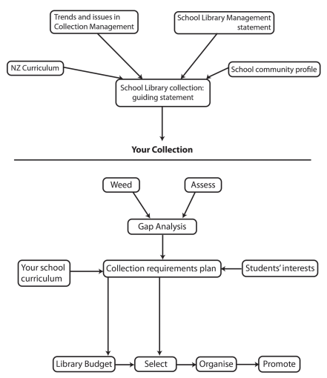
Block Diagram

Slide 10
SOFTWARE REQUIREMENTS:
Operating System : Windows 10
Platform : DOT NET TECHNOLOGY
Front End : ASP.Net 4.0
Back End : SQL SERVER 2014

Slide 11
HARDWARE REQUIREMENTS:
Keyboard
Mouse
Hard disk 500GB
Ram 4 Gb

Slide 12
CONCLUTION
This chapter has highlighted some key aspects of school libraries and school librarianship in Australia and New Zealand. There are comprehensive and exciting changes and developments taking place in the way school libraries can serve their school communities, which reflect the developments taking place in other library sectors or school libraries around the world. Yet even in Australia and New Zealand, there are differences from region to region, or type of school. Nevertheless, the professional standards of engagement, and the overall goal of developing quality curriculum services underpin the work of teacher librarians, librarians and school library teams.

Slide 13
REFERENCE
Asselin, Marlene. 2004. “New Literacies: Towards a Renewed Role of School Libraries.” Teacher Librarian 31(5): 52–53.
Bruce, Christine S., Hilary E. Hughes and Mary M. Somerville. 2011. “Supporting Informed Learners in the 21st Century.” Library Trends 60(1): 522–545. doi: 10.1353/lib.2012.0009. Accessed on 9 December 2016.
Bryce, J. and G. Withers. 2003. Engaging Secondary Students in Lifelong Learning. Camberwell: ACER.
Cart, Michael. 2007. “Teacher-librarian as Literacy Leader.” In Esther Rosenfeld and David V. Loertscher (eds), Toward a 21st-Century School Library Media Program, pp. 262–267. Lanham, Maryland: The Scarecrow Press, Inc
Cox, Ernie. 2010. “Building a Futureready Personal Learning Network.” School Library Monthly 27(3): 34‐35.

Slide 14
Daley, Megan and Jackie Child. 2015. “Makerspaces in the School Library Environment.” Access 29(1): 42–49. http://search.informit.com.au/ documentSummary;dn=064530109882878;res=IELHSS. Accessed on 9 December 2016.
FitzGerald, Lee. 2011. “The Twin Purposes of Guided Inquiry: Guiding Student Inquiry and Evidence Based Practice.” Scan 30(1): 26–41.
Kuhlthau, Carol C., Leslie K. Maniotes and Ann K. Caspari. 2012. Guided Inquiry Design: A Framework for Inquiry in your School. Santa Barbara, CA: Libraries Unlimited.
Library and Information Association of New Zealand Aotearoa (LIANZA). 2016. “Bodies of Knowledge.” http://www.lianza.org.nz/professional-development/bodies-knowledge. Accessed on 9 December 2016.
Ministry of Education (New Zealand). 2007. The New Zealand Curriculum. Wllington: Learning Media. http://nzcurriculum.tki.org.nz/. Accessed on 9 December 2016.

