Slide 1
Labour analyser system

Slide 2
Abstract
The identification of labour market issues in both developed and developing economies critically rests on the availability of data, information and analysis. Labour market information and analysis (LMIA) provides an essential basis for employment and labour policies, and informs the design, implementation, monitoring and evaluation of policies that are better focused and targeted. LMIA also contributes to a reduction in the transaction costs of labour markets as it helps overcome incomplete information of labour market agents.

Slide 3
Existing System
The formal economy is more likely to offer some protection in the form of labour market regulations and some access to formal systems of social protection, both virtually non-existent in the informal economy.
Some of these opportunities may already exist, but they need to be upgraded, or new jobs involving higher technology and skill levels need to be created.
Data from tax audits or labour inspections, when they exist and are publicly available, can also be used to quantify informality although, since they are not usually conducted on a representative sample, it is difficult to extrapolate the results to the population of interest.

Slide 4
Disadvantage of Existing System
This facilitates building the sample of informal production units on which to implement the second survey and thus helps overcome one of the major problems in sampling informal firms, namely that they do not usually appear in official registries.
Such problems as measurement error in the aggregate education data and the endogeneity of both human and physical capital plague estimates of education’s impact on growth.
Some authors have argued that the causality is from growth to education, as periods of sustainable growth generate resources that can be invested in education. Most recent studies, nevertheless, do find education to have a substantial impact on growth, even after correcting for the estimation problems.

Slide 5
PROPOSED SYSTEM :
When informality is due to exclusion from the formal economy, the policy response usually proposed in the literature is a mix of interventions aimed at increasing the productivity of firms and the employability of informal workers, together with measures specifically aimed at poverty alleviation as well as measures to increase aggregate demand.
Proposed activities may range from support for specific aspects (analysis) to comprehensive project development, including support for policy development.
However, the main purpose of LMIA systems that have been established outside academia is the production of information and analysis for policy-makers and other labour market stakeholders.

Slide 6
ADVANTAGE
An employer may take advantage of a hiring subsidy to take on new staff although they would have done so anyway.
Other firms, because of their small size and low level of organization or limited managerial capacity, may not be able to benefit from the potential advantages of belonging to the formal sector, including market access or the possibility to tap into formal credit channels.
Household-based labour force surveys offer a unique advantage to obtain information on the labour market of a country and its structure.
It also considers the impact of vocational training as a tool to provide specific human capital that is useful for performance in the labour market.
Moreover, these studies often assess the single effect of EPL on various labour market performances.

Slide 7
TITTLE | AUTHOR | DESCRIPTION
Employment-led growth and growth-led employment in the recovery | Campbell, D. 2011. | The central problem of employment-led growth is that it is characterized by widespread underemployment, survivalist activities, and persistent poverty.
Employment-to-population ratio | Elder, S. 2011. | A high ratio means that a large proportion of a country’s population is employed, while a low ratio means that a large share of the population is not involved directly in market-related activities, because they are either unemployed or (more likely) out of the labour force altogether.

Slide 8
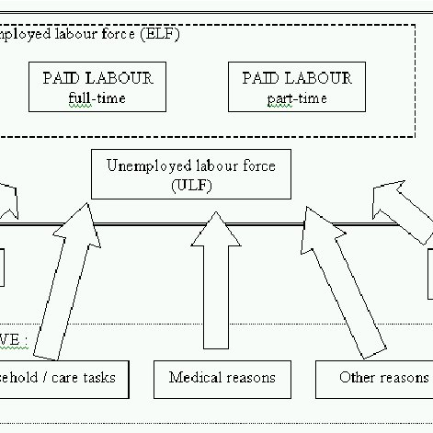
Block Diagram

Slide 9
SOFTWARE REQUIREMENTS:
Operating System : Windows 10
Platform : DOT NET TECHNOLOGY
Front End : ASP.Net 4.0
Back End : SQL SERVER 2014

Slide 10
HARDWARE REQUIREMENTS:
Keyboard
Mouse
Hard disk 500GB
Ram 4 Gb

Slide 11
CONCLUTION
In implementing labour market policies, policy-makers should keep in mind the following principles: the policy response should build on existing measures; the interventions should match the objectives, for example, they should react to the drop in labour demand or set longer-term goals; the relative costs and benefits of different policies should be weighed. The response is also development dependent: due to financial and technical constraints, the set of options available to OECD countries is far larger than that suitable for emerging and developing economies, particularly low-income countries. Nonetheless, this does not imply that labour market policies do not have a role to play in the latter group; rather, it suggests that these countries may require financial and technical assistance to expand policies.

Slide 12
REFERENCE
Buberwa, N.; Matsumoto, M. 2009. Tanzania’s analysis of MDG employment indicators, paper presented at the ILO Technical Seminar on Strengthening Labour Market Information to Monitor Progress on Decent Work in Africa, Addis Ababa, 20-24 July.
Campbell, D. 2011. “Employment-led growth and growth-led employment in the recovery”, in ILO (ed.): The global crisis: Causes, responses and challenges (Geneva, ILO), Chapter 8.
Cazes, S.; Verick, S. 2010. What role for labour market policies and institutions in development? Enhancing security in developing countries and emerging economies, Employment Working Paper No. 67 (ILO, Geneva).
D’Achon, E.; Pagès, N. 2011. “Burkina Faso. Employment at the heart of the national development strategy: The role of the MDG employment indicators”, in T. Sparreboom and A. Albee (eds): Towards decent work in sub-Saharan Africa: Monitoring MDG employment indicators (Geneva, ILO), Chapter 8.
El Achkar Hilal, S. 2011. Employment projection models – A concept note for ILO Trends (Geneva).

Slide 13
Elder, S. 2011. “Employment-to-population ratio” in T. Sparreboom and A. Albee (eds): Towards decent work in sub-Saharan Africa: Monitoring MDG employment indicators (Geneva, ILO), Chapter 3.
European Commission. 2011. Final Report: Technical assistance to support the establishment of the Botswana labour market observatory (Gaborone).
Goldfarb, R.S.; Adams, A.V. 1993. Designing a system of labor market statistics and information, World Bank Discussion Paper No. 205 (Washington, DC, World Bank).
ILO. 1999. Report of the Director-General: Decent Work, International Labour Conference, 87th Session, Geneva, 1999 (Geneva).
Meade, D.S. 2010. “Final macroeconomic and labour market projections” using Lotus (Inforum, College Park, MD, University of Maryland).

