Slide 1
Auditorium management system

Slide 2
Abstract
This system is an auditorium management software projects. It includes all the features and functions needed to efficiently manage an auditorium. It includes an administrator account which is used to handle/control all the system functionality. The system keeps track of auditorium status and advance bookings. The system keeps records of auditorium bookings along with associated event details and customer contacts in a well maintained database. The administrator can easily check the auditorium bookings and timings in the system gui. The system also allows notifies when a new event timing draws near.

Slide 3
Existing System
The imbalanced use of college sports venues resources has not been completely solved now. So lots of researches about the online booking system of college sports venues are seriously needed.
Many college sports venues are opened for free.
But because the usage of venues can't be known good, people often encounter that students of athletics are in the class or there is no place for sports when go to the venues directly.
So a online booking system for college sports venues is necessary.

Slide 4
Disadvantage of Existing System
It reduces employment as the human efforts are being automated by this system.
The use of the system has made up for the current luck of sports venues management, solved the problems of the online booking function of university sports venues, improved the efficiency of the venues and meet the needs of efficient use of the venues.
The basic functions of the system are designed according to the general requirement analysis, including user's registration and login, online venue booking, online payment, personal center, message board and database construction.

Slide 5
PROPOSED SYSTEM :
The purpose of development of this system is to provide convenience to users when they booking venues, and to avoid flashy, so the system’ interface is simple but contain complete functions.
College sports venues are not only an essential part of physical education, but also an important place for fitness activities of the faculties, students as well as nearly residents.
With the rapid development of information technology, college sports venues realizing online booking has become a new trend.

Slide 6
ADVANTAGE
The system is useful as it calculates an exact cost for requested number of days.
It is convenient for user as he do not have to actually visit the place.
This system is effective and saves time and cost of the users.
Easy registration.

Slide 7
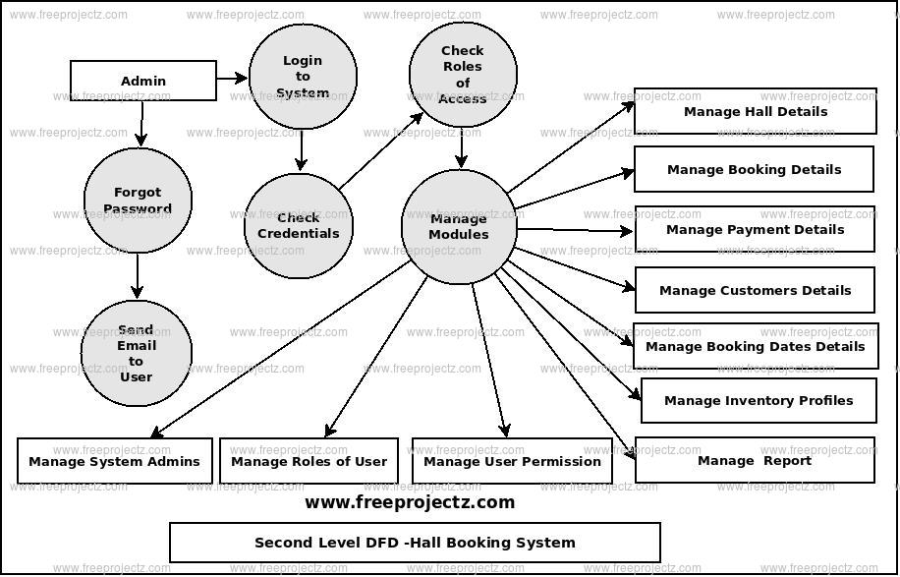
Block Diagram

Slide 8
SOFTWARE REQUIREMENTS:
Operating System : Windows 10
Platform : DOT NET TECHNOLOGY
Front End : ASP.Net 4.0
Back End : SQL SERVER 2014

Slide 9
HARDWARE REQUIREMENTS:
Keyboard
Mouse
Hard disk 500GB
Ram 4 Gb

Slide 10
CONCLUTION
The use of the system can made up for the current luck of sports venues management; It can solve the problems of the online booking function of university sports venues; It can improve the efficiency of the venues and meet the needs of efficient use of the venues. In this study, there are a lot of shortcomings. For instance, there is no limit to the number of reservation; It failed to set up a punishment and give a reasonable credentials into the venues. In the later study, the system needs completely improved. The order number, place number and the time may be feedbacked to users by moblephone messages in the future. The system has a great deal of portability. The website can not only be bordered with web sites of school resources management, improving the management system, but also be extended to other sports venues of zhengzhou city or other colleges and universities, improving the use of stadiums resources.

Slide 11
REFERENCE
1. W. Wang, W. Sun, http://news.xinhuanet.com/mrdx/2010-05/01/content_13451241.htm.
2. X. Dai, N. Zhang, Com. Mod. 11, 123-126 (2012).
3. X. Dai, N. Zhang, Int. Thin. Tech. 7, 69-71(2012).
4. H. Wei, Research and development of network service management platform of university sports facilities based on.NET Technology(Sichuan Normal University, 2011).
5. H. Zhang, The design and implementation of the management system of comprehensive sports facilities in Guizhou Normal University(Xiamen University, 2013).

Slide 12
6. C. Xia, J. Wuhan Eng Inst, 2, 48-50(2013).
7. R.Yuan, DIV + CSS Layout Essence of the Case( Tsinghua University Press, 2011).
8. H. Kong, X. Lu, Web Java design and practical tutorial - based on the application development of Eclipse environment(China Machine Press, 2012).
9. J. Zhao, Design and implementation of mobile business hall charging system based on MYECLIPSE development tools(University of Electronic Science and Technology of China, 2012).
10. C. Feng, Y. Chao, Tomcat and Java Web development Technology Description(Tsinghua University Press, 2008)

