Slide 1
Opinion mining for hotel rating through reviews

Slide 2
Abstract
Opinion mining is very much essential in commerce websites, furthermore, advantages with individuals. An ever-increasing amount of results are stored on the web as well as the amount of people acquiring items from the web are increasing, as a result, the users reviews, or posts are increasing day by day. The reviews towards shipper sites express their feelings, discourse groups, blogs, etc. there will be extensive add up for web, which are functional to both makers and clients. The process of finding the user's opinion about the topic or product or problem is called opinion mining. Analyzing emotions from the extracted opinions is defined as sentiment analysis.

Slide 3
The goal of opinion mining and sentiment analysis is to make computers able to recognize and express emotion. This work concentrates on mining reviews from the websites which allows users to freely write the view. It automatically extracts the reviews from the metric parameters to measure the performance of each algorithm. Determining a consensus opinion on a product sold online is no longer easy because the assessments have become more and more numerous on the Internet. This problem can be addressed by various ways, such as looking for feelings expressed in the documents and exploring the appearance and syntax of reviews. Opinions and reviews can be easily posted on the Web, such as on merchant sites, review portals, blogs, Internet forums, and much more.

Slide 4
Existing System
Each sentence is analyzed by Stanford parser tool and the dependency tree indicating the interaction among the sentence words is created.
Sentences that contain key aspects among the dependencies of the sentence words are forwarded to the Naïve Bayes classifier, trained to recognize the existence and the polarity of users opinions towards the aspect.
The first output is a set of topics which are associated with the set of words, which contribute to the topic via their weights.
The second output consists of a set of reviews with a vector of weight values displaying the probability of a review containing a specific topic.

Slide 5
Disadvantage of Existing System
Objectivity, or comments with a neutral sentiment, tend to pose a problem for systems and are often misidentified.
The use of an opinion mining or sentiment analysis to mine a numerous unstructured data has become an essential study problem.
Several studies have shown that analysing and recognizing opinions in text is a quite complex problem which is acknowledged to be NLP-complete and the interpretation highly depends on the context and the background world knowledge.
User generated content and information in user reviews is valuable to both travel companies and to other people and can have a substantial impact on their decision making process.

Slide 6
PROPOSED SYSTEM :
Many recently proposed algorithms, enrichments and various SA applications are investigated and presented briefly in this survey.
The specification of the dependencies is a quite important step of the proposed approach.
After the analysis of the user’s review and the specification of a person’s references to specific aspects of the hotel, the sentence that contains that aspects, is deeper analysed and the word dependencies are specified.
The automatic analysis of used generated reviews can provide a deeper understanding of users attitudes and opinions.
In this paper, we present a work on the automatic analysis of user reviews on the booking.com portal and the automatic extraction and visualization of information.

Slide 7
ADVANTAGE
It automatically extracts the reviews from the metric parameters to measure the performance of each algorithm.
Data mining software is one of the several different ways to analyse data and can be used for several different reasons.
In decision analysis, a decision tree can be used to optically and notably represent decisions and decision making.
To evaluate the performance of our method, we collected a wide set of reviews for a series of hotels from booking.com.
The integration of the Naïve Bayes method in the system was decided based on its performance during the experimental phase.
A deeper examination of the systems performance revealed the cases that were misclassified concerned neutral opinions that were classified as polarized.

Slide 8
TITTLE | AUTHOR | DESCRIPTION
Understanding Satisfied and Dissatisfied Hotel Customers: Text Mining of Online Hotel Reviews | K.Berezina, A. Bilgihan, C. Cobanoglu, F. Okumus, | This paper aims to examine the underpinnings of satisfied and unsatisfied hotel customers. A text mining approach was followed and online reviews by satisfied and dissatisfied customers were compared.
A Novel Approach to Rate and Summarize Online Reviews According to UserSpecified Aspects | HW. Hu, YL. Chen, PT. Hsu, | The widespread use of network and information technology has led to a wide number of conventional commercial activities being performed online.

Slide 9
TITTLE | AUTHOR | DESCRIPTION
Sentiment Analysis for Hotel | W. Kasper, M. Vela, | We present a system that collects such comments from the web and creates classified and struc-tured overviews of such comments and facilitates access to that information.
Opinion Mining of Online Customer Reviews | P. Gowtham Reddy, | Business organizations and corporate organizations are always eager to find consumer or individual views regarding their products, support and service.

Slide 10
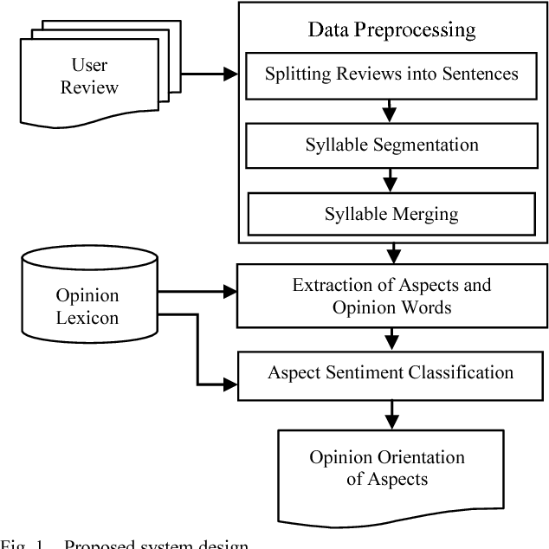
Block Diagram

Slide 11
SOFTWARE REQUIREMENTS:
Operating System : Windows 10
Platform : DOT NET TECHNOLOGY
Front End : ASP.Net 4.0
Back End : SQL SERVER 2014

Slide 12
HARDWARE REQUIREMENTS:
Keyboard
Mouse
Hard disk 500GB
Ram 4 Gb

Slide 13
CONCLUTION
To conclude, the use of an opinion mining or sentiment analysis to mine a numerous unstructured data has become an essential study problem. Development of better products, services, and good business management are the products of sentiment analysis. The review paper presented the related work done until the time in the Sentiment Analysis field. This will help us in deciding the best text classifier in an opinion mining and sentiment analysis. No existing method found which is more general and suitable to be language dependent.

Slide 14
REFERENCE
[1] K.Berezina, A. Bilgihan, C. Cobanoglu, F. Okumus,“Understanding Satisfied and Dissatisfied Hotel Customers: Text Mining of Online Hotel Reviews”, Journal of Hospitality Marketing & Management, Volume 25, Issue 1, 2016.
[2] HW. Hu, YL. Chen, PT. Hsu, “A Novel Approach to Rate and Summarize Online Reviews According to UserSpecified Aspects”, Journal of Electronic Commerce Research, Volume 17, Issue 2, 2016.
[3] W. Kasper, M. Vela, “Sentiment Analysis for Hotel”, Proceedings of the Computational LinguisticsApplications Conference, Poland, pp. 45-52, 2011.
[4] P. Gowtham Reddy, “Opinion Mining of Online Customer Reviews”, MTech thesis, National Institute of Technology, Rourkela, 2014.
[5] W. Songpan, “The Analysis and Prediction of Customer Review Rating Using Opinion Mining”, Software Engineering Research, Management and Applications (SERA), IEEE 15th International Conference, London, 2017.

Slide 15
[6] E. Bjorkelund, T H. Burnett, K. Norvag, “A Study of Opinion Mining and Visualization of Hotel Reviews”, Proceedings of the 14th International Conference on Information Integration and Web-based Applications & Services, Pages 229-238, Indonesia, 2012.
[7] Y. E. Matos-Rodríguez, “Online Traveler Ratings: Impact on Determining the Top 25 Hotels”, MBA Student Scholarship, Johnson & Wales University, 2014.
[8] W. Hensens, “The Future of Hotel Rating, Journal of Tourism Futures”, Volume 1, Issue 1, 2015.
[9] S. Pour fakhimi, “The Impact of Users’ “Online Reviews ``and''Ratings `` on Consumers’ Behaviour toward Hotel Selection Factors”, Information and Communication Technologies in Tourism, pp. 104- 114, 2014.
[10] Y. Chu,” A review of studies on luxury hotels over the past two decades”, Unpublished master’s thesis, Iowa State University, Iowa, United States, 2014.

