Slide 1
Medical shop management

Slide 2
Abstract
The purpose of Medical Shop Management System is to automate the existing manual system by the help of computerized equipments and full-fledged computer software, fulfilling their requirements, so that their valuable data/information can be stored for a longer period with easy accessing and manipulation of the same. The required software and hardware are easily available and easy to work with.Medical Shop Management System, as described above, can lead to error free, secure, reliable and fast management system. It can assist the user to concentrate on their other activities rather to concentrate on the record keeping. Thus it will help organization in better utilization of resources. The organization can maintain computerized records without redundant entries. That means that one need not be distracted by information that is not relevant, while being able to reach the information.The aim is to automate its existing manual system by the help of computerized equipments and full-fledged computer software, fulfilling their requirements, so that their valuable data/information can be stored for a longer period with easy accessing and manipulation of the same. Basically the project describes how to manage for good performance and better services for the Clients.

Slide 3
Existing System
In the existing system the exams are done only manually but in proposed system we have to computerize the exams using this application.
Lack of security of data.
More man power.
Time consuming.
Consumes large volume of pare work.
Needs manual calculations.
No direct role for the higher officials

Slide 4
Disadvantage of Existing System
One more problem was that it was very difficult to find errors while entering the records.
System analysis is a process of gathering and interpreting facts, diagnosing problems and the information about the Medical Shop Management System to recommend improvements on the system.
It is a problem solving activity that requires intensive communication between the system users and system developers.
The designer now functions as a problem solver and tries to sort out the difficulties that the enterprise faces.
We understand the problem domain and produce a model of the system, which describes operations that can be performed on the system.

Slide 5
PROPOSED SYSTEM :
The aim of proposed system is to develop a system of improved facilities. The proposed system can overcome all the limitations of the existing system. The system provides proper security and reduces the manual work.
Security of data.
Ensure data accuracy’s.
Proper control of the higher officials.
Minimize manual data entry.
Minimum time needed for the various processing.
Greater efficiency.
Better service.
User friendliness and interactive.
Minimum time required.

Slide 6
ADVANTAGE
It determines the length of time system used by the system to process transaction data.
This test is conducted prior to implementation to determine how long it takes to get a response to an inquiry, make a backup copy of a file, or send a transmission and get a response.
This included the study of function, performance and constraints that may affect the ability to achieve an acceptable system.
To increase efficiency of managing the Medical Shop, Stocks
It deals with monitoring the information and transactions of Sales.
The system generates types of information that can be used for various purposes.

Slide 7
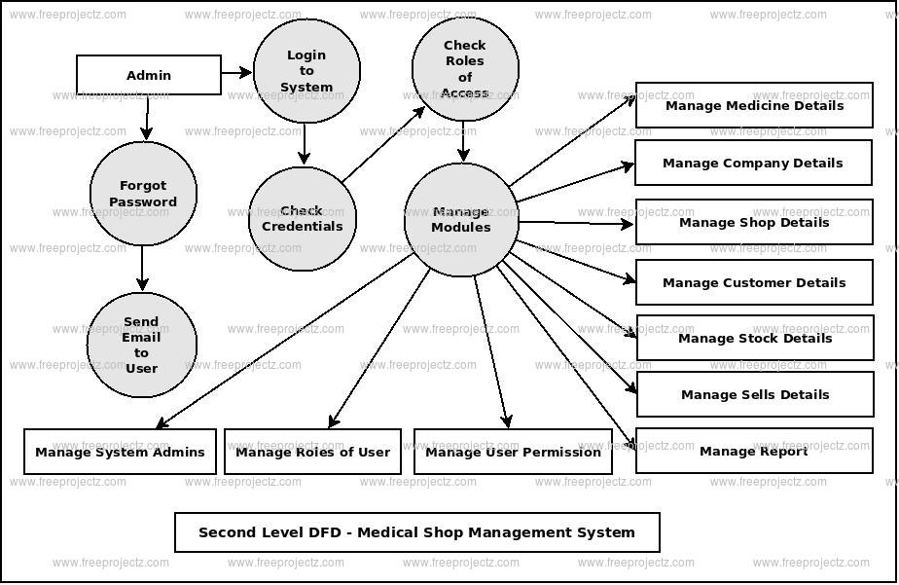
Block Diagram

Slide 8
SOFTWARE REQUIREMENTS:
Operating System : Windows 10
Platform : DOT NET TECHNOLOGY
Front End : ASP.Net 4.0
Back End : SQL SERVER 2014

Slide 9
HARDWARE REQUIREMENTS:
Keyboard
Mouse
Hard disk 500GB
Ram 4 Gb

Slide 10
CONCLUTION
Our project is only a humble venture to satisfy the needs to manage their project work. Several user friendly coding have also adopted. This package shall prove to be a powerful package in satisfying all the requirements of the school. The objective of software planning is to provide a frame work that enables the manger to make reasonable estimates made within a limited time frame at the beginning of the software project and should be updated regularly as the project progresses.

Slide 11
REFERENCE
Google for problem solving
http://www.javaworld.com/javaworld/jw-01-1998/jw-01Credentialreview.html
Database Programming with JDBC and Java by O'Reilly
Head First Java 2nd Edition
http://www.jdbc-tutorial.com/
Java and Software Design Concepts by Apress
https://www.tutorialspoint.com/java/
http://www.javatpoint.com/java-tutorial
https://docs.oracle.com/javase/tutorial/
http://www.wampserver.com/en/
http://www.JSP.net/
http://www.tutorialspoint.com/mysql/
httpd.apache.org/docs/2.0/misc/tutorials.html

