Slide 1
File info tracking management system

Slide 2
Abstract
Locating files is one of the biggest problems in universities nowadays. Time is wasted in searching files, energy is wasted chasing misspelled files, deadlines are missed. Due to this , I decided to make a system for file tracking that will solve all problems in the best way.File Tracking System is a internet application that manages all the file movement from one desk to another one and helps them in managing flow of files effectively and efficiently. All the files such as: reports, decisions, requests, reminders, and others can be processed and can also tracked by the system at any time. The system helps in online tracking or locating information and pendency monitoring more effectively by providing a plethora of data at a glance. It has large facilities for managing classification of all files. The system follows a steps of file unique numbering and enables file management, file status monitoring, etc. It also has a very powerful search form to locate a file and analyze the history of movement of that file. It also has a very powerful search form to locate a file/data and analyse the history of movement of that file. Other than this, the system will allow the administrator to create faculties of that university and assign to them all the departments . Each department must have a user who will be responsible for that department. In the other hand.

Slide 3
Existing System
To systemize these operations and hence to keep track of those files, the National Informatics Centre (NIC) as a ICT Consultant has conducted thorough study of the existing system to come out with a web enabled system.
To fulfill the requirement, a thorough study was conducted of the existing system. It was decided that the system should be a lightweight application requiring minimal inputs and user-friendly interface.
The worker finds the existing file or document is time-consuming and file misallocation, paper usage is wasted; and more spaces for storing the document files at premises.

Slide 4
Disadvantage of Existing System
The impact of this research brings efficiency in searching the ISO document’s file in the university.
Since offices nowadays spend too much time in organizing (archiving, finding) their files in a systematic way, without forgetting also the cost of papers, this web application will solve all of these problems by saving time and money.
Therefore, to overcome the document misallocation problem, an Internet-of-Things (IoT) based file tracking prototype is implemented.
The implementation of the study shows how the system work, user interface design, and architecture of the system. This new design shows the solution to the current problem.

Slide 5
PROPOSED SYSTEM :
The proposed file-tracking system will not disturb any file which existed as a file movement system.
Electronic records for existing files (Long Term files) as well as new files will be created to track their movement.
The proposed file tracking-system will involves all entities of the existing system except dispatch registers, which will be replaced by electronic File Database.
Each type of user will be assigned specific roles to maintain the system. involved in the design and development of the system will have no control on the functioning of the system.
File creation will be done by the University employees including office incharges of various offices as in the previous system.

Slide 6
ADVANTAGE
File Tracking System is a web application that manages all the files movement at any time from one desk/room to another one and help in managing the flow of files efficiently.
Solution for effective and efficient management of files
Easy File Tracking
Online fast and secure file management
Staff improvement
Organizational efficiency improvement
Paper cost reduce
Less energy used
Time spent reduce
Eliminates duplication of file

Slide 7
TITTLE | AUTHOR | DESCRIPTION
File Tracking System: User Manual | N. DoPT, | It was felt that a system is required to monitor the movement of Files and Receipts at different levels in the decision making process.
Files Management System | Infronics, | File management system consists of system utility programs that run as privileged applications.

Slide 8
TITTLE | AUTHOR | DESCRIPTION
The Web as a Platform: The Saga Continues | T. Mikonen and A. Taivalsaari, | In this paper we take a look at the evolution of the Web from a relatively simple document sharing system to a massively popular, general purpose application and content distribution environment.
Mashware: The Future of Web Applications | A. Taivalsaari, | A key observation in the paper is that web applications do not have to live by the same constraints that characterized the evolution of conventional desktop applications.

Slide 9
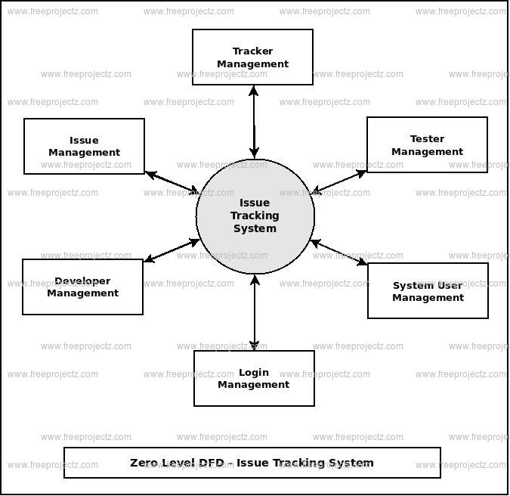
Block Diagram

Slide 10
SOFTWARE REQUIREMENTS:
Operating System : Windows 10
Platform : DOT NET TECHNOLOGY
Front End : ASP.Net 4.0
Back End : SQL SERVER 2014

Slide 11
HARDWARE REQUIREMENTS:
Keyboard
Mouse
Hard disk 500GB
Ram 4 Gb

Slide 12
CONCLUTION
This paper has discussed about a Web Application which aims to serve offices that has to do with paper work, especially universities, in the best way possible. The goal of this web application is to improve file management, increase staff efficiency, save staff energy and time, reduce cost and improve the work efficiency by using the latest and fastest technologies. The one important thing that needs to be mentioned in this conclusion is that from the research I have done on file tracking systems, there is no file tracking system developed or implemented for universities at all. There are some file tracking systems used for some other purposes (ex: governmental purpose) implemented in few countries, however they are also some simple ones who tracks only receipts. Hence, I took this condition as a favors and hope that the project I am developing will have a massive usage worldwide in the near future.

Slide 13
REFERENCE
[1]. N. DoPT, “File Tracking System: User Manual,” MADHYA PRADESH FOREST DEPARTMENT, Bhopal, 2013.
[2] J. Anne, “FILETACTICS - File Tracking Software and System,” Wordpress, 11 July 2012. [Online] Available: http://blog.filetactics.com/
[3] Infronics, “Files Management System,” Infronics Systems, 2011.
[4] T. Mikonen and A. Taivalsaari, “The Web as a Platform: The Saga Continues,” in Proceedings of the 37th EUROMICRO Conference on Software Engineering and Applications, Oulu, IEEE Computer Society, 2011, pp. 170-174.
[5] M. Richards, “Web Based vs. Desktop Based Software for Self Storage,” Hi-Tech Smart Systems, Inc, Honolulu County, 2011.

Slide 14
[6] D. G. Bakshi, “Kerala Govt Nod For Online File Tracking,” Alphabet Media, 22 August 2011. [Online]. Available: http://www.futuregov.in/.
[7] R. Chaladan, “File Tracking System for State Government Offices,” 11 August 2010.[Online] Available: http://www.sics.kerala.gov.in.
[8] A. Taivalsaari, “Mashware: The Future of Web Applications,” Sun Microsystems Laboratories, New Jersey, 2009.
[9] T. Mikkonen and A.Taivalsaari,“Apps vs. Open Web: The Battle of Decade,” Oulu, 2010.
[10] P. Staff, “PHP: What can PHP do?,” 04 January 2010. [Online]. Available: http://php.net/manual/en/introwhatcando.php

