Slide 1
Department store management

Slide 2
Abstract
This project develops a Departmental Store Management System (DSMS) is commonly found today at most retail store registers. Store merchandise, identified by a price code is checked out by a cashier who then accepts payment for the item(s). A DSMS is either read by a bar code scanner or manually entered by the cashier. At the completion of a sale, a receipt is created for the customer and sales information is collected for the generation of reports at a later time. A DSM system should help you alleviate the daily chores of your business. A DSM system should not interfere or make it harder for you to run your business. It should run parallel to your business operation. A perfect DSM system should run your business for you, but not in a literal sense where it takes total control. You want one comprehensive package for your entire business, either small or large. And it should scale as much as your business grows. The system also provides for processing the return of purchased items and reimbursement to the customer. While many DSM Systems support multiple terminals that are networked together and interface with external systems (such as inventory control) the primary goal of this system is to develop a self-contained sales terminal application that supports the purchase and return of store merchandise.

Slide 3
Existing System
Many forms of state diagrams exist, which differ slightly and have different semantics.
System Analysis is the process of planning a new System to either replace or complement an existing system.
At present the stores management of TEFCO does not have any automated system to manage the data of, receiving, issuing, of raw material, capital goods, packing material and finish product.
After studying the existing manual system, the need for a change was recognized and system development life cycle initiated.
This helps to understand the system and permit changes to be made in the existing system to satisfy new user needs.

Slide 4
Disadvantage of Existing System
DSM systems rely on predictable operation, and any number of problems can appear when hardware, software or users do not perform as expected.
The user’s problem is that his branches and their associated systems function Independently thus creating difficulties in keeping track of any changes made to the local Databases.
This phase defines the problem that the customer is trying to solve. The deliverable result at the end of this phase is a requirement document.
In our country we find many shopping mall, they are used desktop base DSM software and fact many problems .

Slide 5
PROPOSED SYSTEM :
We need to study how it functions currently, what are the problems, and what are the requirements that the proposed system should meet.
We proposed a new system in which all the details of material, product transaction handled by a computerized system rather than a manual system.
Requirement Analysis is the process of understanding the customer & users and top management expectations from a proposed system or application and is well defined stage in the software development.
The main purpose of this project is to give all details about the Items transaction in the stores such as , Item issuing, Items receiving, & Report generation about the stock statement, Issue Register, & receive register were successfully developed.

Slide 6
ADVANTAGE
A Departmental store management system will help you replenish items efficiently and negotiate lower vendor costs.
The right Departmental store management system will give you control over many different areas of your business operations increasing efficiency and profitability.
A Departmental store management system enables cashiers to process transactions and serve customers efficiently, and allows managers to maintain tight control.
DSM systems more easily integrate with numerous sales and ordering systems, including mail or online ordering systems used in conjunction with in-person sales.

Slide 7
TITTLE | AUTHOR | DESCRIPTION
project planning | Ian Somerville, | This plan is developed at the beginning of the software project and is continually refined and improved as the work rocesses.
Software Implementation and Testing | Ian Somerville, | The study centers on the five key parts of software testing, explicitly software testing methods, software testing metrics, practices and techniques, testing standards, automated testing tools, and testing education & training.

Slide 8
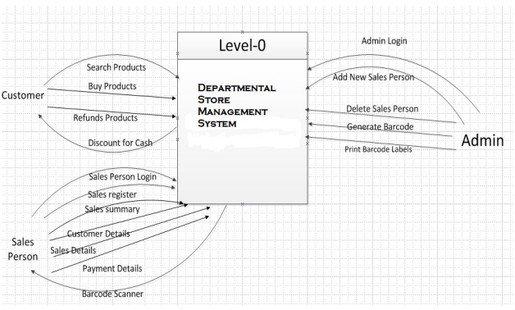
Block Diagram

Slide 9
SOFTWARE REQUIREMENTS:
Operating System : Windows 10
Platform : DOT NET TECHNOLOGY
Front End : ASP.Net 4.0
Back End : SQL SERVER 2014

Slide 10
HARDWARE REQUIREMENTS:
Keyboard
Mouse
Hard disk 500GB
Ram 4 Gb

Slide 11
CONCLUTION
Now words any mini shopping mall don’t have an online DSM software. We have to work it to have online based DMS software for a Mini Shop. So that, their transaction process and payment report should be clear. In our country we find many shopping mall, they are used desktop base DSM software and fact many problems .So, we made an online base DSM system software to improve that system and also developed our country. I have done proper in this project are compliantly logical business model and it's really sequential effective project. This project functionality, usability each and every point structural. While point of sale systems are an integral part of today’s commercial workplace, the details and options available for purchase can be mind-boggling to the novice shopper. It is vital to narrow down the numerous selections available in order to find which DSM system will best suit a particular user. Shopping on Agora allows the option of narrowing selections to find the necessary options, in addition to allowing shoppers to buy from sellers worldwide.

Slide 12
REFERENCE
[1] Ian Somerville, “project planning”, Software Engineering Pearson Education, Update 8th Edition, 1989-1992.
[2] Ian Somerville, ”Software Implementation and Testing”, Software Engineering, Update 6th Edition, 1995-1997.
[3] PhP and MySql (Version: 5) Witten By: Md. Mijanur Rahman
[4] http://www.shopify.com/pos (Last Access : 03/02/2017)
[5] http://en.wikipedia.org/wiki/Point_of_sale (Last Access : 11/02/2017)
[6]http://www.academia.edu/6967044/Software_Requirements_Specification_for_Point_Of_Co mmunication_Sale_System (Last Access : 22/02/2017)
[7] http://www.pos.com/pos (Last Access : 15/02/2017)
[8] http://www.phpreferencebook.com (Last Access : 25/02/2017)

