Slide 1
Online customer service

Slide 2
Abstract
Customer interactions with an organization’s website create opportunities for positive experiences that can lead to long-term relationship building. The range of potential interactions is now quite diverse, including product information search, purchase transaction and/or service delivery. The domain of customer experience (CE) is well developed in the face-to-face context, but little attention has been paid to exploring the concept in the online context. The purpose of this paper is to provide a review of the online consumer literature in order to inform understanding of the antecedents and consequences of online customer experience (OCE) in the purchase context. The paper offers four important contributions for both academics and practitioners. First, it adds to understanding of OCE in the purchase context and, second, specifically recognizes and discusses the antecedents of OCE by drawing on existing literature relating to online consumer purchase. Third, it proposes the potential consequences of OCE and provides a framework for future testing. Finally, the paper addresses a problem of relevance to both academics and practitioners, and proposes future research and managerial implications.

Slide 3
Existing System
A significant number of online studies exist which can help one identify the likely drivers of online customer experience (OCE).
This enabled the researchers to identify quickly the overall nature of existing research, its epistemological assumptions and methodological features.
The first key difference between the two contexts is the degree of personal contact, which can range from very intensive in a face-to-face context to nonexistent online.
Online, the brand is presented in a predominantly audio-visual way, whereas offline opportunities exist for the brand to be experienced via a range of artefacts such as staff and their presentation, buildings and facilities, vehicles, livery and other tangible elements.

Slide 4
Disadvantage of Existing System
This paper enables us to address a problem of relevance and interest to academics and practitioners alike and to propose future research.
The paper extends understanding of the factors that potentially impact OCE and provides a discussion not found so far in the literature.
They provide a useful structural model which is centred upon the cognitive view of experience and which tests the relationships between various internal customer components (such as computer skill and control, level of arousal or degree of attention) that impact the user’s experience of the website.
Therefore, we suggest a strong interactive effect between antecedent factors and their impact upon OCE.

Slide 5
PROPOSED SYSTEM :
They propose seven key elements which enhance consumers’ experience of M-commerce.
They propose that the customer is involved in reviewing incoming information in relation to past, present and potentially future experiences.
The third set of proposed antecedents of OCE relates to skill (SK) and perceived control (PC).
The literature so far does not suggest this proposition and, to this extent, is weak in its linkage between proposed antecedents.
This model proposes trust and satisfaction to be outcome variables that both independently and together have a direct influence upon customer loyalty.

Slide 6
ADVANTAGE
Online customer experience therefore becomes an important concept for e-marketers responsible for the online B2C environment, and particularly in the context of online purchase, given the increasing performance in online sales.
The creation of the subjective response is via the customer’s interaction with the various components of the organization’s offer, which includes the performance of the product itself, packaging, pricing, advertising, retail environment and customer service handling.
Managerial effort tends to focus on the former in terms of the development of website performance.
Such frameworks provide practitioners with clear direction in the development of effective websites that provide efficient and effective customer experience, thereby leading to a positive emotional state.

Slide 7
TITTLE | AUTHOR | DESCRIPTION
Dimensions of consumer expertise | Alba, J.W. and Hutchinson, J.W. (1987). | The purpose of this article is to review basic empirical results from the psychological literature in a way that provides a useful foundation for research on consumer knowledge.
Physical environment and service experience: an appropriation-based model | Bonnin, G. (2006). | The aim of the paper is to show how the appropriation process gives an improved understanding of the consumer-physical environment relationship.

Slide 8
TITTLE | AUTHOR | DESCRIPTION
B2C e-commerce web site quality: an empirical examination | Cao, M., Zhang, Q. and Seydel, J. (2005). | This paper fulfils the identification of web site quality and the development and validation of its measures and offers a framework and practical guidelines for e-commerce managers and web designers.
Perspectives on consumer decision making: an integrated approach | Hansen, T. (2005). | In this paper, a framework which integrates several perspectives on consumer decision making and hypothesises possible links between several basic constructs is developed.

Slide 9
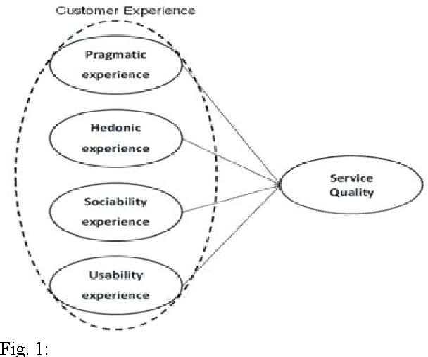
Block Diagram

Slide 10
SOFTWARE REQUIREMENTS:
Operating System : Windows 10
Platform : DOT NET TECHNOLOGY
Front End : ASP.Net 4.0
Back End : SQL SERVER 2014

Slide 11
HARDWARE REQUIREMENTS:
Keyboard
Mouse
Hard disk 500GB
Ram 4 Gb

Slide 12
CONCLUTION
The paper discusses current definitions and understanding of the concept of customer experience and explores the newly extended concept of OCE. A review of key literature is presented that gives insight and direction to an understanding of the antecedents of OCE which helps to develop a conceptual framework for future testing. A number of conclusions can be drawn. Managerial implications stem from this literature review. The proposed framework suggests that e-marketers need to be aware that, while functional performance of a website is important (as embedded in the proposed antecedents, e.g. easy navigation, usefulness, information provision), it is also important to understand the experiential state of customers and the responses they are likely to generate. Managerial effort tends to focus on the former in terms of the development of website performance. Consumer research should focus upon understanding the emotional and cognitive state of customers both during and following the online purchase process, and understanding how to adjust the features of a website to improve these. At the same time, there may be differences in the relevance of different experiential states, depending on the nature of the product or service type being delivered via the website. The output of the research proposed in this paper would lead to effective measurement scales for the e-marketer to use in the identification of relevant inputs and outputs of an effective OCE for retail websites.

Slide 13
REFERENCE
Alba, J.W. and Hutchinson, J.W. (1987). Dimensions of consumer expertise. Journal of Consumer Research, 13, pp. 411–454.
Algesheimer, R. and Dholakia, P.M. (2006). Do customer communities pay off? Harvard Business Review, 84, pp. 26–30.
Bonnin, G. (2006). Physical environment and service experience: an appropriation-based model. Journal of Services Research, 6, pp. 45–65.
Brown, J.R. and Dant, R.P. (2008). On what makes a significant contribution to the retailing literature. Journal of Retailing, 84, pp. 131–135.
Cao, M., Zhang, Q. and Seydel, J. (2005). B2C e-commerce web site quality: an empirical examination. Industrial Management & Data Systems, 105, pp. 645–661.

Slide 14
Coursaris, C. and Hassanein, K. (2001). Understanding M-commerce: a consumer centric model. Quarterly Journal of Electronic Commerce, 3, pp. 247–271.
Davis, F.D. (1989). Perceived usefulness, perceived ease-ofuse and user acceptance of information technology. MIS Quarterly, 13, pp. 319–340.
Frow, P. and Payne, A. (2007). Towards the ‘perfect’ customer experience. Journal of Brand Management, 15, pp. 89–101.
Geffen, D. (2003). TAM or just plain habit: a look at experienced online shoppers. Journal of End User Computing, 15, pp. 1–13.
Hansen, T. (2005). Perspectives on consumer decisionmaking: an integrated approach. Journal of Consumer Behaviour, 4, pp. 420–437.

