Slide 1
College social networks

Slide 2
Abstract
This paper discusses about the project implementation of social networking site for teaching and learning purposes. The type of social space available to users can provide a more personalized and interactive experience for educative purpose. The growing demand of engineers in the industry makes it very important for the students to know about the practical use of technologies that are taught in the college and also to know about the latest technology and projects that the industry works with. Thus, a platform where students can interact with the industry professionals would prove to be a great benefit for them. In this project a social networking site exclusive for the college has been created whereby students, faculty and selective people from the industry would be able to socialize and share their knowledge. Also it would be a hub to share information about all the ongoing activities in the college campus. This paper describes the features implemented in this project and presents a glimpse of how the website works.

Slide 3
Existing System
While such research has done an effective job of understanding what technologies exist and how they are used, the question of how they relate to social factors has been difficult to answer.
Many university units also utilize existing technologies and mainstream services, like social networking sites and other communication mediums, to connect to students.
While Internet technologies provide connectivity to a large global population, the recent trend has been to use these technologies to improve interconnectedness within existing relationships.
Some research, however, suggests that there exist some limits to these positive gains, wherein individuals can overuse the Internet, leading to negative gains in many areas.

Slide 4
Disadvantage of Existing System
This social networking site focuses on collaborative teaching and learning, the above mentioned research has been done to come across the positive and negative impacts of SNSs which formed the basis to assist us in regulating our SNS.
The study that follows first examines literature relevant to the issues of online technologies and socialization of college students.
One difficulty in this study stems from drawing connections between technology use and issues such as persistence and retention.
In other words, issues such as stress, anxiety, and depression have less of an impact on college adjustment and psychological well-being when an individual has a strong social support network.

Slide 5
PROPOSED SYSTEM :
It is therefore a concept that is difficult to objectively quantify; as a result, researchers have sought to measure these perceptions among individuals for comparative purposes.
Researchers often believed that the purpose of social support was to serve as a buffer for the effects of other psychological factors, such as stress, depression, and others, in order to diminish or remove their effects entirely on factors such as college adjustment and psychological well-being.
This is important to note, as the purpose of Internet technologies must be taken into account when considering their impacts on any population.

Slide 6
ADVANTAGE
This is the major advantage of this project as it will promote the students and faculty alike to strengthen their educational communications and collaborations.
The effects of social interaction and social support on college student success, retention, academic performance, and other outcomes are profound.
In measuring feelings of belonging within classes and institutions alongside academic motivations and performance, they found a positive correlation between both senses of belonging and academic motivation.
This indicates that these variables, including integration, have a significant relationship with academic performance.

Slide 7
TITTLE | AUTHOR | DESCRIPTION
An introduction to the potential of social networking sites in education | Griffith, S., & Liyanage, L. (2008, June). | This paper reviews Social Networking Sites (SNS) that have become available via the Internet in the light of usability for teaching and learning.
Findings on Facebook in higher education: A comparison of college faculty and student uses and perceptions of social networking sites | Roblyer, M., McDaniel, M., Webb, M., Herman, J., & Witty, J. V. (2010). | Social Networking Sites (SNSs) such as Facebook are one of the latest examples of communications technologies that have been widely-adopted by students and, consequently, have the potential to become a valuable resource to support their educational communications and collaborations with faculty.

Slide 8
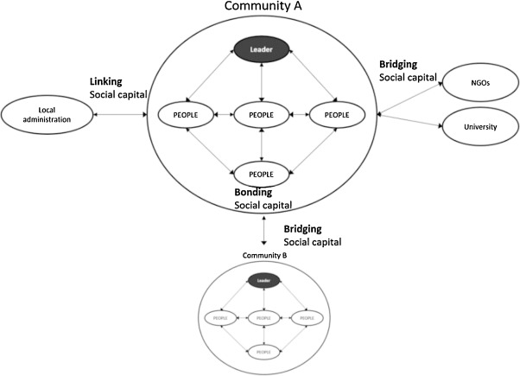
Block Diagram

Slide 9
SOFTWARE REQUIREMENTS:
Operating System : Windows 10
Platform : DOT NET TECHNOLOGY
Front End : ASP.Net 4.0
Back End : SQL SERVER 2014

Slide 10
HARDWARE REQUIREMENTS:
Keyboard
Mouse
Hard disk 500GB
Ram 4 Gb

Slide 11
CONCLUTION
By creating this website for college, it is aimed to strengthen the communication among users and make campus life more lively and exciting by combining academics and cultural activities. This social media platform will become an asset for the campus and can be used for various productive purposes. This social networking site can be further expanded to all the engineering colleges in the city whereby all engineering students and faculties would be able to connect and share their knowledge with each other. Also efforts can be taken to incorporate links to various journals which students and teachers can use to publish their papers and also get an access to other research papers. An android application can be developed as well which would enable users to access this social media through their mobile devices.

Slide 12
REFERENCE
[1] https://www.pinterest.com/pin/97249673173266393/
[2] Griffith, S., & Liyanage, L. (2008, June). An introduction to the potential of social networking sites in education. In Emerging Technologies Conference 2008 (p. 9).
[3] Tenzin Tendar . (April 09, 2014) . Netlink - social networking site. www.slideshare.net.
[4] Roblyer, M., McDaniel, M., Webb, M., Herman, J., & Witty, J. V. (2010). Findings on Facebook in higher education: A comparison of college faculty and student uses and perceptions of social networking sites. The Internet and Higher Education, 13(3), 134-140.

Slide 13
[5] http://www.w3schools.com/php/php_intro.asp
[6]http://www.w3schools.com/php/php_mysql_intro.asp
[7]http://www.w3schools.com/php/php_ajax_php.asp
[8]http://www.slideshare.net/search/slideshow?searchfrom=header&q=social+networking+site

