Slide 1
Advanced encypted blind watermarking hiding text

Slide 2
Abstract
Information security is a critical issue in modern society and image watermarking can effectively prevent unauthorized information access. Optical image watermarking techniques generally have advantages of parallel high-speed processing and multi-dimensional capabilities compared with digital approaches. This paper provides a comprehensive review on the research works related to optical image hiding and watermarking techniques conducted in the past decade. The past research works are focused on two major aspects, various optical systems for image hiding and the methods for embedding optical system output into a host image. A summary of the state-of-the-art works is made from these two perspectives.

Slide 3
Existing System
Encryption techniques transform the original image into noise-like ciphertext, which is not accessible by unauthorized users without the correct key.
However, the existence of ciphertext is usually known to the third party. The aim of watermarking is to hide the existence of original image to unauthorized users.
In this scheme, the crosstalk between different depth sections of the 3D object can yield a noise-like recorded diffraction patterns, which are favorable for watermarking applications.
As a drawback, a large number of optical exposures, recorded diffraction patterns and host images are required.

Slide 4
Disadvantage of Existing System
The problem of inconsistency in data representation format between gray scale image and phase-only image (or binary image) is addressed in these works with appropriate algorithms.
With the rapid development of Internet and information technology, the problem of unauthorized acquisition, transmission, manipulation and distribution of digital content is increasingly more severe in recent years.
This problem can be possibly tackled by combining these optical systems with some incoherent operations such as visual cryptography, where an approximate overlapping (rather than very precise alignment) of optical components can yield correct decrypted result.

Slide 5
PROPOSED SYSTEM :
This paper presents a comprehensive review on various optical image watermarking systems and schemes proposed in the past decade.
A method to detect whether there is DRPE encrypted secret information embedded in a given image is proposed.
In, an image hiding technique is proposed that combines the complementary advantages of cascaded Fourier transform and RSA encryption algorithm, which is a hybrid of optical and digital security approaches.
An improved single-shot-ptychography watermarking scheme is proposed by recording one diffraction intensity pattern constituting a series of tiny diffraction spots.

Slide 6
ADVANTAGE
These adaptive watermarking schemes can give more satisfactory watermarking performance (embedding more hidden ciphertext information into the host image while causing less damage to the host image) but the expense is much higher complexity.
In, the hologram is weight added to the median-frequency coefficients of the discrete cosine transformed (DCT) host image instead of spatial domain.
The low frequency and high frequency coefficients are well preserved so the host image quality after watermarking is better than the work.
The wavelet coefficients are quantized by two different quantizers according to the binary bit values of the hidden holographic data.

Slide 7
TITTLE | AUTHOR | DESCRIPTION
Multimedia encryption and watermarking | B. Furht, E. Muharemagic, D. Socek. | Digital rights management (DRM) is a collection of techniques and technologies that enable technically enforced licensing of digital information.
Roadmap on optical security | B. Javidi, A. Carnicer, M. Yamaguchi, et al. | This roadmap article presents an overview of the potential, recent advances, and challenges of optical security and encryption using free space optics.

Slide 8
TITTLE | AUTHOR | DESCRIPTION
Advances in optical security systems | W. Chen, B. Javidi, and X. Chen. | It has been demonstrated that optical technology possesses several unique characteristics for securing information compared with its electronic counterpart, such as many degrees of freedom.
A review of image watermarking applications in healthcare | G. Coatrieux, L. Lecornu, B. Sankur, and C. Roux. | In this article, we focus on the complementary role of watermarking with respect to medical information security (integrity, authenticity ...) and management.

Slide 9
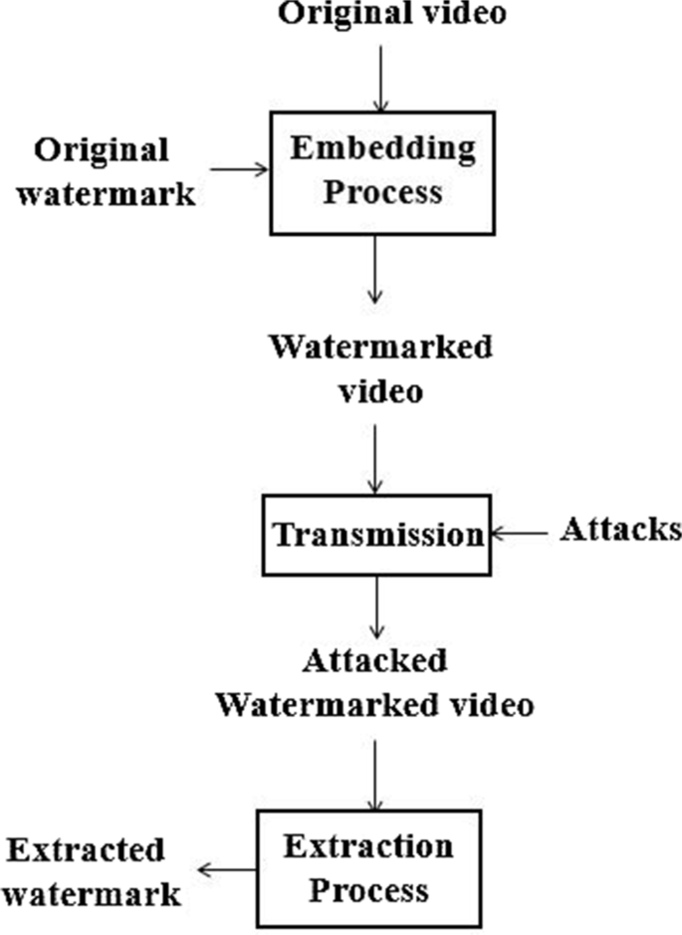
Block Diagram

Slide 10
SOFTWARE REQUIREMENTS:
Operating System : Windows 10
Platform : DOT NET TECHNOLOGY
Front End : ASP.Net 4.0
Back End : SQL SERVER 2014

Slide 11
HARDWARE REQUIREMENTS:
Keyboard
Mouse
Hard disk 500GB
Ram 4 Gb

Slide 12
CONCLUTION
To the best of our knowledge, this is the first comprehensive summary of various optical architectures and related processing algorithms for optical image hiding or optical watermarking proposed in the past decade. The past research works are focused on two major aspects, various optical systems for image hiding and the methods for embedding optical system output into a host image. The previously proposed optical systems for image hiding include Double Random Phase Encoding (DRPE), off-axis holography system, phase shifting holography system, cascaded phase only mask architecture, Joint Transform Correlator (JTC), ghost imaging system and ptychography system. The features of each system are compared and discussed. Furthermore, different methods for embedding optical system output (ciphertext) into a host image are summarized, from simple weighted addition to sophisticated adaptive embedding. Some future research directions for optical image hiding are discussed in this paper.

Slide 13
REFERENCE
[1] B. Furht, E. Muharemagic, D. Socek. Multimedia encryption and watermarking. Springer Science & Business Media; 2006.
[2] B. Javidi, A. Carnicer, M. Yamaguchi, et al. Roadmap on optical security. J Opt 2016; 18(8): 083001.
[3] W. Chen, B. Javidi, and X. Chen. Advances in optical security systems. Adv Opt Photonics 2014; 6:120-55.
[4] B. U. Rani, B. Praveena, and K. Ramanjaneyulu. Literature review on digital image Watermarking. Proceedings of the 2015 International Conference on Advanced Research in Computer Science Engineering & Technology (ICARCSET 2015). ACM, 2015.
[5] G. Coatrieux, L. Lecornu, B. Sankur, and C. Roux. A review of image watermarking applications in healthcare. In Engineering in Medicine and Biology Society, 2006. EMBS'06. 28th Annual International Conference of the IEEE (pp. 4691-4).

Slide 14
[6] N. K. Nishchal. Hierarchical encrypted image watermarking using fractional Fourier domain random phase encoding. Opt Eng 2011; 50(9): 097003.
[7] I. Mehra, N. K. Nishchal. Image fusion using wavelet transform and its application to asymmetric cryptosystem and hiding. Opt Express 2014; 22(5):5474-82.
[8] Y. Sheng, Z. Xin, C. Jian-guo, X. Yong-liang, L. Qiang. A blind image detection method for information hiding with double random-phase encoding. Opt Laser Technol 2009; 41(5):590-5.
[9] L. C. Ferri, A. Mayerhoefer, M. Frank, C. Vielhauer, R. Steinmetz. Biometric authentication for ID cards with hologram watermarks. Electronic Imaging 2002, International Society for Optics and Photonics, 629-40.
[10] N. Takai, Y. Mifune. Digital watermarking by a holographic technique. Appl Opt 2002; 41(5):865-873.

