Slide 1
Mango pulp management

Slide 2
Abstract
Mango, the king of tropical fruits had a great potential for value added products due to its greater impact on human health. Mango pulp is a preservation technique that overcomes the postharvest losses during the seasons. The current study was focused to develop a pulp from Kartha kolomban mango cultivar and evaluate its physical, biochemical, microbial properties, acceptability and storability. Mango pulp was prepared after steam blanching of fruits for 15 min to preserve the colour at storage time. Developed mango pulp contains 0.58 mg carotene/100 g, 4.83 mg gallic acid/g, 245.9 mg ascorbic acid/100 g and 374.4 µM Trolox/100 g, as antioxidant. Microbial counts were less than the standard maximum limits for the mango pulp throughout the 3 months storage period.

Slide 3
TSS and the titratable acidity were significantly increased (p<0.05) and pH, colour change and moisture were not significantly different during the three-month storage period. However, pH of the pulp was slightly reduced at the time and carotenoid, phenol, ascorbic contents and antioxidant activity were not significantly different and not observed gradual increases or decreases. Sensory evaluation revealed that jam prepared from developed mango pulp at initial stage and two months after storage were significantly different from control for the colour, taste, odor, consistency and overall acceptability. The developed mango pulp is successfully accepted by the people. Karthakolomban mango pulp had superior properties for adding value to the fruit without any preservatives and retained antioxidant properties up to three months.

Slide 4
Existing System
High postharvest loss has been reported in the season due to nonexistence of a cold chain system, lack of proper storage facilities and inadequate processing facilities and agrobased industries with improved value addition technologies.
No sudden change in the existing system of package of this fruit seems to be possible.
These may be drawn up in consultation with trade, research organizations and Government departments, keeping the economy, availability of the raw material and existing systems of transportation in view.
In terms of the existing instructions, NABARD charge the concerned banks, a rate of interest, which would be 3% below the rate charged by the Bank.

Slide 5
Disadvantage of Existing System
Therefore, introduction of appropriate processing techniques, which can preserve organoleptic, rheological, nutritional and other quality attributes of fresh mango, will be beneficial in solving this problem.
Mango, the king of tropical fruits had a great potential for value added products due to its greater impact on human health.
The profile covers almost all aspects of the marketing, such as post-harvest management, marketing practices, quality standards, grading, packaging, transportation, storage, SPS requirements, marketing problems, marketing information, etc
This problem has been attributed to the causes like genetical, physiological, environmental and nutritional factors.

Slide 6
PROPOSED SYSTEM :
Separate pre-cooling facility is proposed for rapid removal of field heat. Ideally, Mangoes are graded, packed, pre-cooled and transhipped.
The proposed size 120 Cu.m. is adequate for storing about 50 tonnes mango at a time.
An export-oriented unit should have an office to manage various operations. Therefore, an office building of 50 sq.m. size has been proposed. Office should be fully equipped with facilities such as telephone, typewriter, and fax machine.
On a commercial scale or for export purpose, they are sometimes dipped in hot water, containing fungicide for the control of diseases.

Slide 7
ADVANTAGE
Grading of agricultural produce as per accepted quality standards helps farmers, marketing functionaries, processors, traders and consumers in efficient marketing.
Packaging of fruits is also required for efficient handling and marketing, better eye appeal and better shelf life by reducing mechanical damage and water loss.
Proper packaging helps in efficient marketing of fresh fruits, as it protects them from mechanical damage, moisture loss, pilferage and dirt.
Although marine transport is relatively slow which consume a fairly more time in comparison to other means of transportation to cover long destinations, inter-continental transportation, ship is the cheapest and most energy efficient.

Slide 8
TITTLE | AUTHOR | DESCRIPTION
Post-harvest quality of mango (mangifera indica. L) fruit as affected by chitosan coating | Abbasi NA, Zafar I, Maqbool M, Hafiz AF (2009). | The effect of various chitosan coatings on fruit ripening behaviour, biochemical and organoleptic characteristics were evaluated during storage.
Kinetics of colour changes in dehydrated carrots | Koca N, Burdurlu HS, Karadeniz F (2007). | Nonenzymatic browning of dehydrated carrots was also investigated and this reaction fitted to zero-order kinetic model.

Slide 9
TITTLE | AUTHOR | DESCRIPTION
Food Analysis | Nielsen S (2010). | The laboratory manual, now in its second edition, should be a useful resource to help students meet the third requirement.
Storage studies of mango packed using biodegradable chitosan film | Sirinivasa PC, Baskaran R, Ramesh MN, Prashanth H, Tharanathan R N (2002). | The fruits stored as such had a shelf-life of 9ǃ days, whereas those stored in low-density polyethylene showed off-flavour due to fermentation and fungal growth on the stalk and around the fruits, and were partially spoiled.

Slide 10
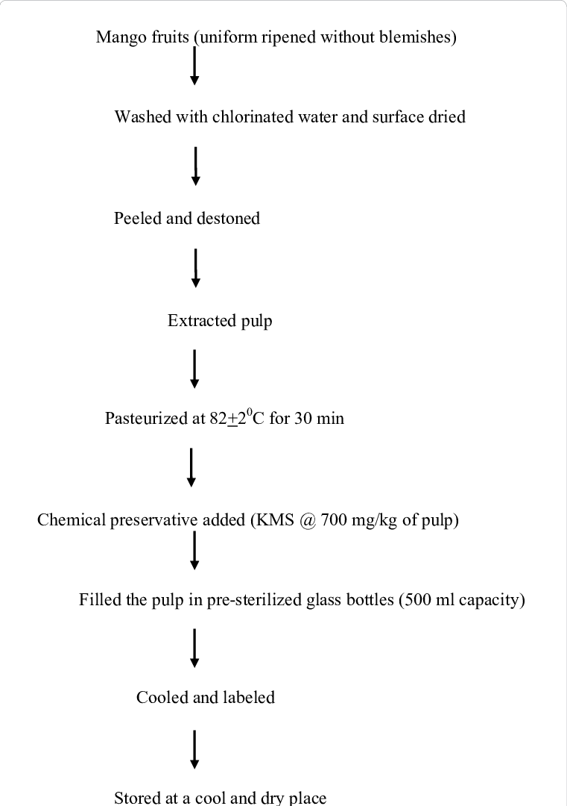
Block Diagram

Slide 11
SOFTWARE REQUIREMENTS:
Operating System : Windows 10
Platform : DOT NET TECHNOLOGY
Front End : ASP.Net 4.0
Back End : SQL SERVER 2014

Slide 12
HARDWARE REQUIREMENTS:
Keyboard
Mouse
Hard disk 500GB
Ram 4 Gb

Slide 13
CONCLUTION
Current study was conducted to develop a mango pulp with the consumer acceptability and the storability without any preservative or any additive. Though, people have judgment that Karthakolomban mango can’t process because of its’ easily browning nature. The study was able to successfully minimize the colour changes during processing and maintain it for two months storage due to applied steam blanching treatment (for 15 min) prior to processing. The processing conditions of developing mango pulp was successfully established by obtaining a product with low microbial count (103 ) and maintaining the level at acceptable range (105 ) during the storage. Moreover, the product was superior in other physico-chemical properties and organoleptic properties. Finally, as a recommendation, Karthakolomban mango pulp could be a good alternative to preserve fresh mango without using any harmful chemical preservatives, additives and without significant losses in nutritional quality up to three months. This will be a good solution to reduce the postharvest loss of mango fruits in seasons and to overcome the deficit and higher prices in the off season.

Slide 14
REFERENCE
Abbasi NA, Zafar I, Maqbool M, Hafiz AF (2009). Post-harvest quality of mango (mangifera indica. L) fruit as affected by chitosan coating. Pak. J. Bot.41(1): 343-357.
Akhtar SS, Mahmood S, Naz M, Sultan MT (2009). Sensory evaluation of mangoes (Mangifera indica. L) grown in different regions of Pakistan. Pak. J. Bot. 41(6): 2821-2829.
Koca N, Burdurlu HS, Karadeniz F (2007). Kinetics of colour changes in dehydrated carrots. J. Food Eng. 78:449-455.
Ndiaye C, Xu Shi-Ying, Wang Z (2009). Steam blanching effect on polyphenoloxidase, peroxidase and colour of mango (Mangifera indica. L.) slices. FOOD CHEM. 113 (1): 92-95.
Nielsen S (2010). Food Analysis. 4thedn. New York, USA. Springer, pp.227-232.

Slide 15
Oranusi US, Braide W, Nezianya HO (2012). Microbial and chemical quality assessment of some commercially packed fruit juices sold in Nigeria. GJBS. 2 (1):1-6.
Ranganna S (1986). Handbook of analysis and quality control for fruit and vegetable products. New Delhi, India. Tata McGraw-Hill, pp.12-123.
Re R, Bramley PM, Rice-Evans C (2002). Effects of food processing on flavonoid and lycopene status in a Mediterranean tomato variety. FREE RADICAL RES. 36(7):803-810.
Sirinivasa PC, Baskaran R, Ramesh MN, Prashanth H, Tharanathan R N (2002). Storage studies of mango packed using biodegradable chitosan film. EUR FOOD RES TECHNOL. 251:504-508.
SLS 516: part 1. (1991). General guide line for enumera tion of micro- organisms colony count techniques at 30 0C. Sri Lanka Standards Institution, Elvitigala Mawatha, Colombo 08.

