Slide 1
Hostel management system

Slide 2
Abstract
As the name specifies “HOSTEL MANAGEMENT SYSTEM” is a software developed for managing various activities in the hostel. For the past few years the number of educational institutions are increasing rapidly. Thereby the number of hostels are also increasing for the accommodation of the students studying in this institution. And hence there is a lot of strain on the person who are running the hostel and software’s are not usually used in this context. This particular project deals with the problems on managing a hostel and avoids the problems which occur when carried manually.

Slide 3
Existing System
Thereby the number of hostels are also increasing for the accommodation of the students studying in this institution.
And hence there is a lot of strain on the person who are running the hostel and software’s are not usually used in this context.
Identification of the drawbacks of the existing system leads to the designing of computerized system that will be compatible to the existing system with the system which is more user friendly and more GUI oriented.
The project, developed using PHP and MySQL is based on the requirement specification of the user and the analysis of the existing system, with flexibility for future enhancement.

Slide 4
Disadvantage of Existing System
This particular project deals with the problems on managing a hostel and avoids the problems which occur when carried manually.
The Standard PHP Library (SPL) attempts to solve standard problems and implements efficient data access interfaces and classes.
This leads to confusion over which data is escaped and which is not, and to problems when data is not in fact used as input to a database and when the escaping used is not completely correct.
Maintenance often includes minor enhancements or corrections to problems that surface in the system’s operation.
Maintenance is also done based on fixing the problems reported, changing the interface with other software or hardware enhancing the software.

Slide 5
PROPOSED SYSTEM :
It is a widely-used general-purpose scripting language that is especially suited for web development and can be embedded into HTML.
PHP is a general-purpose scripting language that is especially suited for web development. PHP generally runs on a web server, taking PHP code as its input and creating web pages as output.
This purpose user manuals are prepared and handled over to the user to operate the developed system. Thus the users are trained to operate the developed system.
The proposed system has three major inputs. They are Machine Registration, Machine Scheduling and Request Form.

Slide 6
ADVANTAGE
A database is a collection of interrelated data stored with minimum redundancy to serve many users quickly and efficiently.
Code optimizers aim to reduce the computational complexity of the compiled code by reducing its size and making other changes that can reduce the execution time with the overall goal of improving performance.
These can offer significant performance gains by caching the compiled form of a PHP script in shared memory to avoid the overhead of parsing and compiling the code every time the script runs.
System testing is the stage of implementation, which is aimed at ensuring that the system works accurately and efficiently before live operation commences.

Slide 7
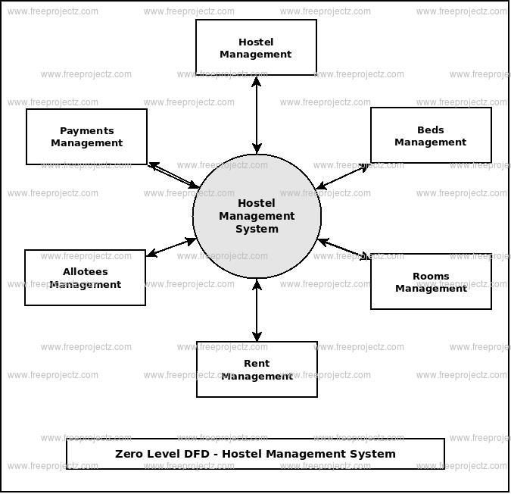
Block Diagram

Slide 8
SOFTWARE REQUIREMENTS:
Operating System : Windows 10
Platform : DOT NET TECHNOLOGY
Front End : ASP.Net 4.0
Back End : SQL SERVER 2014

Slide 9
HARDWARE REQUIREMENTS:
Keyboard
Mouse
Hard disk 500GB
Ram 4 Gb

Slide 10
CONCLUTION
To conclude the description about the project : The project, developed using PHP and MySQL is based on the requirement specification of the user and the analysis of the existing system, with flexibility for future enhancement. The expanded functionality of today’s software requires an appropriate approach towards software development. This hostel management software is designed for people who want to manage various activities in the hostel. For the past few years the number of educational institutions are increasing rapidly. Thereby the number of hostels are also increasing for the accommodation of the students studying in this institution. And hence there is a lot of strain on the person who are running the hostel and software’s are not usually used in this context. This particular project deals with the problems on managing a hostel and avoids the problems which occur when carried manually. Identification of the drawbacks of the existing system leads to the designing of computerized system that will be compatible to the existing system with the system which is more user friendly and more GUI oriented.

Slide 11
REFERENCE
1. www.w3schools.com
2. in.php.net
3. en.wikipedia.org/wiki/PHP
4 . www.hotscripts.com/category/php/
5. www.apache.org/
6. www.mysql.com/click.php?e=35050

