Slide 1
Flood alert monitoring system

Slide 2
Abstract
Flooding is the most common worldwide natural disaster which is stylish throughout the year. There are various methods of alerts such as the email notifications, sirens etc. The design goal of this project is to monitor sudden floods can create a alert that will reach an end user through their mobile phone. Living in a very place that gets several warnings might create it troublesome to induce insurance. People might not hear or have access to warnings. Television and radio take time to get electronic sirens capable of reproducing warning signals and voice announcement. Information can be broadcast simultaneously through SMS. Here we propose to use such as Ultrasonic pressure, Node MCU, GSM module. The ultrasonic pressure will monitor the water level. The GSM modem is a device that can be either a mobile phone or a modem device that can be used to make a computer or any other processor communicate over a network. In addition, it requires a SIM card to be operated and operates over a network range subscribed by the network operator. It may be connected to laptop through serial, USB or Bluetooth connection..The advantage of this system is to monitor the sudden flood occur and then it will send the report immediately for protecting lives and livelihoods.

Slide 3
Existing System
There have been many successful solution on flood alerts using SMS, yet most count on either having a constant power source or which rely completely on solar energy as their main source of power.
In the existing system a sensing unit is built using a GSM module and a PIC18F452 micro controller with 3 different liquid level sensor as input.
The system defines a level threshold and sends one SMS text alert via GSM.
Once the levels start receding it will also alert the user on said event.

Slide 4
Disadvantage of Existing System
The drawbacks of this design are that the sensing and alert system are concentrated into one unit. Also, the system is designed to be only be triggered by the levels and does not store historical data.
However, the system can only be used by two users at a time, which input their phone numbers to the system and receive three alerts per threshold reached.
This design relies on solar power as its only energy source, making it unsuitable for twenty-four hour operation.
It measures distance by causation out a acoustic wave at a particular frequency and listening for that acoustic wave to heal.

Slide 5
PROPOSED SYSTEM :
The proposed system is an enhanced technique for monitoring the water level and to alert the end user. It uses such as Ultrasonic sensor, Node MCA, GSM module.
The ultrasonic pressure will monitor the water level. The GSM modem is a device that can be either a mobile phone or a modem device that can be used to make a computer or any other processor communicate over a network.
In addition, it requires a SIM card to be operated and operates over a network range subscribed by the network operator.
It will be connected to a pc through serial, USB or Bluetooth affiliation.

Slide 6
ADVANTAGE
The advantage of this system is to monitor the sudden flood occur and then it will send the report immediately for protecting lives and livelihoods.
There are four main components used in IoT: Low- power embedded systems –Less battery consumption, high performance are the inverse factors play a significant role during the design of electronic systems.
Massively scalable and efficientIP-based addressing cannot be appropriate within the forthcoming future.
These sensors are used for a large sort of functions from observance the extent of water in a very tank to fluid identification/concentration, to police investigation object proximity.

Slide 7
TITTLE | AUTHOR | DESCRIPTION
Early flood alerts using short message service(SMS) | E. Kuantama, L. Setyawan, and J.Darma | This system focused on an accurate measurement of the height of the water level and sending a warning message of the threshold height set before to the clients.
Cooperative flood detection using GSM via SMS | I. A. Aziz, I. A. Hamizan, N. S. Haron, and M. Mehat, | It is hope that the proposed architecture can be further develop into a functioning system, which would be beneficial to the community and act as a precautionary action to save lives in the case of flood disaster.

Slide 8
TITTLE | AUTHOR | DESCRIPTION
Evaluation of Global Flood Detection Using Satellite-Based Rainfall and a Hydrologic Model | Wu, H., Adler, R. F., Hong, Y., Tian, Y., & Policelli. F, | The purpose of this paper is to evaluate the performance of this new version of the GFMS in terms of flood event detection against flood event archives to establish a baseline of performance and directions for improvement.
Flash flood detection through a multi-stage probabilistic warning system for heavy precipitation events | Alfieri, L., Velasco, D., & Thielen, J, | This paper contributes to flash flood early warning by proposing a multi-stage warning system for heavy precipitation events based on threshold exceedances within a probabilistic framework.

Slide 9
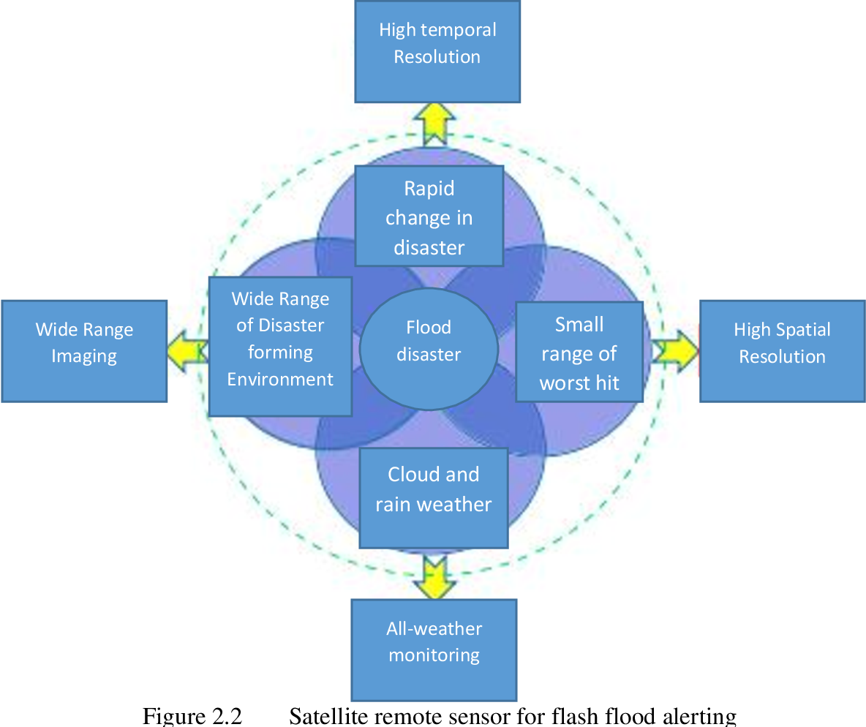
Block Diagram

Slide 10
SOFTWARE REQUIREMENTS:
Operating System : Windows 10
Platform : DOT NET TECHNOLOGY
Front End : ASP.Net 4.0
Back End : SQL SERVER 2014

Slide 11
HARDWARE REQUIREMENTS:
Keyboard
Mouse
Hard disk 500GB
Ram 4 Gb

Slide 12
CONCLUTION
The project proposed is a simple technique which can be easily implemented and cost effective for the flood alerting system. The idea has been implemented as a prototype and verified successfully. The results shows that immediate report will be given to the concerned authority which helps in immediate remedial measures. In future the other parameters measuring can be included and remedial measurements may be added. The idea proposed is now concentrates on flood alerting system and the same can be used to other types of flood alerting also. Here blynk app is used to notice the sensor measurement and also the water level then it will inform the end user through SMS or email or sirens.

Slide 13
REFERENCE
[1] E. Kuantama, L. Setyawan, and J.Darma “Early flood alerts using short message service(SMS),” in 2012 (Early flood alerts system is use to create a tool to measure water level, which powered by solar cell panel).
[2] M. S. Baharum, R. A. Awang, and N. H. Baba, “Flood monitoring system (MYMFS),” in 2011 pp, IEEE 06 2011.
[3] L. S. T. Molina, E. W. Harmsen, and S. Cruz- Pol, “Flood alert system using rainfall forecast data in western puerto rico,” in 2013 (Flooding due to sudden, extreme rainfall events, some of which fail to be detected by radar).
[4] I. A. Aziz, I. A. Hamizan, N. S. Haron, and M. Mehat, “Cooperative flood detection using GSM via SMS,” in 2008 (This project focuses on monitoring water level remotely using wireless sensor network).
[5] Johor Bahru,”UTM SMS Based Flood Device Minimizes” 2015(Flood warning device that alerts people through Short Message System(SMS) once the water level nearby starts to rise).

Slide 14
[6] Wu, H., Adler, R. F., Hong, Y., Tian, Y., & Policelli. F, “Evaluation of Global Flood Detection Using Satellite-Based Rainfall and a Hydrologic Model”,2012(The purpose of this paper is to evaluate the performance of this new version of the GFMS in terms of flood event detection against flood event archives to establish a baseline of performance and directions for improvement).
[7] Alfieri, L., Velasco, D., & Thielen, J, “Flash flood detection through a multi-stage probabilistic warning system for heavy precipitation events”,2011(This paper contributes to flash flood early warning by proposing a multi-stage warning system for heavy precipitation events based on threshold exceedances within a probabilistic framework).
[8] Yamada, Y, “Flood extent detection in paddy area and future plan of disaster information sharing platform in rural areas”,2011(The author also tried to make a disaster information sharing platform, ‘GeoWeb’, using open source software and the ISO orOGC standards).
[9] Fang, S., Xu, L., Zhu, Y., Liu, Y., Liu, Z., Pei, H., … Zhang, H.“An integrated information system for snowmelt flood earlywarning based on internet of things”,2015(This paper presents an integrated approach to snowmelt floods early warning based on geo informatics (i.e. remote sensing (RS), geographical information systems (GIS) and global positioning systems(GPS)),Internet of Things(IoT) and cloud services).
[10] Bartholmes, J. C., Thielen, J., Ramos, M. H., & Gentilini. S,”The European Flood Alert System EFAS – Part 2: Statistical skill assessment of probabilistic and deterministic operational forecasts”,2008(EFAS aims at increasing preparedness for floods in trans-national European river basins by providing medium-range deterministic and probabilistic flood forecasting information, from 3 to 10 days in advance, to national hydro-meteorological services).

