Slide 1
Blood bank automation

Slide 2
Abstract
THE INCOMPATIBLE blood transfusion remains a great danger in hemotherapy. It perhaps is most hazardous to the patient when it involves his receiving incompatible red blood cells. Pain, shock, chills, fever, and renal failure with acute tubular necrosis, abnormal bleeding due to disseminated intravascular coagulation, and death can result.Modern blood bank laboratory techniques readily recognize most incompatibilities in the test tube, and new automated testing equipment is further reducing the chances for technical errors. As a result, incompatible blood transfusions mostly result from human error,¹ which can occur from before the drawing of blood up to the moment of transfusion. Human error refers to clerical errors made identifying patient specimens; in transcribing information from the donor record to the blood-bag label, from the label to various recording sheets and logbooks, from one label to another label; and most important, in matching donor blood information with intended recipient requirements.

Slide 3
Existing System
A plan was developed to interface the existing Transfusion Medicine disaster plan standard operating procedures (SOP) with the institutional and Department of Laboratory Medicine (DLMP) MEICS plans.
We modified our existing Transfusion Medicine disaster plan SOP to integrate with the institutional MEICS plan while at the same time maintaining flexibility and scalability to deal with a variety of emergency and disaster responses.
In Transfusion Medicine we decided to incorporate the specific action items for MEICS activation into our already existing disaster plan procedure.
The luxury of a pause in operations to accommodate the move did not exist.

Slide 4
Disadvantage of Existing System
This is often a serious disadvantage notably in cases wherever there is associate degree pressing would like of blood.
While selecting an appropriate technology for automation there are a number of other issues to be considered and are discussed later.
The decision to buy an automated system depends on the location of the blood bank, type of services provided; cost issues, space availability, staff competency, and feedback regarding the equipment and services of the vendor.
The important issue here is to keep the backup equipment in working order and the concerned staff should be trained to use both the systems.

Slide 5
PROPOSED SYSTEM :
All communication takes place via SMS (Short Messaging Service) which is compatible with almost all mobile types. "Automated Blood Bank" proposes to bring voluntary blood donors and those in need of blood on to a common platform.
The proposed work aims to overcome this communication barrier by providing a direct link between the donor and the recipient by using low cost and low power Raspberry Pi B+ kit.
The proposed work explores to find blood donors by using GSM based Smart Card CPU Raspberry Pi B+ Kit.
This project is originated on an android APP, this will help to find the donors. Blood donor will participate in donor list using APP.

Slide 6
ADVANTAGE
A record of downtime is essential to audit performance of the system and a record of the same should be maintained by the staff in-charge of the equipment.
All the above described methods have reduced the manual input in putting up various serology tests and hence improved the laboratory efficiency.
There are several fully automated immunohematology work stations available at present which differ in the technology used, configuration of the immunohematology tests, throughput, turnaround time, sample loading options, priority sample facility.
To ensure all reagents are used and there is minimal wastage due to expiry of reagents especially reagent red cells, which are short expiry products.

Slide 7
TITTLE | AUTHOR | DESCRIPTION
Data Mining to Improve Safety of Blood Donation Process | Erraguntla, Madhav, Peter Tomasulo,Kevinland,Hany Kamel, Barbee whitaker, | Blood donation is very safe, but a small percentage of donors can have reactions and some of these reactions can lead to serious injury.
A New Concept of Blood Bank Management System Using Cloud Computing for Rural Area(INDIA) | Khan,Javed Akhtar,and M.R Alony . | The paper is basically focused on improving conventional working of blood bank management information system using the concept of cloud computing.

Slide 8
TITTLE | AUTHOR | DESCRIPTION
Android Blood Donar Life Ssving Application in cloud computing | Jenipha, T.Hilda, and R.Bachiyalakshmi. | Cloud- based services can prove important in emergency blood delivery since they can enable central and immediate access to donors' data and location from anywhere.
A Framework for a smart social blood donation system based on mobile cloud computing | Mostafa,Almetwally M.,Ahmed E.Youself,and Gamal Alshorbagy, | Blood banks suffer frequent shortage of blood; hence, advertisements are frequently seen on social networks urging healthy individuals to donate blood for patients who urgently require blood transfusion.

Slide 9
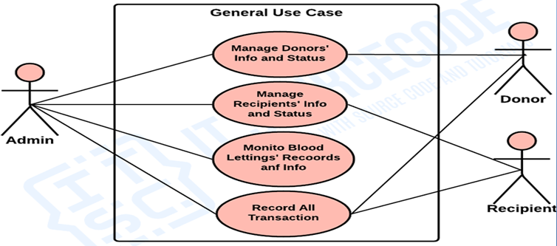
Block Diagram

Slide 10
SOFTWARE REQUIREMENTS:
Operating System : Windows 10
Platform : DOT NET TECHNOLOGY
Front End : ASP.Net 4.0
Back End : SQL SERVER 2014

Slide 11
HARDWARE REQUIREMENTS:
Keyboard
Mouse
Hard disk 500GB
Ram 4 Gb

Slide 12
CONCLUTION
Blood is the primary necessity of life and demand for the healthy blood increasing day by day but finding donators at right time is not a easy job, There are different methods /ways available for searching blood donors but many of them are not user friendly, hectic and yields less or no results many times, This proposed system will be one step ahead from the other blood donation systems. Blood recipient can contact the blood donor directly by using this system .When there is urgent need for blood, it may not be possible for people to connect to the internet to look into the online blood database systems that are already in existence. If people adopt this model, the caller is immediately connected to the donor. Consider a SMS based database system is in which whenever a SMS is send to prospective senders, based on the demand.

Slide 13
REFERENCE
[1] Erraguntla, Madhav,PeterTomasulo,Kevinland,Hany Kamel, Barbee whitaker,”Data Mining to Improve Safety of Blood Donation Process.in System Sciiences(HICSS),2014 47th Hawali International Conference on(pp.789-795).IEEE,2014.
[2] Khan,Javed Akhtar,and M.R Alony .”A New Concept of Blood Bank Management System Using Cloud Computing for Rural Area(INDIA).”International Journal of Electrical ,Electronics and Computer Enginnering,4(1),p.20
[3] Jenipha,T.Hilda,andR.Bachiyalakshmi.”Android Blood Donar Life Ssving Application in cloud computing.”Biometrics and Bioinformatics6.1(2014):34-36.
[4] Mostafa,Almetwally M.,Ahmed E.Youself,and Gamal Alshorbagy,”A Framework for a smart social blood donation system based on mobile cloud computing .arXiv preprint arxiv:1412.7276(2014).
[5].BalaSethilMuruga,L.,and Anitha Julian.”Design and implementation of automated blood bank using embedded system.” Innovations in information Embedded and Communnication systems(ICIIECS),2015 International Conference on(pp.1-6).IEEE(2015).

