Slide 1
Railway reservation system

Slide 2
Abstract
The railway reservation system facilitates the passengers to enquiry about the trains available on the basis of source and destination, booking and cancellation of tickets, enquiry about the status of the booked ticket, etc. The aim of case study is to design and develop a data base maintaining records of different trains, train status and passengers.This project contains introduction to the railways reservation system. It is the computerized system of reserving the seats of train seats in advance. It is mainly used for a long route. Online reservation has made the process for the reservation of seats very much easier than ever before. In our country India, there are number of counters for the reservation of the seats and one can easily make reservations and get tickets.

Slide 3
Railway reservation system, has described above, can lead to error free, secure, reliable and fast management system. It can assist the user to concentrate on their other activities rather to concentrate on the record keeping. Thus it will help organization it better utilization of resources.Administrator of the project, with the help of a password, can enter new train record, display all train records, modify train records and delete train records. The record of train includes its number, name, source, destination, and days on which it is available, whereas record of train status includes dates for which tickets can be booked, total number of seats available, and number of seats already booked.

Slide 4
Existing System
Existing railway reservation system not having feature of displaying appropriate messages for events and errors which occur while accessing the system.
This railway reservation system do not able to provide the details of customers transactions and their payment mode along with date time and processing charge details. Making changing in information and perform administrative task was not possible while using existing system.
Making changes in information and perform administrative task was not possible while using existing system.
In the existing system the exams are done only manually but in proposed system we have to computerize the exams using this application.

Slide 5
Disadvantage of Existing System
The “Railway reservation system” has been developed to override the problems prevailing in the practicing manual system.
The Current Day Reservation System also posed problems and reservations to intermediate stations were not possible. The Coaching Refund System was also not integrated with the PRS.
The Railways faced a number of problems in the restoration of disrupted BSNL channels as the maintenance was very poor.
Though the problems in the system existed for more than three years, they were not rectified.
If the passenger was still available after restoration of the link, the operator had to search the data base for the saved transaction and then issue a blank paper ticket.

Slide 6
PROPOSED SYSTEM :
Security of data.
Ensure data accuracy’s
Proper control of the higher officials.
Minimize manual data entry.
Minimum time needed for the various processing.
Greater efficiency.
Better service.
User friendliness and interactive.

Slide 7
ADVANTAGE
In PRS, the role of the communication system is also vital, as the functioning of the system is primarily dependent on the performance of the network.
In spite of involving CRIS, the performance of the contractors was not satisfactory particularly in ER, where there were undue delays in rectification of faults.
Where BSNL links have to be continued for strategic reasons it is necessary to ensure effective performance and efficient delivery of services through proper agreements and penal clauses.
Any discrepancies in the outputs generated would present a skewed picture of railway performance.

Slide 8
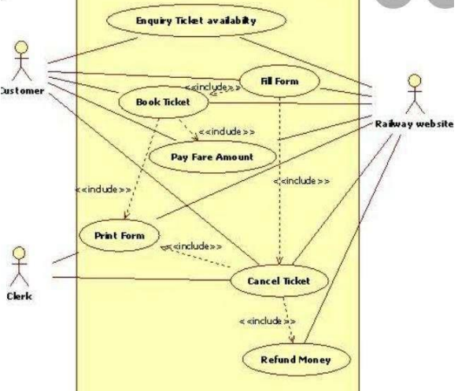
Block Diagram

Slide 9
SOFTWARE REQUIREMENTS:
Operating System : Windows 10
Platform : DOT NET TECHNOLOGY
Front End : ASP.Net 4.0
Back End : SQL SERVER 2014

Slide 10
HARDWARE REQUIREMENTS:
Keyboard
Mouse
Hard disk 500GB
Ram 4 Gb

Slide 11
CONCLUTION
The main of developing reservation system is to provide all information that is required by the users. User friendliness is a must that is the user must get the details without complicated searching procedures .Other important requirements of software are data security, extensibility and maintainability.

Slide 12
REFERENCE
1. http://www.google.com/
2. http://en.wikipedia.org
3. Computer science with C++ by Sumita Arora

