Slide 1
Three level password authentication schemes

Slide 2
Abstract
Textual passwords are more commonly used in day to day life. They tend to be more vulnerable as far as security is concerned. Users tend to pick short password that are easy to remember which makes the password vulnerable for attackers to break. Furthermore, textual password is vulnerable to hidden camera, shoulder surfing, key loggers, spyware and brute force attack. Graphical password schemes have been proposed as a possible alternative to text-based scheme. However, they are mostly vulnerable to shoulder surfing and key loggers.

Slide 3
Existing System
It can replace or coexist with conventional textual password systems without changing existing user password profiles.
Hackers are mostly hacking our bank details, office details and personal mail. Now many security methods are used, but most of all failure process, because all the applications have some easy way to hack.
Our username identifies us and the password validates us. But passwords have some weaknesses: more than one person can possess its knowledge at one time.
Moreover, there is a constant threat of losing your password to someone else with venomous intent.

Slide 4
Disadvantage of Existing System
Someone standing behind or besides you can intentionally see the credentials (The Shoulder Surfing Problem).
There is a need for solving the above stated problem. In this paper, we propose a Three Phase Textual-Graphical Password Authentication scheme.
This technique seamlessly integrates both graphical and textual password schemes and provides nearly perfect resistant to shoulder-surfing, hidden-camera, spyware attacks, key loggers and brute force attack.
When increasing security is an issue text based passwords are not enough to counter such problems.

Slide 5
PROPOSED SYSTEM :
Graphical password schemes have been proposed as a possible alternative to text-based scheme.
The proposed scheme has an extremely wide scope as it can be used for banking application, ATM services and other such application where user interaction with private data is controlled by means of password authentication.
This scheme proposes that, instead of clicking on the characters of session password, user will remember those characters, and at the end the user has to enter the session password which will lead to its authentication.
According to the system requirement, desired level of security can be achieved by using three proposed levels of authentication.

Slide 6
ADVANTAGE
This system use only security purpose, it uses to all security place.
Hackers are not very easily to hack the security, because three levels are more useful this concept.
Any hacker if in the extreme case, suppose (although difficult) will cross through the above two mentioned security levels, will definitely not be able to cross the third security level, unless he has access to the original user’s email id.
We also consider further cryptographic advantages given to the adversary when considering the password protocol being instantiated with particular encryption schemes.

Slide 7
TITTLE | AUTHOR | DESCRIPTION
Recognition memory for words, sentences and pictures | R. N. Shepard. | They were then tested for their ability to recognize these “old” stimuli in pairs in which the alternative was always a “new” stimulus selected at random from the stimuli remaining in the original population.
Graphical passwords | G. E. Blonder, | In this paper, we conduct a comprehensive survey of the existing graphical password techniques.

Slide 8
TITTLE | AUTHOR | DESCRIPTION
Authenticating Users on Handheld Devices | W. Jansen, | Adequate user authentication is a persistent problem, particularly with handheld devices, which tend to be highly personal and at the fringes of an organization’s influence.
S3PAS:A Scalable ShoulderSurfing Resistant Textual-Graphical Password Authentication Scheme | Huanyu Zhao and Xiaolin Li, | S3PAS seamlessly integrates both graphical and textual password schemes and provides nearly perfect resistant to shoulder-surfing, hidden-camera and spyware attacks.

Slide 9
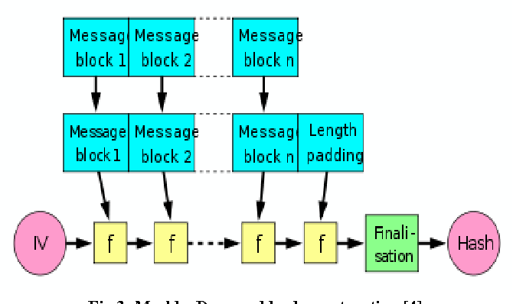
Block Diagram

Slide 10
SOFTWARE REQUIREMENTS:
Operating System : Windows 10
Platform : DOT NET TECHNOLOGY
Front End : ASP.Net 4.0
Back End : SQL SERVER 2014

Slide 11
HARDWARE REQUIREMENTS:
Keyboard
Mouse
Hard disk 500GB
Ram 4 Gb

Slide 12
CONCLUTION
We proposed a three level authentication system.3LAS demonstrates desirable features of a secure authentication system being immune to shoulder surfing, hidden camera and spyware attacks. According to the system requirement, desired level of security can be achieved by using three proposed levels of authentication.

Slide 13
REFERENCE
[1] R. N. Shepard. Recognition memory for words, sentences and pictures. Journal of Verbal Learning and Verbal Behavior, 6:156– 163, 1967.
[2] G. E. Blonder, "Graphical passwords," in United States Patent, vol.5559961, 1996.
[3] W. Jansen, "Authenticating Mobile Device User Through Image Selection," in Data Security, 2004.
[4] W. Jansen, "Authenticating Users on Handheld Devices," in Proceedings of Canadian Information Technology Security Symposium, 2003.
[5] W. Jansen, S. Gavrila, and V. Korolev, "A Visual Login Technique for Mobile Devices," in National Institute of Standards and Technology Interagency Report NISTIR 7030, 2003.
[6] L. Sobrado and J. C. Birget. Graphical passwords. The Rutgers Scholar, An Electronic Bulletin for Undergraduate Research,4, 2002.
[7] Huanyu Zhao and Xiaolin Li,"S3PAS:A Scalable ShoulderSurfing Resistant Textual-Graphical Password Authentication Scheme,"in 21st International Conference Advanced Information Networking and Application Workshop, 2007

