Slide 1
School attendance management system through sms

Slide 2
Abstract
Child Safety is very important nowadays and everyone wants to get SMS alerts from the school about their child attendance in the school. Traditional ways of sending SMS is very time-consuming. It takes so many hours in collecting data and informing the parent about the child attends. We have a new solution for this in which we automate the attendance.

Slide 3
Existing System
Most of the existing systems have tried to resolve the problem of taking attendance manually. But, almost all of them are unable to make the attendance system all around automatic.
A major problem in the existing approaches is that no one has applied an RTC to fix the duration for taking attendance.
In existing systems, if a student comes late, he/she is considered to be present, which should not happen. These are the main problems in the existing systems.
In many cases, the attendances are marked using RFID technique and messages are sent to the parents of only those students, who are present.

Slide 4
Disadvantage of Existing System
When student place his/her finger on fingerprint sensor, if the fingerprint matches with the data which is stored in database, then attendance will be registered and at the same time the SMS will be send to parent’s mobile, indicating the presence of their child.
In today’s world parents are worried whether their children are reaching safely to school or college, this problem will be solved with this system.
Whenever an RFID tag is brought in front of the RFID reader, it starts matching the frequencies of both. For every card, a special ID number is issued.
Radio Frequency Identification (RFID) based attendance system is one of the solutions to this problem.

Slide 5
PROPOSED SYSTEM :
In this paper, development and management of attendance reports using biometrics is proposed. The system makes use of fingerprints, which is a unique identification for every person.
The method proposed here would eliminate the use of stationary materials as well as reduce human efforts in the process of attendance development.
This paper will discuss the general overview of the proposed system; details of design and operation of system in both hardware and software domain.
The records are stored in Microsoft SQL (Structured Query Language) Server database .This database is very fast and it can store large number of records.

Slide 6
ADVANTAGE
Attendance is an important criteria for measuring the performance of any institute. For making this attendance management procedure simpler, fingerprints are one of the most common methods of biometric identification.
As this system is less time consuming, the performance and efficiency of the system is much better than traditional way.
An efficient and effective system is needed to mark attendance of students, which will deliver SMS via Global System for Mobile communication (GSM) to their respective parents.
The system has used barcode scanner for recording attendance. The RFID technology has a number of advantages, which include simultaneous collection of large quantities of data with high accuracy and no contact.

Slide 7
TITTLE | AUTHOR | DESCRIPTION
Development of Attendance Management System using Biometrics | O. Shoewu, Ph.D. and O.A. Idowu, B.Sc., | The ability to compute the attendance percentage becomes a major task as manual computation produces errors, and also wastes a lot of time.
Fingerprint Based Student Attendance System WithSmsAlert To Parents | K.Jaikumar, M.Santhosh Kumar, S.Rajkumar and A.Sakthivel, | This paper is a study of a fingerprint recognition system based on minutiae based fingerprint algorithms used in various techniques.

Slide 8
TITTLE | AUTHOR | DESCRIPTION
Automation of Attendance System using RFID,Biometrics, GSM Modem with .Net Framework | AamirNizam Ansari, ArundhatiNavada, SanchitAgarwal, SiddharthPatilandBalwant A. Sonkamble, | The purpose of this paper is to develop a wireless system to detect and maintain the attendance of a student and locate a student.
Biometric Attendance | M.A. Meor Said, M.H. Misran , M.A. Othman, M.M. Ismail, H.A. Sulaiman, A. Salleh and N. Yusop, | The system will facilitate institutions! organization to make attendance individual in time along with data information thumb impression will be taken as a signature for the system entry.

Slide 9
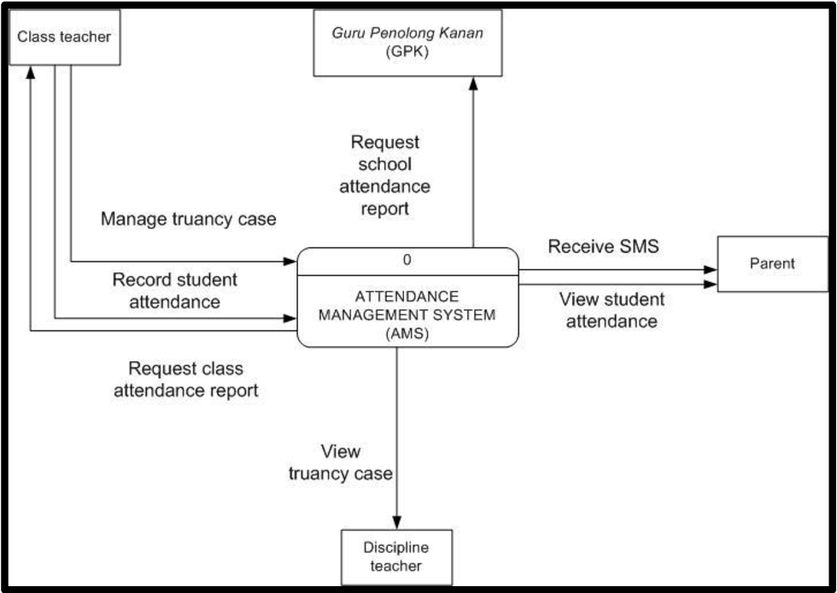
Block Diagram

Slide 10
SOFTWARE REQUIREMENTS:
Operating System : Windows 10
Platform : DOT NET TECHNOLOGY
Front End : ASP.Net 4.0
Back End : SQL SERVER 2014

Slide 11
HARDWARE REQUIREMENTS:
Keyboard
Mouse
Hard disk 500GB
Ram 4 Gb

Slide 12
CONCLUTION
The system is able to take students attendance successfully. As this system is less time consuming, the performance and efficiency of the system is much better than traditional way. Attendance data is stored in database along with updated date and time.SMS notification about the attendance is successfully sent to parent’s mobile using GSM. Stored data of attendance is used for calculating defaulters list.

Slide 13
REFERENCE
[1] O. Shoewu, Ph.D. and O.A. Idowu, B.Sc., “Development of Attendance Management System using Biometrics,” in The Pacific Journal of Science and Technology,Volume 13. Number 1. May 2012 (Spring)
[2] K.Jaikumar, M.Santhosh Kumar, S.Rajkumar and A.Sakthivel,“Fingerprint Based Student Attendance System WithSmsAlert To Parents,” in IJRET: International Journal of Research in Engineering and Technology,Volume: 04 Issue: 02 | Feb-2015.
[3] AamirNizam Ansari, ArundhatiNavada, SanchitAgarwal, SiddharthPatilandBalwant A. Sonkamble, “Automation of Attendance System using RFID,Biometrics, GSM Modem with .Net Framework,” in 978-1-61284-774-0/11/$26.00 ©2011 IEEE.
[4] M.A. Meor Said, M.H. Misran , M.A. Othman, M.M. Ismail, H.A. Sulaiman, A. Salleh and N. Yusop, “Biometric Attendance,” in 978-1-4799-3704- 2/14/$31.00 ©2014 IEEE.
[5] Yash Mittal, AishwaryVarshney, PrachiAggarwa, KapilMatani and V. K. M ittal “Fingerprint Biometric based Access Control and Classroom Attendance Management System,” in [978-1-4673-6540-6/15/$31.00 ©2015 IEEE].

Slide 14
[6] MadduKamaraju and Penta Anil Kumar , “Wireless Fingerprint Attendance Management System,” in 978-1-4799-6085-9/15/$31.00 ©2015 IEEE.
[7] The IEEE website. [Online]. Available: http://www.ieee.org/
[8] The fingerprint scanner website. [Online]. Available https://computer.howstuffworks.com/
[9] The circuit digest website. [Online]. Available: https://circuitdigest.com/
[10] Rishabh Mishra and PrashantTrivedi , “`Student Attendance System Based On Fingerprint Recognition and One-to-Many Matching, ”National Institute of Technology, Rourkela, Sep 2011.
[11] MasoudNosrati , “Python: An appropriate language for real world Programming,” in World Applied Programming, Vol (1), No (2), June 2011.

