Slide 1
Marriage hall booking system

Slide 2
Abstract
The aim of making the marriage hall reservations and accounting system with online facility is to provide such generic software which could facilitate any kind of marriage hall with the best reservation and accounting system. It will be serving as the backbone of the marriage hall management system. With this software, the management team gets reliable and efficient computerized database reservation and accounting system. The management team will be able to reserve customer’s marriage at any specific time along with their customized request.

Slide 3
Existing System
The existing system is manual /machine systems where the users must have to perform their manually. It will take more time and this whole procedure is very tedious and takes a lot of time.
The existence of Wedding Arch is meant to assist users in making decisions while design and planning their weddings or any wedding related occasions.
Besides end users, this wedding planner is put together with the vendors in mind for them to strategies their marketing plan.
The web-based wedding planner not only serves as a solution for providing information on bridal products and services, it also functions as an electronic commerce portal for vendors to trade and advertise their products and expertise.

Slide 4
Disadvantage of Existing System
It is limited to a single system.
It has lot of manual work (Manual work does not mean working with pen or paper, rather includes working on spread sheets and other simple software.)
The present system is very less secure.
It unable to generate different kinds of reports.
It is difficult to maintain phone bookings and cancellations.
Does not provide global support. User cannot do the reservation from remote place.
Retrieval of information is difficult and time consuming.
A lot of time and manual effort is required

Slide 5
PROPOSED SYSTEM :
To provide the information regarding Wedding.
To provide the information about the Booking of users choice.
Online Users can submit their queries by giving the wedding destination, tentative date, number of guests, contact number etc.
Interested Users can book accommodations for their guests in Hotels.
It can be a 5 Star,4 Star or 3 Star hotel. Online users can provide their requirements like no. of rooms, no. of nights, accommodation budget etc.
Wedding themes are available in the websites.
There is a facility to book caterers according to the budget.

Slide 6
ADVANTAGE
Online Wedding Planning Hall booking System is a web based project which act as a bridge between potential users and wedding planners.
As people spend lots of money on Weddings, Parties and MICE, but they involve their selves in each and every affair in such a way that at the end of the day they feel that they have not seen the wedding of their only Son/Daughter or they have not been able to enjoy the program.
That is why, a Wedding Planner-Co-coordinator is required to make all people comfortable on the day of the Wedding /Event.
The web- based decision support system sustains an analysis tool for users and vendors alike by providing price analyzing services to assist in the decision making processes.

Slide 7
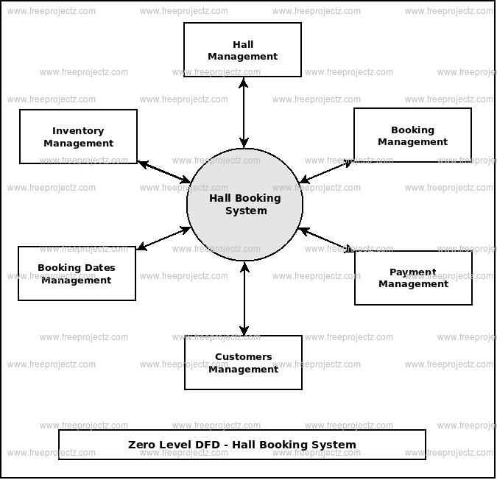
Block Diagram

Slide 8
SOFTWARE REQUIREMENTS:
Operating System : Windows 10
Platform : DOT NET TECHNOLOGY
Front End : ASP.Net 4.0
Back End : SQL SERVER 2014

Slide 9
HARDWARE REQUIREMENTS:
Keyboard
Mouse
Hard disk 500GB
Ram 4 Gb

Slide 10
CONCLUTION
We have shown how to build a room booking system with a database as the back-end and a front-end in HTML embedded with C#. It is easy to make Marriage Hall reservations in the graphical user interface and the week schema gives a good overview of the reservations for the Marriage Hall. The combinations of the search functions, the ability to reserve for any user and the ability to manage the whole database from the web-site made this system a very powerful administrative Marriage Hall booking system. The security model used based on different privilege for different users also makes the system a real-life application.

