Slide 1
Hostel fees management

Slide 2
Abstract
A hostel management system (HOMASY) was designed to provide a computerized process that is stress free, reliable and quick through the use of PHP computer programming language and MySQL database application to both the students and the staff in charge of the registration and hostel management processes. HTML would be at the front-end and provide the graphical user interface that relates with the user, while the MySQL database will be at the back-end to handle the data storage process. The porter and students’ affairs officers will also be able to access and create student records with ease and regular update of student profile is enhanced when adopted. The usual practice of filing and procedures involved in students’ registration and hostel accommodation in Lagos State University and other university was appraised for efficiency, economics and time management. The existing procedure was formed to be manually carried out. This is associated with inadequacies as more personnel are often required and a lot of times are wasted while the semester is on with lectures and other activities.

Slide 3
Existing System
Hostel management is not a new thing it is came into existence when people have the idea of hostel.
It’s very difficult perform the repetitive task by the authorized person to the existing data, we need to search and perform all the modification, upgradations and other activity.
The data in hard copy is not so secure, because unauthorized persons will steal the data and can also perform some inconsistence modification to the existing data.
It allows authorized person to access the data easily and modification to the existing data. Student can do their registration easily by student portal, and room allotment will be handled by hostel clerk and allotted the room according to availability.

Slide 4
Disadvantage of Existing System
System analysis is a method of problem-solving that deals with the breaking down of a system into components parts in order to study how well the individual parts work and interact to accomplish their purpose.
It involves the process of enumerating the existing problems, analyzing the proposed system for costs and benefits, analyzing the system and user requirements, and considering possible alternative system.
We can also maintain the room number and floor number, student overall reports easily without any problem.
This problem can be solved by a system which can do the entire task related to information handling without any complexity and just a few clicks.

Slide 5
PROPOSED SYSTEM :
In proposed system the information about the hostel maintained in highly secured manner, no one can hack the information about the hostel.
System also maintain student payment details, and generate unique room number for each student, System also maintain hostel clearance details, if student vacate the hostel he should complete this procedure, hostel clerk has a response with room physical checking and enter final charge if applicable.
System also maintain and generate report of students staying in hostel, student report can access by the authorized person from anywhere at any time.

Slide 6
ADVANTAGE
These processes are carried out manually with pen and papers; an unreliable procedure which is associated with inefficiencies.
An increase in the number of student will obviously mean more paper work and less efficiency of the traditional registration system, hence, many Universities are finding the e-registration a better and more effective way of catering for the inconvenience and inefficiency of the traditional system of registration.
An electronic system of registration focuses on saving cost, improving the efficiency of the processes involved in both registration and management of hostels and makes the overall procedure stress free.
This system will help improve productivity and reliability of the hostel registration and management process in a more efficient manner.

Slide 7
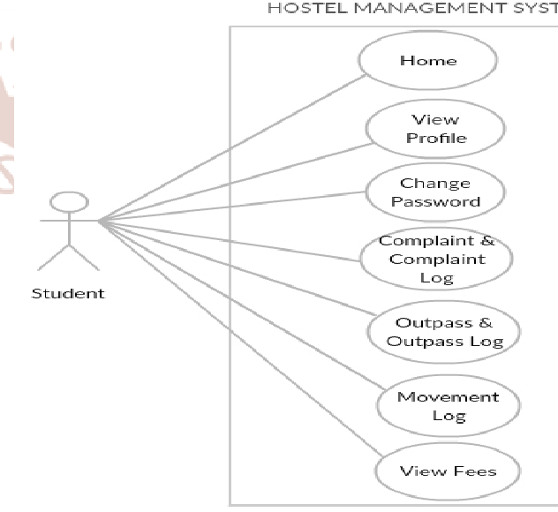
Block Diagram

Slide 8
SOFTWARE REQUIREMENTS:
Operating System : Windows 10
Platform : DOT NET TECHNOLOGY
Front End : ASP.Net 4.0
Back End : SQL SERVER 2014

Slide 9
HARDWARE REQUIREMENTS:
Keyboard
Mouse
Hard disk 500GB
Ram 4 Gb

Slide 10
CONCLUTION
The introduction of an electronic system of registration focuses on saving cost, improving the efficiency of the processes involved in both registration and management of hostels and makes the overall procedure stress free. The hostel management system is aimed at streamlining the registration and management process of hostels for both students and the administrators in charge of the procedures involved. It is to eliminate unnecessary administrative tasks and reduce or even avoid paper work. This system will help improve productivity and reliability of the hostel registration and management process in a more efficient manner.

Slide 11
REFERENCE
1. Whitten, Bentley, and Dittman. 2004. System Analysis and Design Methods (5th ed). McGrawHill: New York, NY.
2. PerlScriptsJavaScripts.com. 2006. “MySQL Tutorial, Database Commands, Beginners Guide”. http://www.perlscriptsjavascripts.com/tutorials/mys ql/index.html. Accessed 2/3/06.
3. HTML Elements. W3schools. Retrieved 3/16/15.
4. CSS Introduction. W3schools. Retrieved 3/16/15.
5. Xhtml.com. Retrieved on 5/16/12.

Slide 12
6. MySQL: Project Summary. Black Duck Software. Retrieved 9/17/12.
7. PHP Manual: www.php.net
8. PHP for Windows: php.net. Retrieved 10/29/13. https://wikipedia.org/wiki/PHP
9. https://wikipedia.org/wiki/HTML
10. https://wikipedia.org/wiki/CSS
11. https://wikipedia.org/wiki/MySQL
12. Segun O. Olatinwo and et al. 2014. “Development of an Automated Hostel Facility Management System”. Journal of Science and Engineering. 5 (1): 1-10.

