Slide 1
High secure corporate web search engine

Slide 2
Abstract
Internet has become the biggest repository of information in the world. It can be considered as a global library where variety of information in different languages and formats is stored in digital form. The volume of information on web is enormous and it has become near to impossible to estimate its size. Because of its size and storing mechanism, finding relevant and precise information has become a difficult task. For searching information from this vast repository, we use search engines. There are thousands of search engines available on internet. For example, if you visit http://www.thesearchen ginelist.com/, you will find a classified list of search engines. This list is category-wise and includes all-purpose search engines in various fields like accounting, blogs, books, legal, medical, etc.

Slide 3
Existing System
A search engine for the Web of Things has to support searching for structured and rapidly changing content, which is a key challenge given that existing Web search engines are based on the assumption that most Web content changes slowly, such that it is sufficient to update an index at a frequency of days or weeks.
We discover so-called periodic patterns in the time window using a variant of an existing algorithm.
This allows a seamless integration into the existing Web infrastructure, making it possible to utilize existing applications and services with Web-enabled things.
In contrast to existing Web search engines, such a real-world search engine has to support searching for rapidly changing state information generated by sensors.

Slide 4
Disadvantage of Existing System
The key challenge that needs to be addressed in constructing a search engine for the Web of Things is the anticipated huge size and extreme dynamics of the search space.
Analysis indicates that this is an implementation-specific problem caused by memory management issues in the Java virtual machine.
When a user issues a search request (in this case “room ifw occupancy : empty”), the resolver is in charge of handling its execution.
For this, it will first reduce the result set to entities which match the static part of the search term (“room ifw”) and feature the requested sensor type(s) (“occupancy”), by querying the index.

Slide 5
PROPOSED SYSTEM :
We have proposed an approach called sensor ranking, which for a given query computes the probability that a sensor produces the sought output at the time of the query by using indexed prediction models.
Sensors are then pulled in decreasing order of probability until enough matches have been found, thus spending effort first where it counts.
We also exploit the fact that users of search engines are typically not interested in all results, since these are typically far too many to check manually.
We proposed the augmentation of the existing Web with representations of these real-world entities – thus offering online and real-time Web access to the state of the real world.

Slide 6
ADVANTAGE
The former tries to optimize the performance of the search engine, while the latter tries to optimize user satisfaction.
Inaccurate prediction models will, however, degrade the performance of the search engine.
To sum up, prediction models are periodically created by a sensor gateway, based on a set of recent sensor states, periodically indexed by Dyser, at a rate of days to weeks, and evaluated by Dyser during the resolution of a search request.
We evaluated the performance of our prototypical search engine in terms of the communication overhead and latency.
To obtain repeatable results, we used a realistic data set that is replayed by the sensor gateway instead of real sensors.

Slide 7
TITTLE | AUTHOR | DESCRIPTION
Sensing Meets Mobile Social Networks: The Design, Implementation and Evaluation of the CenceMe Application | E. Miluzzo, N. D. Lane, K. Fodor, R. Peterson, H. Lu, M. Musolesi, S. B. Eisenman, X. Zheng, and A. T. Campbell, | We report performance measurements that characterize the computational requirements of the software and the energy consumption of the CenceMe phone client.
Architecting a Mashable Open World Wide Web of Things | D. Guinard, V. Trifa, and E. Wilde, | Many efforts are currently going towards networking smart things from the physical world (e.g. RFID, wireless sensor and actuator networks, embedded devices) on a larger scale.

Slide 8
TITTLE | AUTHOR | DESCRIPTION
Putting Things to REST | E. Wilde, | This paper presents a path towards a Web where physical objects are made available through RESTful principles.
Sensor Ranking: A Primitive for Efficient Content-Based Sensor Search | B. M. Elahi, K. Romer, B. Ostermaier, M. Fahrmair, and W. Kellerer, | In this paper we introduce a primitive called sensor ranking to enable efficient search for sensors that have a certain output state at the time of the query.

Slide 9
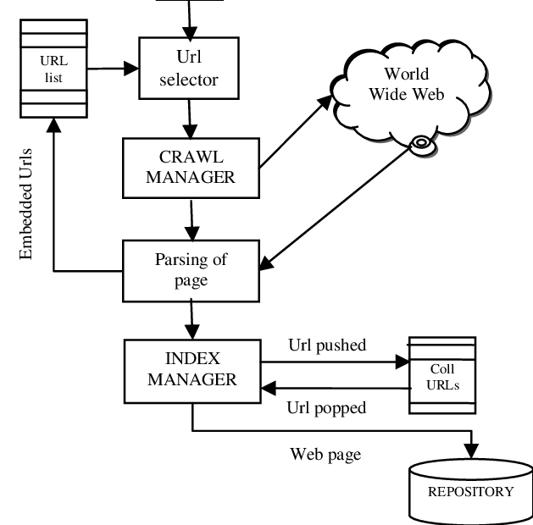
Block Diagram

Slide 10
SOFTWARE REQUIREMENTS:
Operating System : Windows 10
Platform : DOT NET TECHNOLOGY
Front End : ASP.Net 4.0
Back End : SQL SERVER 2014

Slide 11
HARDWARE REQUIREMENTS:
Keyboard
Mouse
Hard disk 500GB
Ram 4 Gb

Slide 12
CONCLUTION
Founded in the increasing trend of enriching real-world entities with embedded and globally networked sensors, we proposed the augmentation of the existing Web with representations of these real-world entities – thus offering online and real-time Web access to the state of the real world. We presented the design and implementation of Dyser, a realtime search engine that enables finding real-world entities that exhibit a certain state at the time of the query. We studied the performance of Dyser on a real-world data set containing data from 385 sensors over a period of 5 months. An important thread for future work is the distribution – where several instances of the search engine take care of certain subsets of entity and sensor pages – and parallelization of the search engine – where the search engine itself and its index are distributed over multiple computers. The former is expected to offer a significant speedup for the execution of multiple simulateneous queries, while the latter can be expected to also speed up the execution of a single query.

Slide 13
REFERENCE
[1] E. Miluzzo, N. D. Lane, K. Fodor, R. Peterson, H. Lu, M. Musolesi, S. B. Eisenman, X. Zheng, and A. T. Campbell, “Sensing Meets Mobile Social Networks: The Design, Implementation and Evaluation of the CenceMe Application,” in SenSys 2008, pp. 337–350.
[2] “Botanicalls.” [Online]. Available: www.botanicalls.com
[3] “Bicing.” [Online]. Available: www.bicing.com
[4] D. Guinard, V. Trifa, and E. Wilde, “Architecting a Mashable Open World Wide Web of Things,” ETH Zurich, Tech. Rep. CS-663, 2010. [Online]. Available: www.vs.inf.ethz.ch/publ/papers/WoT.pdf,
[5] E. Wilde, “Putting Things to REST,” UC Berkeley School of Information, Tech. Rep. 2007-015, November 2007.

Slide 14
[6] B. M. Elahi, K. Romer, B. Ostermaier, M. Fahrmair, and W. Kellerer, ¨ “Sensor Ranking: A Primitive for Efficient Content-Based Sensor Search,” in IPSN 2009, pp. 217–228.
[7] N. Eagle and A. Pentland, “Eigenbehaviors: identifying structure in routine,” Behavioral Ecology and Sociobiology, vol. 63, no. 7, pp. 1057– 1066, 2009.
[8] C. Song, Z. Qu, N. Blumm, and A. L. Barabasi, “Limits of Predictability in Human Mobility,” Science, vol. 327, no. 5968, pp. 1018–1021, 2010.
[9] M. G. Elfeky, W. G. Aref, and A. K. Elmagarmid, “Using Convolution to Mine Obscure Periodic Patterns in One Pass,” in EDBT 2004, pp. 605–620.
[10] “Microformats.” [Online]. Available: http://microformats.org

