Slide 1
Department staff attendance mailing system

Slide 2
Abstract
Attendance management is the act of managing attendance or presence in a work setting. Considering an academic institute, the conventional method of taking staff attendance is by signing on paper is very time consuming and insecure, hence inefficient. Maintaining these records for a long time adds to the difficulty of the task. In lieu of this, an efficient system is proposed to solve the problem of manual attendance. In this research work, staff attendance is taken electronically with the help of a fingerprint Biometric system, and all the records are saved for subsequent operations. Fingerprints are considered to be the best and fastest method for biometric identification because they are secure to use, unique for every person and do not change in one's lifetime. Staff attendance management system using fingerprint biometric identification technique employs an automated system to calculate staff attendance in lecture rooms in an institution and do further calculations of daily and monthly attendance summary in order to reduce human errors during calculations. In essence, this system can be employed in curbing the problems of tardiness or lateness of lecturers to lecture rooms, impersonation and missing lecture periods in any institution. The system will also improve the productivity of any institution if properly implemented.

Slide 3
Existing System
The Organizations are required to register online (once) on the portal for using attendance.gov.in by giving number of employees and their existing website name.
Such system should leverage on existing identity infrastructure created by Aadhaar which will result in cost, efficiency and scalability advantages.
The Government agencies shall provide connectivity from various telecom service providers for connecting the bio-metric attendance terminals (GPRS/Wi-Fi using NICNET/Broadband/existing Internet) in a decentralized manner.
Government organizations shall make suitable provision for getting Client ‘API’ installed on the software provided for wall mounted and desktop finger print devices.

Slide 4
Disadvantage of Existing System
A secure and effective identity management system plays an important role in the successful deployment of an attendance management system.
Carrying different cards and remembering passwords for different services is a significant issue for individuals and organizations.
The system provided faster processes, less inventory, fewer efforts, and better quality via providing direct cost savings while it caused some technical issues and slow system deployment.
Employees can give their feedback about their attendance marking experience and the problems the encounter in the process.

Slide 5
PROPOSED SYSTEM :
The proposed system is achieving two aims, the first objective is to register, record, and manage a student attendance using RFID tag, and the second aim is to provide student information service such as timetable, lecture time and classroom number, and other student-related data that displayed in screen or LCD.
The conducted system recorded students' attendance by using Bluetooth, but the limitation of the proposed system is that the phones must have Bluetooth technology within the operating system.
The proposed circuit aims to investigate student’s services that provide presence and information services based on the internet of things applications and technologies by literature review that gives an overview of what has been done.

Slide 6
ADVANTAGE
The system provides attendance managing records to evaluating their performance as well support an information services for students and faculty staff.
It is an Object oriented programming language and has its core, many similarities to Java, C++ and VB. In fact C# combines the power and efficiency of C++ and it’s the simple and clean object oriented design of Java and the language simplification of VB.
It can be concluded from the above discussion that a reliable, secure, fast and efficient system has been developed replacing a manual and unreliable system.
While, and the proposed system is providing tracking students in their school, college or university to improve their student performance.

Slide 7
TITTLE | AUTHOR | DESCRIPTION
Fingerprint-Based Authentication System for Time and Attendance Management | Ikuomola A (2014). | A fingerprint recognition system uses the distinctive and persistent characteristics from the ridges, also referred to as fingerprint features, to distinguish one person from another.
Attendance Management for Industrial Workers | Md. S and Rabindra N (2013) | Fingerprint recognition is a mature field to-day, but still identifying individual from a set of enrolled fingerprints is a time taking process.

Slide 8
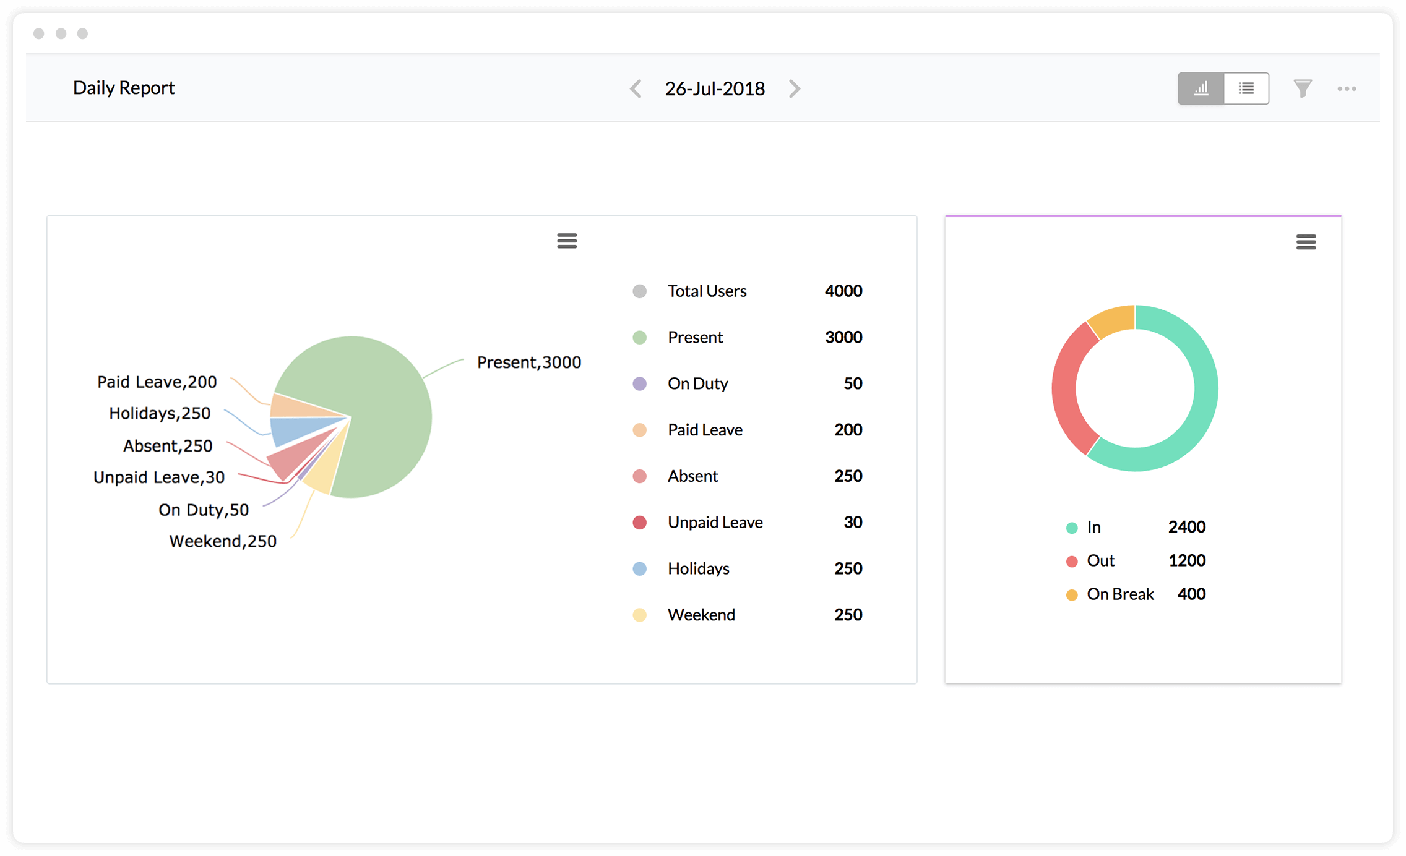
Block Diagram

Slide 9
SOFTWARE REQUIREMENTS:
Operating System : Windows 10
Platform : DOT NET TECHNOLOGY
Front End : ASP.Net 4.0
Back End : SQL SERVER 2014

Slide 10
HARDWARE REQUIREMENTS:
Keyboard
Mouse
Hard disk 500GB
Ram 4 Gb

Slide 11
CONCLUTION
Traditionally, lecturer’s attendance is taken using the manual method which involves pen and paper registers. This research mainly comprises of development of staff attendance management system using fingerprint biometric technique. Attendance management system is very helpful in saving valuable time of students and lecturers, saving paper and generating report at required time. This research has presented a framework in which attendance management has been made automated. Furthermore, it can curb tardiness of lecturers in the institution and make them regular if implemented. It can be concluded from the above discussion that a reliable, secure, fast and efficient system has been developed replacing a manual and unreliable system. Results have shown that this system can be implemented in an institution for better results regarding the management of attendance. This system will save time, reduce the amount of work the administrator has to do and replace the stationery material with electronic devices. Hence, a system with expected results has been developed but there is still room for improvement.

Slide 12
REFERENCE
AFIS (1981). Automated Fingerprint Identification System. Textbook by Keneth R. Moses
FBI (1969). Federal Bureau of Investigation, “The Ten most wanted fugitives “ from the Wikipedia, the free encyclopedia.
Ikuomola A (2014). Fingerprint-Based Authentication System for Time and Attendance Management. BJMCS 5 (6) :735-747
Maltoni D. and Cappelli R. (2008): Fingerprint Recognition, In Handbook of Biometrics, Springer Science and Business Media, U.S.A.
Md. S and Rabindra N (2013) . Attendance Management for Industrial Workers. GJCST 13(6) :
Ravi J.K, Raja B. and Venugopal K.R.(2009 a,b): Fingerprint Recognition Using Minutia Score Matching, IJEST (2): 35-42.
SrideviBonthu. (2014). Security Enhancement of ATM System with Fingerprint and DNA Data: IJARCSSE 4 (8) : 477-479

