Slide 1
Electrical shop management

Slide 2
Abstract
Electronic Shop Management software helps Electronic showrooms owners and management staff by producing different kind of financial and stock tracking reports, etc. This software is able to manage all electronic stocks. In this software shop owner can manage the data of customer and buyers. Also tax information and other government charges including recycle charges. Electrical shop management system is workable application for retail store inventory and account management. It keeps a list STOCKS and products at a store and can do operation on them. The most important operation on them. The most important operation is a PURCHASE, all the transactions and the billing details and stock purchasing details involved on it.

Slide 3
Existing System
These software s has brought a revelation in the way we work, live and socialize.
It has opened up entirely new business and technology, and revolutionized the current existing ones.
Using the power of these software s all the information are acquired and finished at the particular schedule of time.

Slide 4
Disadvantage of Existing System
The organizations in which all the works are done manually the management approved the need of communication of office. During the study of existing system following Points are observed.
As the current system is totally manual. Due to manually process is requires more time for completion of any work Existing system is manual. So it increases the chances of errors.
To generate success reports, Each Report needed to generate next report. Lots of consumed for each report generation.
More man Power is require and timely updating complicated. Immediate responses to the queries are difficult and time-consuming.

Slide 5
PROPOSED SYSTEM :
The system is easy to use as it is very simple.
After the system implementation, the user will need no changes on the system is developed by keeping in view the user s requirements.
The proposed system will cost no harm to the industry; instead it will enhance the result in a better respect.
The new system will avoid confusion and resistance by catching the user s attention, as it is presentable.

Slide 6
ADVANTAGE
The electricity generated should be utilised efficiently to meet the demand of countries. This improves the reliability of the power supply system.
In the residential sector, rebates have been commonly offered for the purchase of efficient appliances and compact fluorescent bulbs.
Improve voltage drop at the point of use, (voltages below equipment rating reduces efficiency, increases current, and reduces starting torque in motors).
DSM options that are potential for efficiency improvement have to be identified, evaluated and implemented.

Slide 7
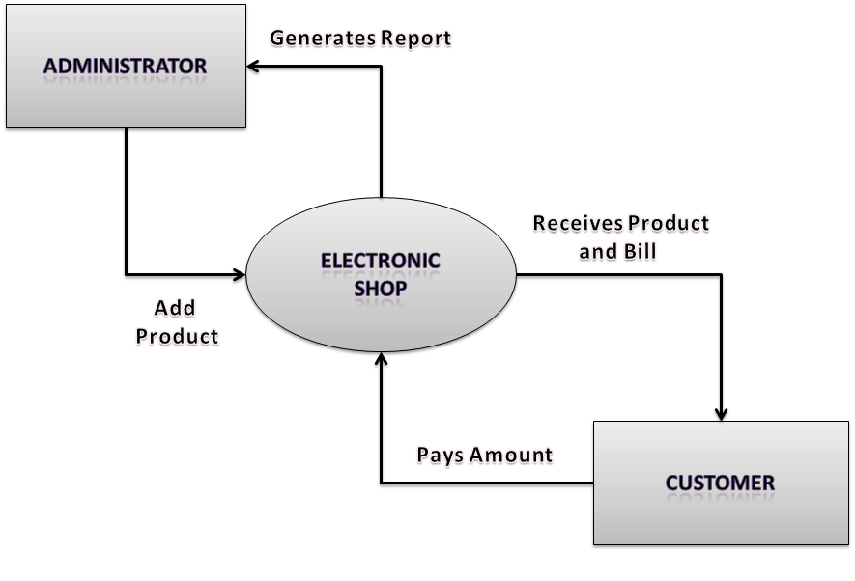
Block Diagram

Slide 8
SOFTWARE REQUIREMENTS:
Operating System : Windows 10
Platform : DOT NET TECHNOLOGY
Front End : ASP.Net 4.0
Back End : SQL SERVER 2014

Slide 9
HARDWARE REQUIREMENTS:
Keyboard
Mouse
Hard disk 500GB
Ram 4 Gb

Slide 10
CONCLUTION
In this paper, electrical load management techniques on the supply side and demand side have been reviewed. On the supply side, this review found that there are three main methods used for load management i.e. direct load control, interruptible load control and time of use (TOU). These methods were developed on the supply side and implemented on the demand side, aiming at a reduction of system peak demand and improving the reliability of power supply.

